Slide 1

Lamb Boulevard
Safety Management Plan
E. Desert Inn Road to Lake Mead Boulevard
Public Information Meeting
December 5, 2017
All Information Presented is Preliminary and Subject to Revision

Slide 2
How to Comment on this Study:
Court reporter is recording this presentation and is available to take comments before and after the presentation
Place comment form in comment box
Submit comment form by mail to:
Lori Campbell, Program Manager
Traffic Safety Engineering
Nevada Department of Transportation
1263 S. Stewart St.
Carson City, NV 89712
Via email to lcampbell@dot.nv.gov (reference Lamb Blvd. Safety Management Plan in the subject line)
Comments accepted until 5:00 p.m. Friday, December 15, 2017
Welcome!
All Information Presented is Preliminary and Subject to Revision

Slide 3

What is a Safety Management Plan
Stakeholder Collaboration
Study Overview
Why Lamb Boulevard?
Corridor Alternatives
Short Term Recommendations
Contact Information
Public Comment Period
Agenda
All Information Presented is Preliminary and Subject to Revision

Slide 4
Planning level study
Safety focused corridor study
Review & Evaluate Existing Conditions for Safety Issues
  Crash Trends: Time of Day, Crash Type, Vehicle & Driver Factors, Weather and Lighting
  Land Use, Cost/Benefit Ratios and Economic Development
Develop, Evaluate, & Make Recommendations
  Improvements: Vehicles, Motorcycles, Pedestrians, & Bicycles
Active participation from technical advisory committee, stakeholders and public involvement
Study to be completed winter 2017
All Information Presented is Preliminary and Subject to Revision
What is a Safety Management Plan?

Slide 5




Participating Agencies:
  City of Las Vegas
  Clark County
  Regional Transportation Commission of Southern Nevada
  Law Enforcement
Technical Advisory Committee meetings
Public Information Meeting
All Information Presented is Preliminary and Subject to Revision
Stakeholder Collaboration

Slide 6
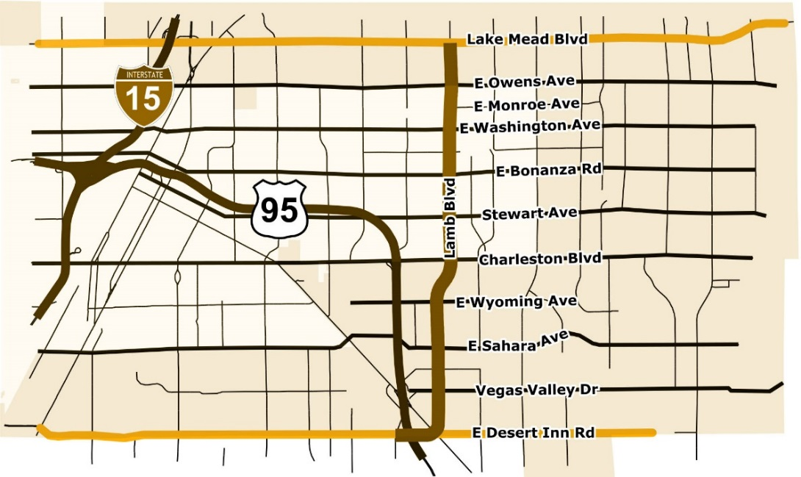
Study Limits
Lamb Boulevard from E. Desert Inn Road to Lake Mead Boulevard
Distance of 4.5 miles
Includes City of Las Vegas and Clark County jurisdictions
Schedule
Study complete end of 2017
Study Overview
All Information Presented is Preliminary and Subject to Revision

Slide 7
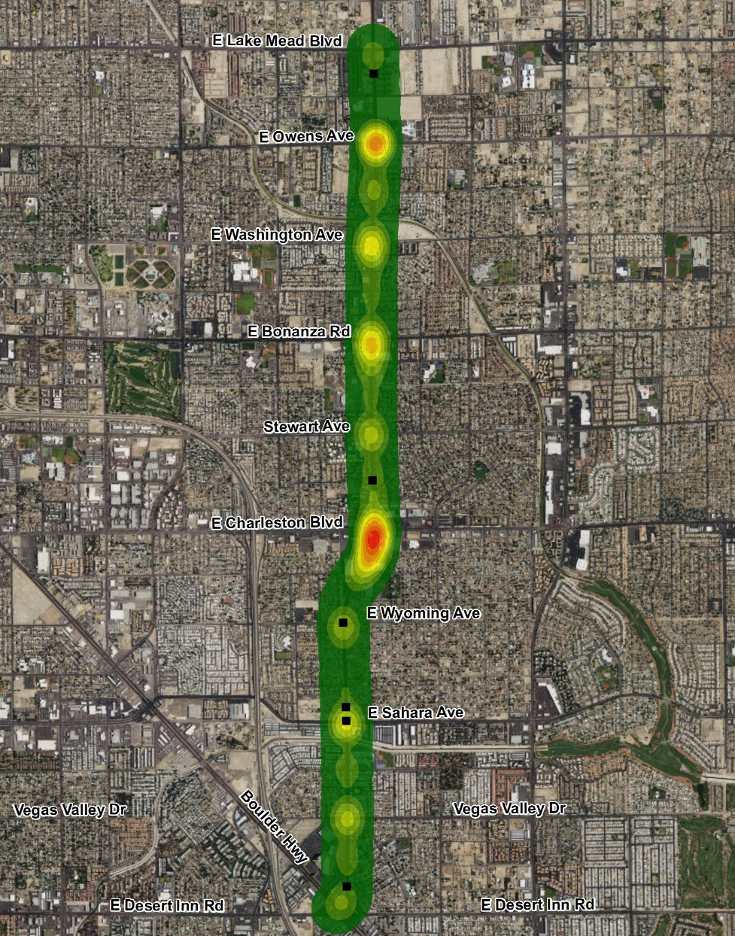

Crash Analysis Summary
5 Years of Data Analyzed From 2011 to 2016
A total of 1,286 crashes:
  6 fatalities
  26 serious injury crashes
  25 pedestrian crashes
  16 bicycle crashes
  31 motorcycle crashes
  12 bus crashes
Crash rates are 15% higher than the statewide average
Fatality
Why Lamb Boulevard?
All Information Presented is Preliminary and Subject to Revision

Slide 8
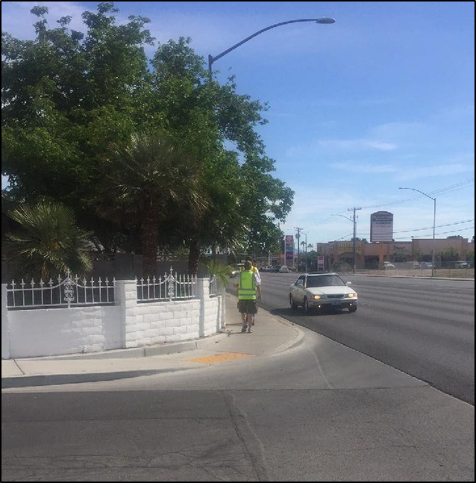
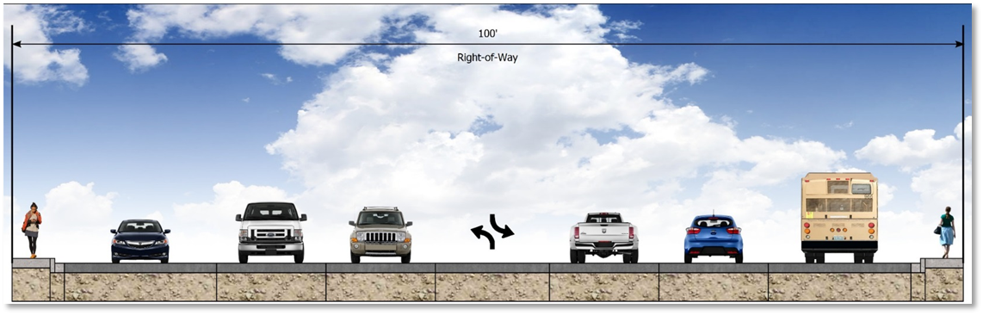
High Speeds
An NDOT speed study confirms average vehicular speeds exceed the speed limit
Modal Infrastructure
Minimum width sidewalks have numerous obstructions, high speeds adjacent to pedestrians are uncomfortable and there are no bicycle facilities
Congested Intersections
10 of 17 intersections perform below Level of Service standards
Sight Distance
Residential walls at cross streets make it hard to see oncoming traffic
Why Lamb Boulevard?
All Information Presented is Preliminary and Subject to Revision

Slide 9
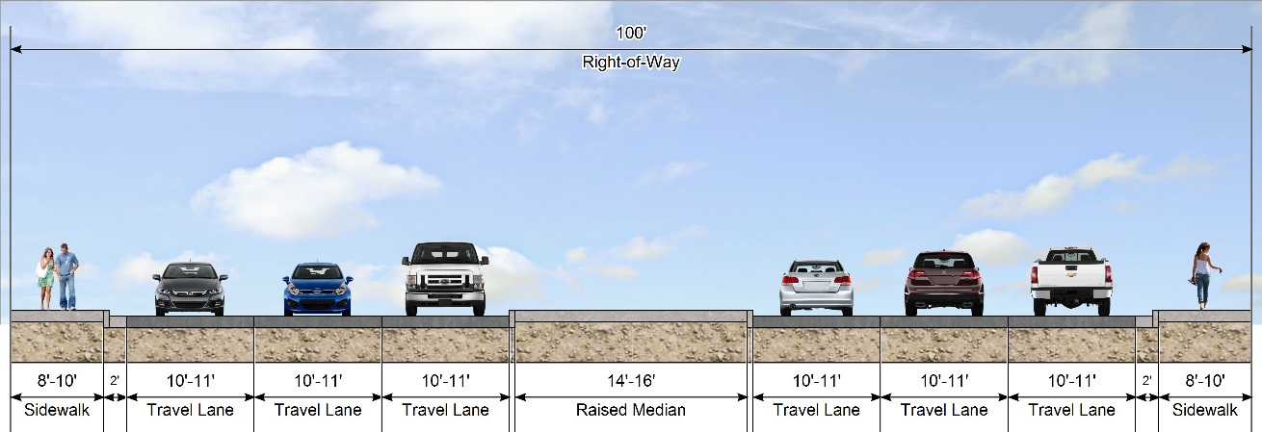
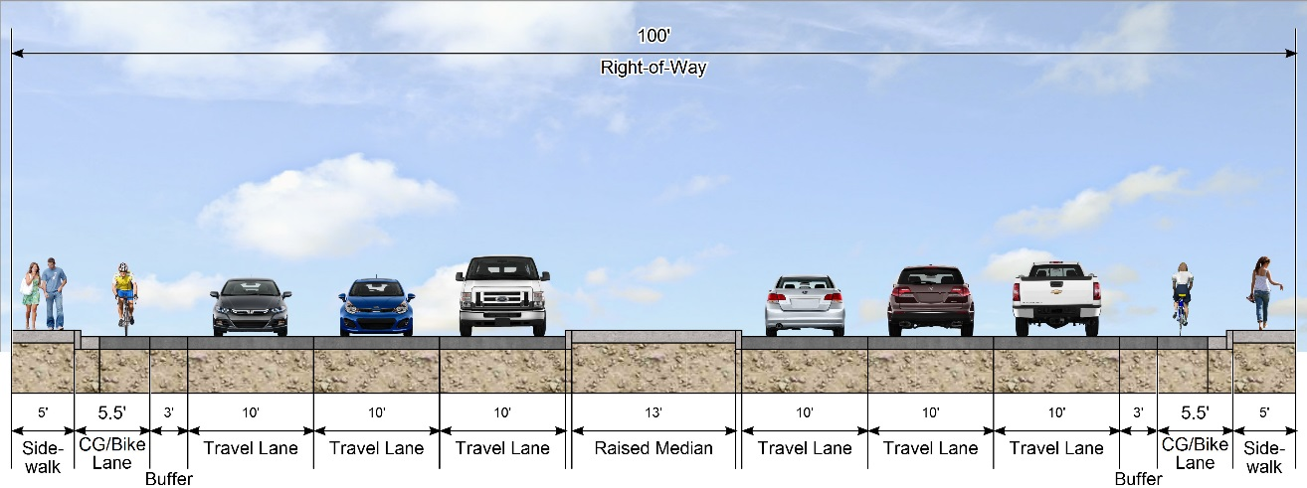
Alternative 1
Widen Sidewalk
Narrowed driving width to reduce speeds
Raised center median
Widen 5’ sidewalk to 8’-10’
Must reconstruct roadway
Alternative 2
Buffered Bike Lanes
Narrowed driving width to reduce speeds
Raised center median
Bike lanes with 3’ buffer
Maintain existing sidewalk
Corridor Alternatives
All Information Presented is Preliminary and Subject to Revision

Slide 10
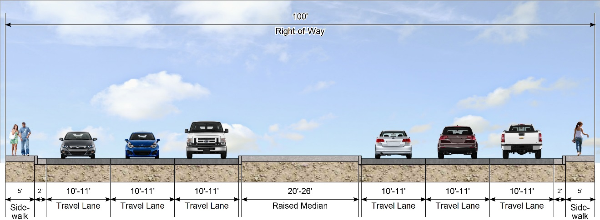
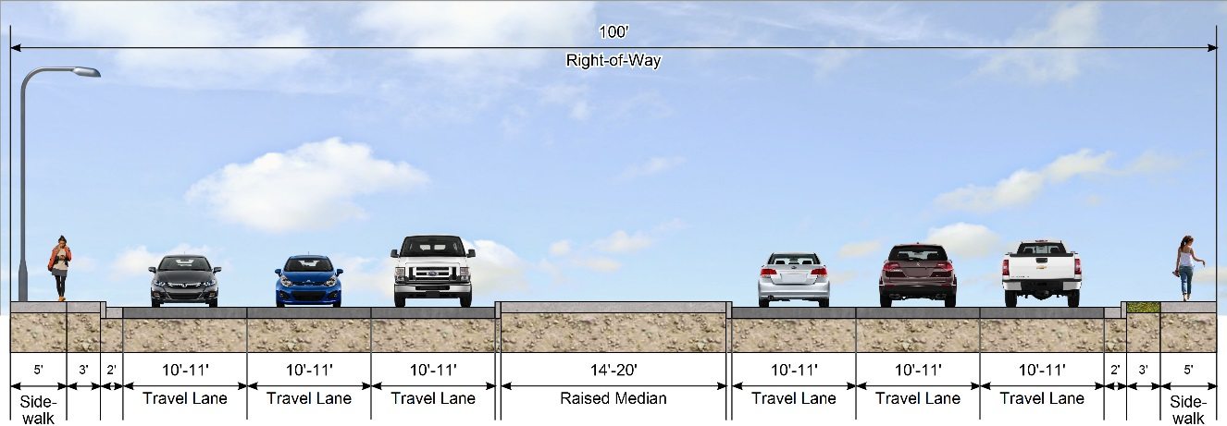
Alternative 3
Wider Raised Median
Narrowed driving width to reduce speeds
Wider 20’-26’ raised center median
Maintain existing sidewalk
Alternative 4
Pedestrian Buffer
Narrowed driving width to reduce speeds
14’-20’ raised center median
3’ compacted pedestrian buffer with concrete around pole obstructions
Corridor Alternatives
All Information Presented is Preliminary and Subject to Revision

Slide 11


Alternative Description | Cost Estimate | Benefit/Cost Ratio | Multi-Modal Support | Improved Sight Distance
Alternative 1 Widen Sidewalk | $34M | 0.84 |  | 76%
Alternative 2 Buffered Bike Lane | $14M | 1.64 |  | 134%
Alternative 3 Wider Raised Median | $10M | 3.03 |  | 22%
Alternative 4 Pedestrian Buffer | $15M | 1.9 |  | 76%
Corridor Alternatives
All Information Presented is Preliminary and Subject to Revision

Slide 12
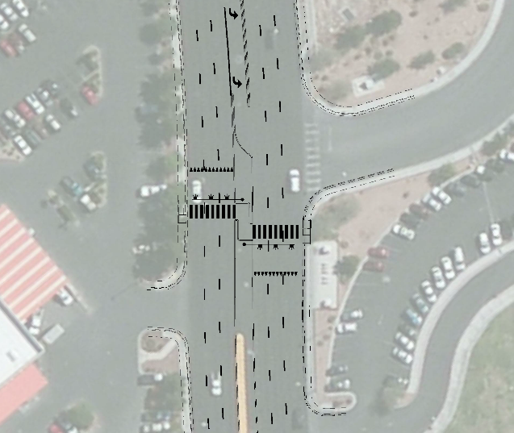
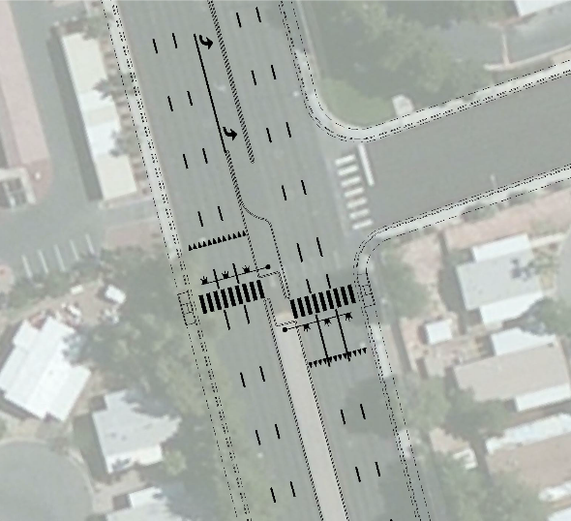
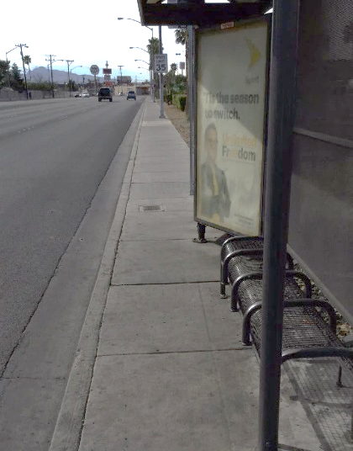
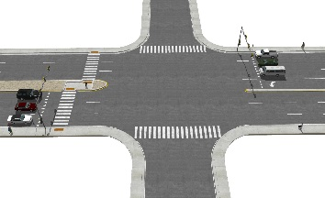
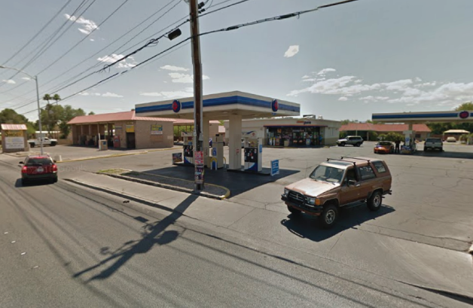
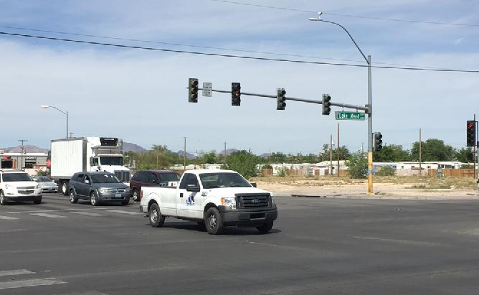
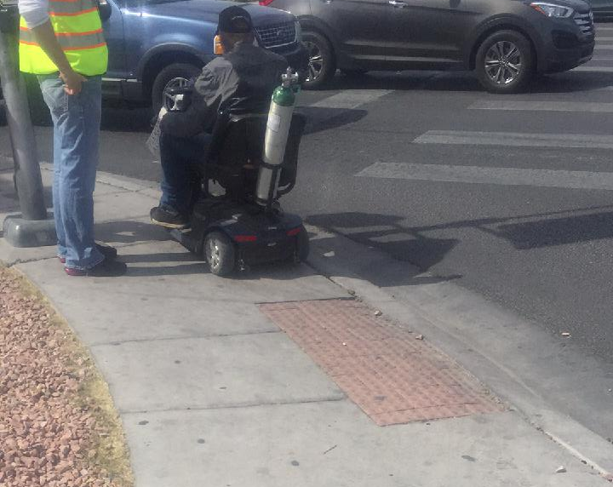
Lamb Boulevard Short-Term Safety Recommendations
Example Danish Offset Pedestrian Crossing
Potential Pedestrian Crossing at Colorado Ave.
Improved Crossing at Monroe Ave.
Bus Stop Amenities
Driveway Removals & Consolidations
Signal Timing Optimization
ADA Upgrades to Current Standards
Short-Term Recommendations
All Information Presented is Preliminary and Subject to Revision

Slide 13
Mail:
Lori Campbell, Program Manager
Traffic Safety Engineering
Nevada Department of Transportation
1263 S. Stewart St.
Carson City, NV 89712
Email:
Lori Campbell, Program Manager
lcampbell@dot.nv.gov
(reference Lamb Blvd. Safety Management Plan in the subject line)
Contact Information
All Information Presented is Preliminary and Subject to Revision

Slide 14

Please state your full name and address prior to your question or statement
Three-minute verbal comment per individual
A stenographer will be recording the presentation and is available to take comments before and after the presentation
Thank you
Open Comment Period
All Information Presented is Preliminary and Subject to Revision

