Slide 1
Vendor Portal Registration Procedures
Agreement Services 775-888-7070, Option 1

Slide 2
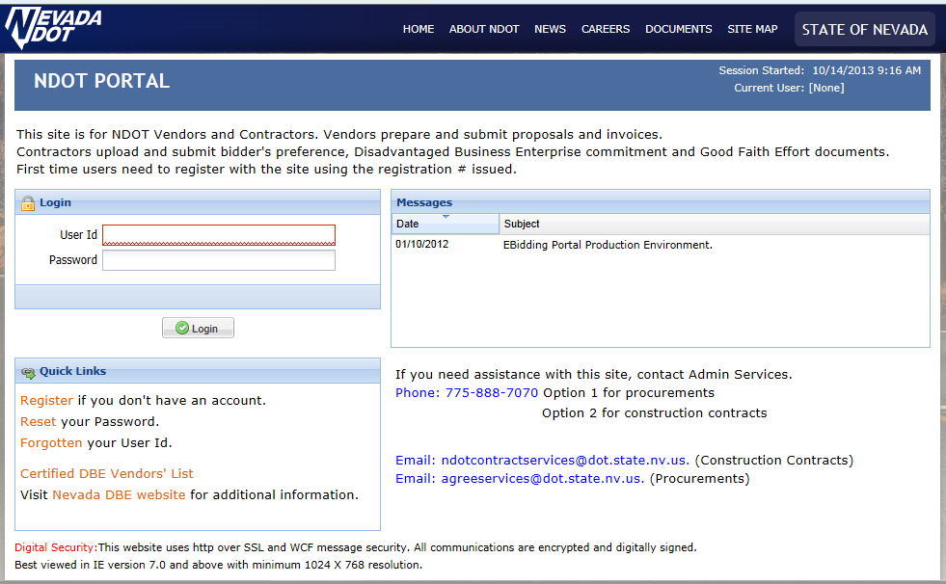
NDOT Portal Home Page
Click Register

Slide 3
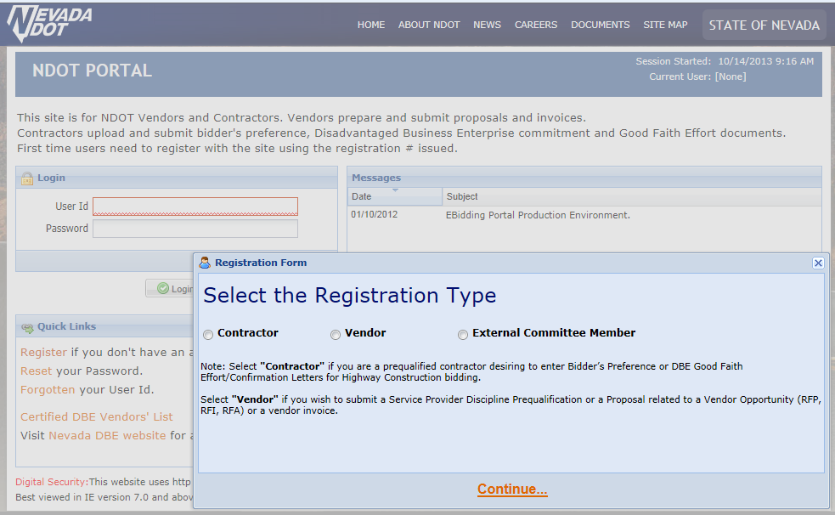
Vendor Registration
Click Vendor

Slide 4
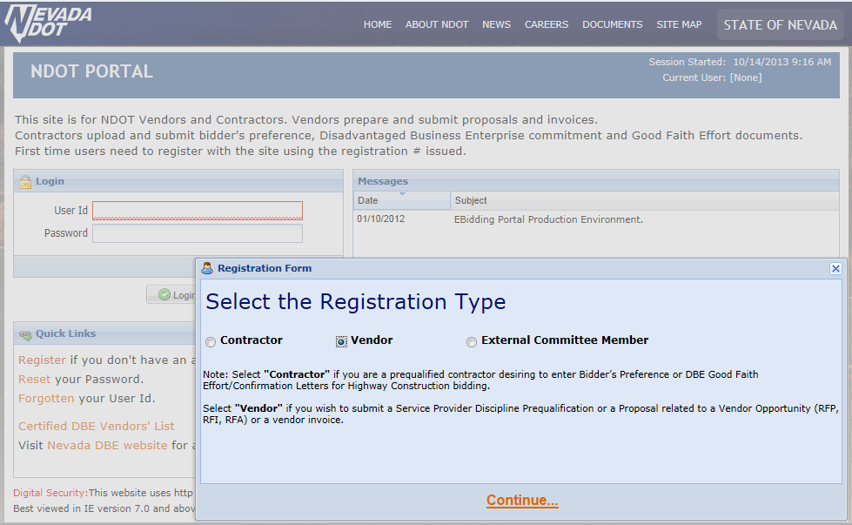
Vendor Registration - continued
Click Continue

Slide 5
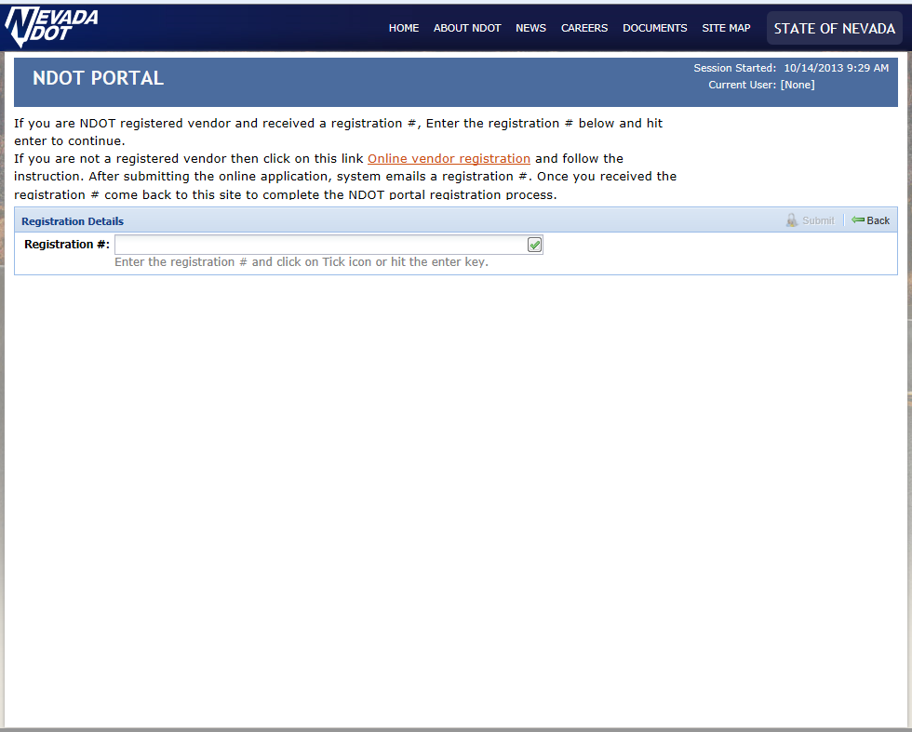
Vendor Registration - continued
Click Link

Slide 6
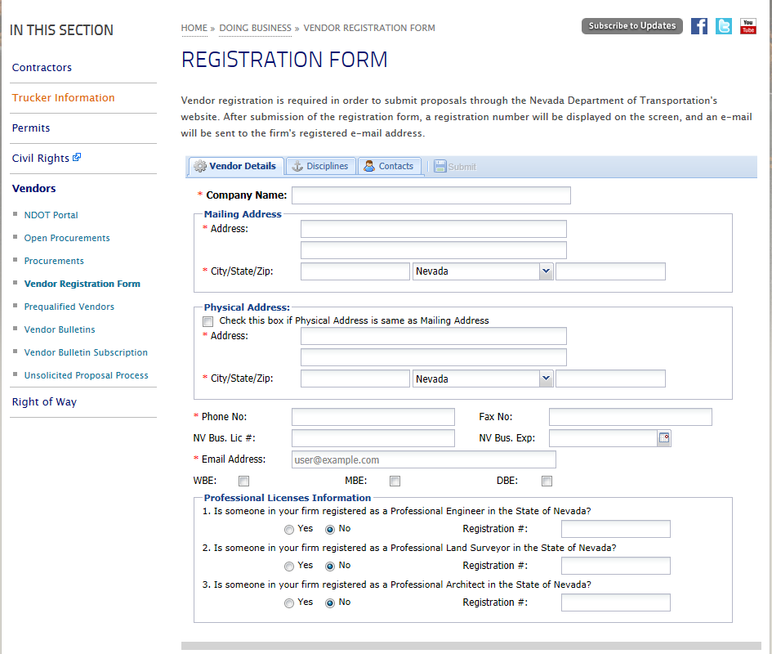
Vendor Details Screen
Select Vendor Details
Enter Information
Enter Information
Enter Information
Enter Information
Enter Information

Slide 7
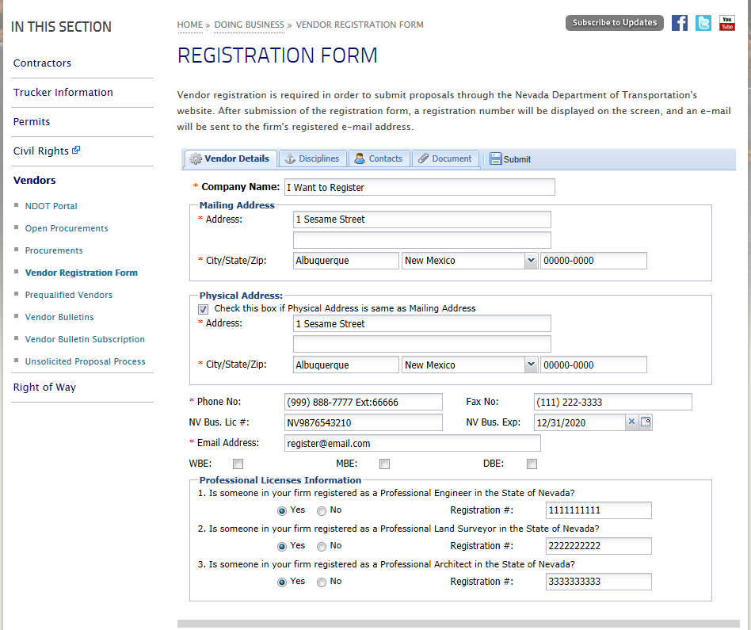
Vendor Details Screen - continued

Slide 8
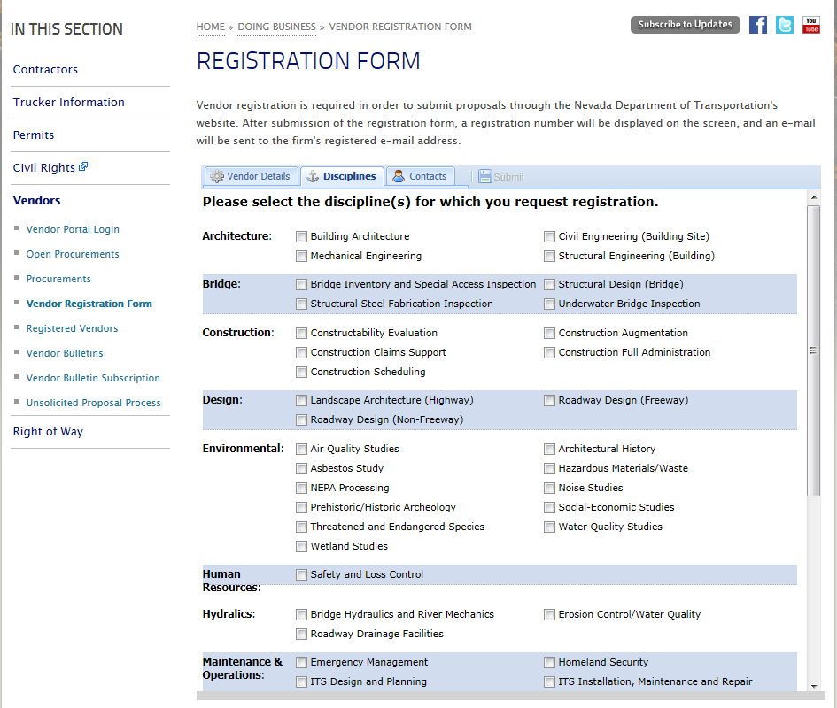
Disciplines Screen - continued
Select Disciplines for Registration

Slide 9
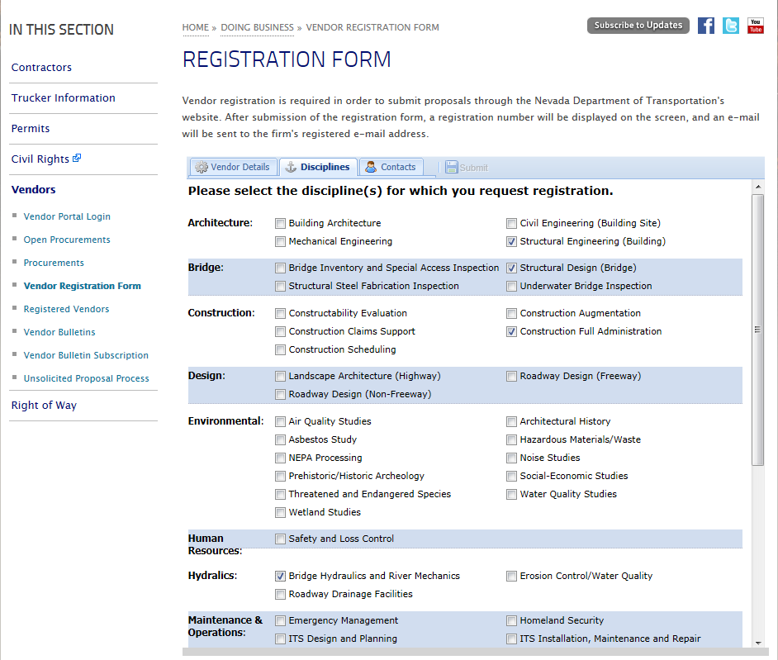
Disciplines Screen - continued

Slide 10
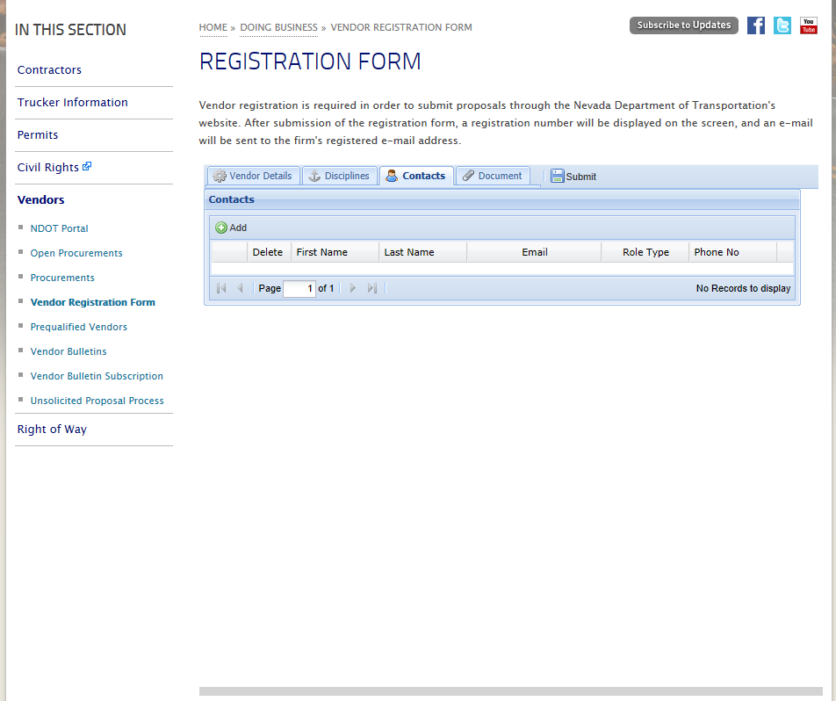
Contacts Screen
Select Contacts
Select Add
Enter Information

Slide 11
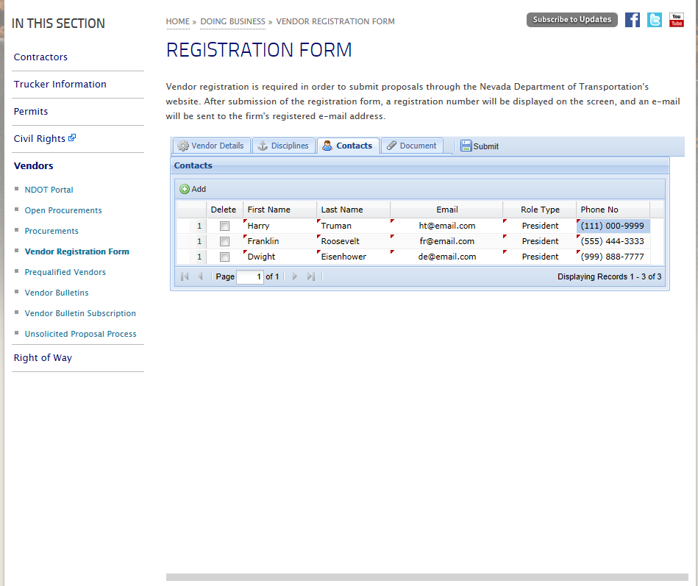
Contacts Screen - continued

Slide 12
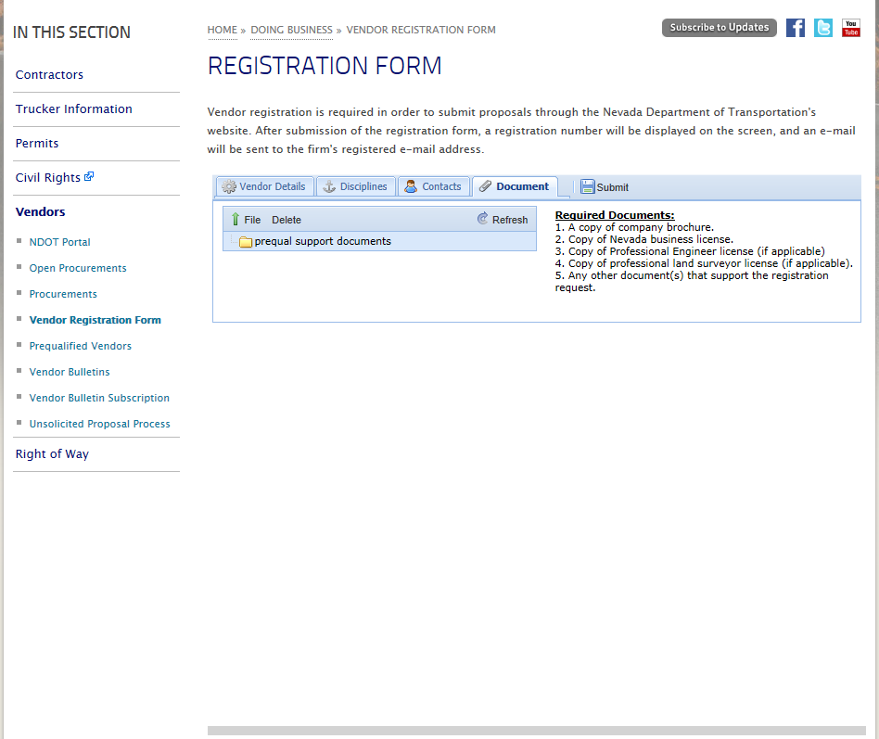
Document Screen
Click File

Slide 13
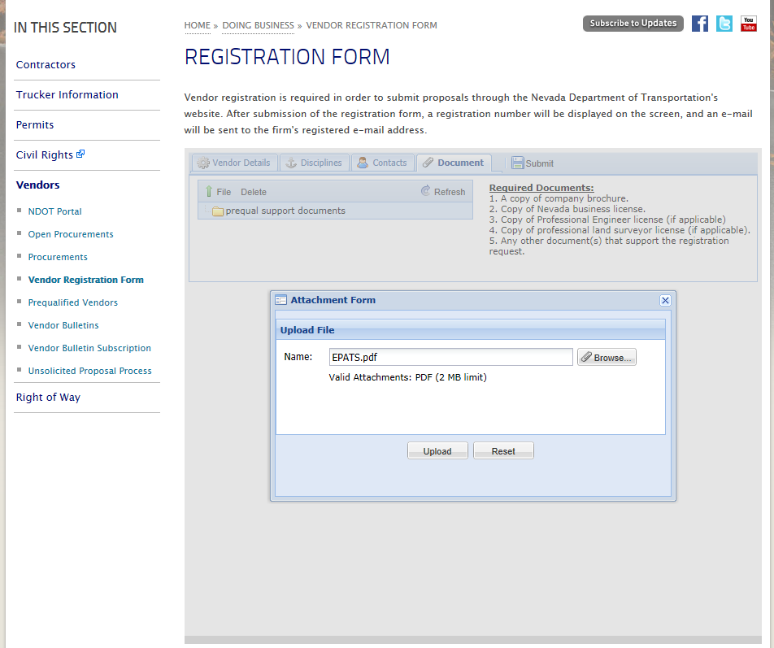
Document Screen - continued
1. Click Browse
2. Click Upload

Slide 14
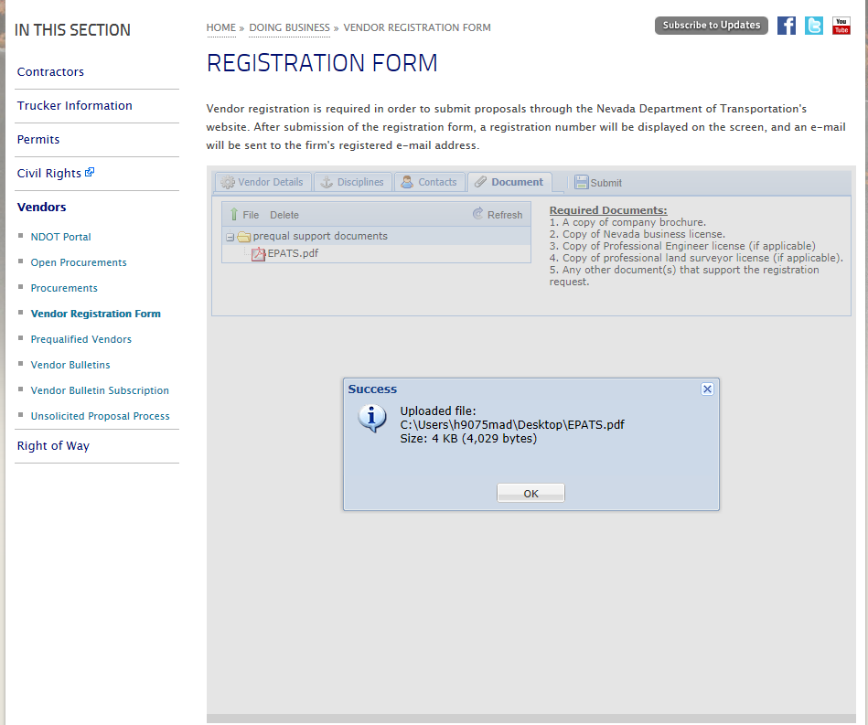
Document Screen - continued
Click OK

Slide 15
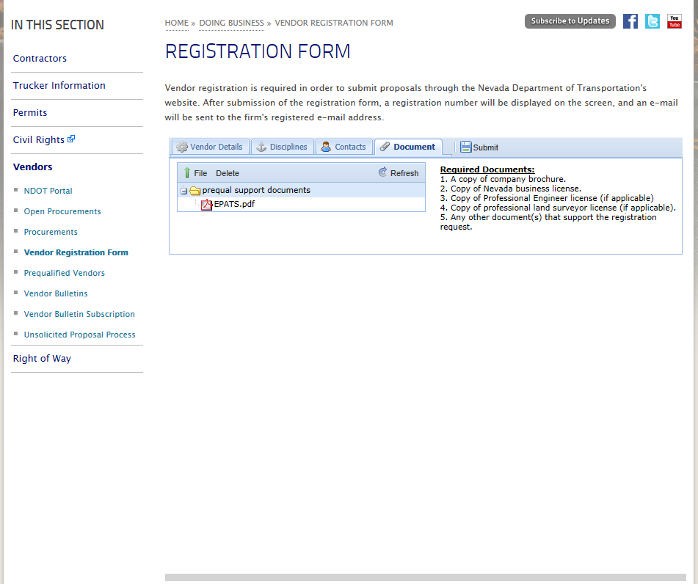
Document Screen - continued
Click Submit

Slide 16
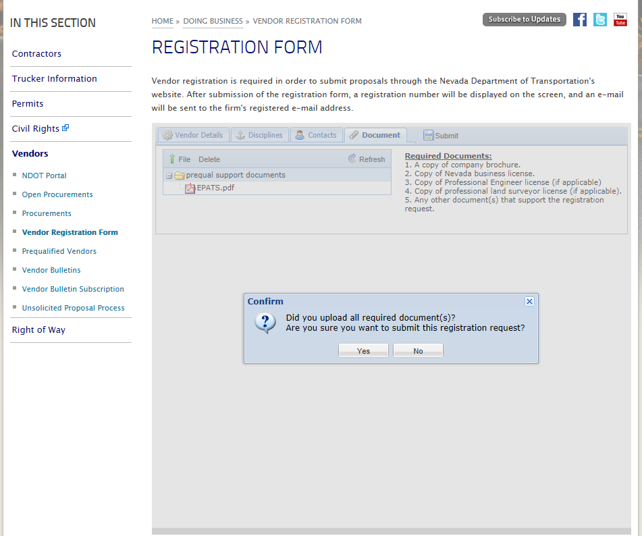
Registration Submission
Click Yes

Slide 17
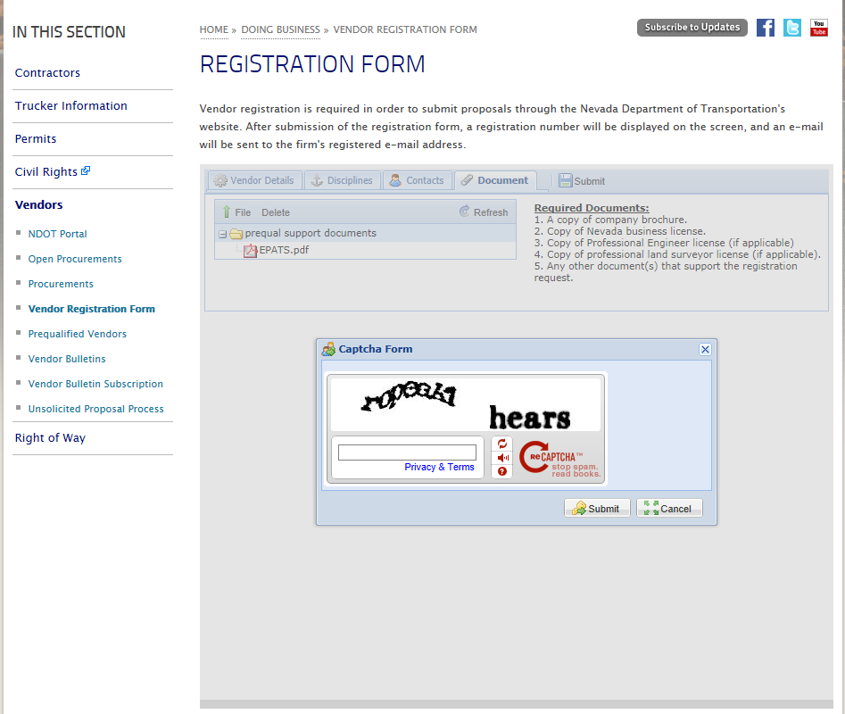
Submission Protection
Enter Words Exactly
Click Submit

Slide 18
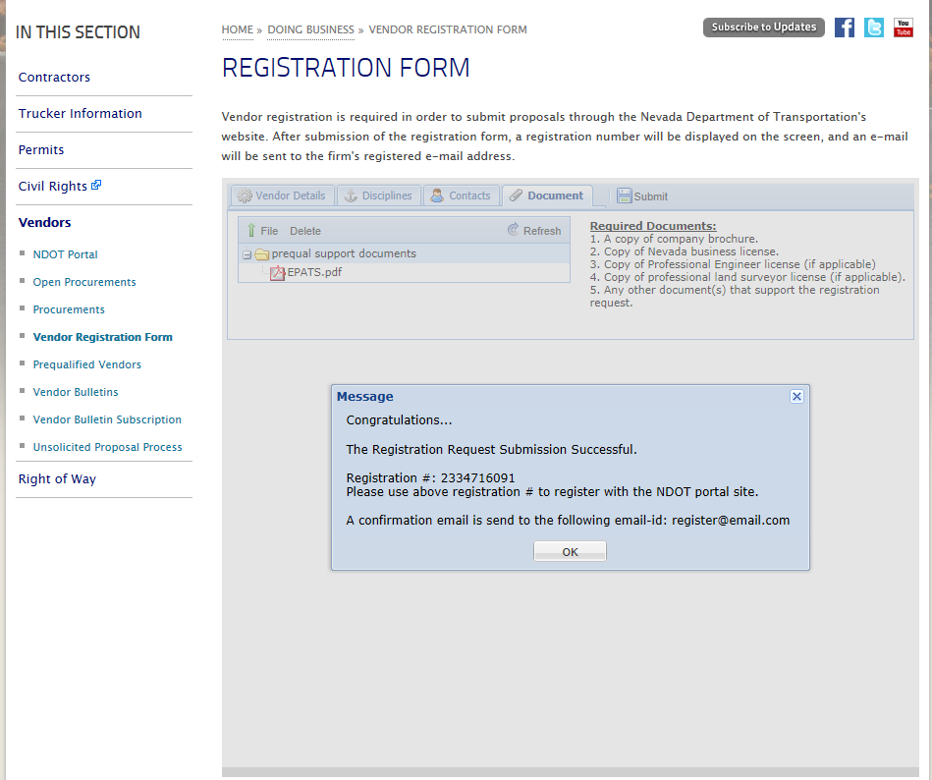
Registration Success Screen
Write Down Registration #
Click OK

Slide 19
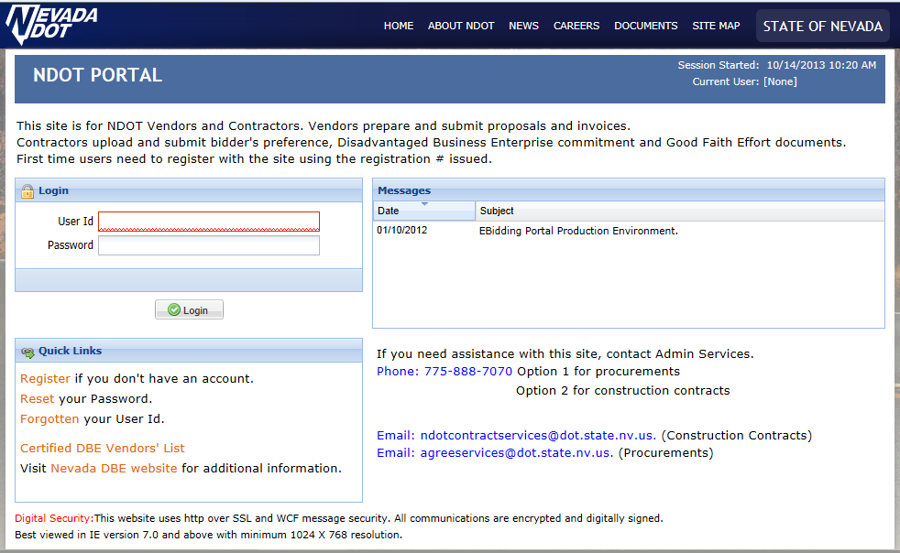
NDOT Portal Home Page
Click Register

Slide 20

Vendor Registration
Click Vendor
Click Continue

Slide 21
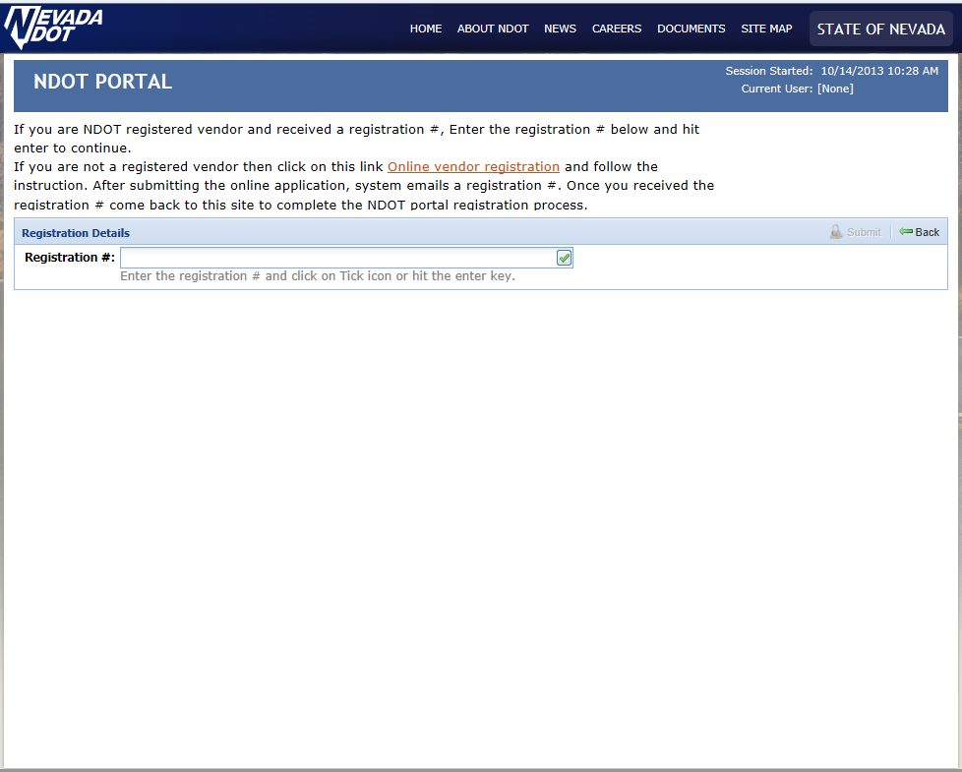
Registration Number
Enter Registration #
Click Check Mark

Slide 22
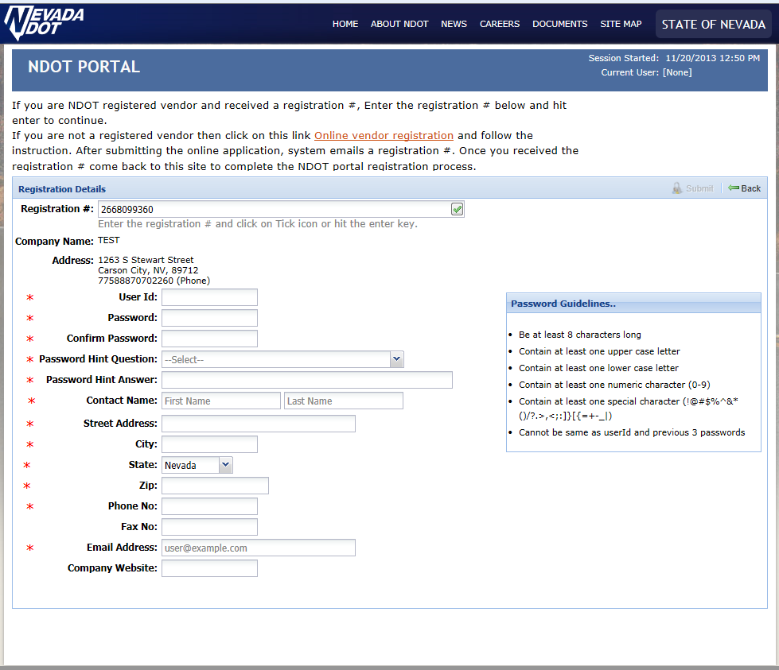
Registration Information
Enter Information
Enter Information
Enter Information
Enter Information
Enter Information
Enter Information
Enter Information
Enter Information
Enter Information

Slide 23
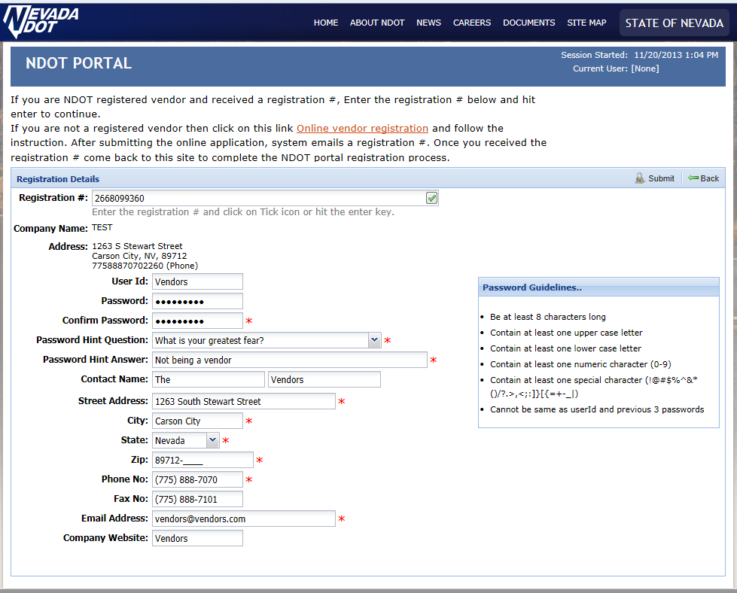
Registration Information - continued
Click Submit

Slide 24
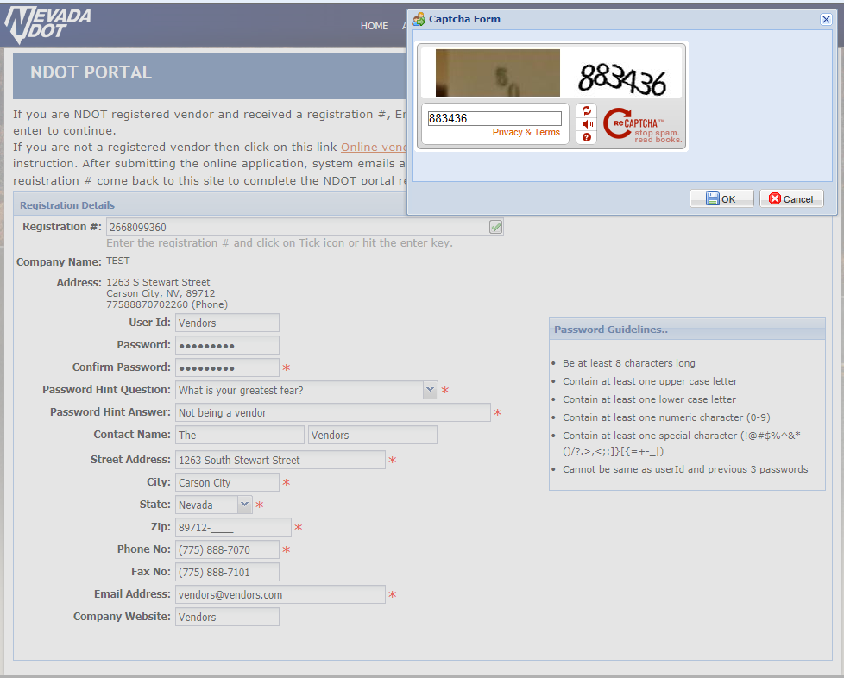
Submission Protection
Enter Code
Click OK

Slide 25
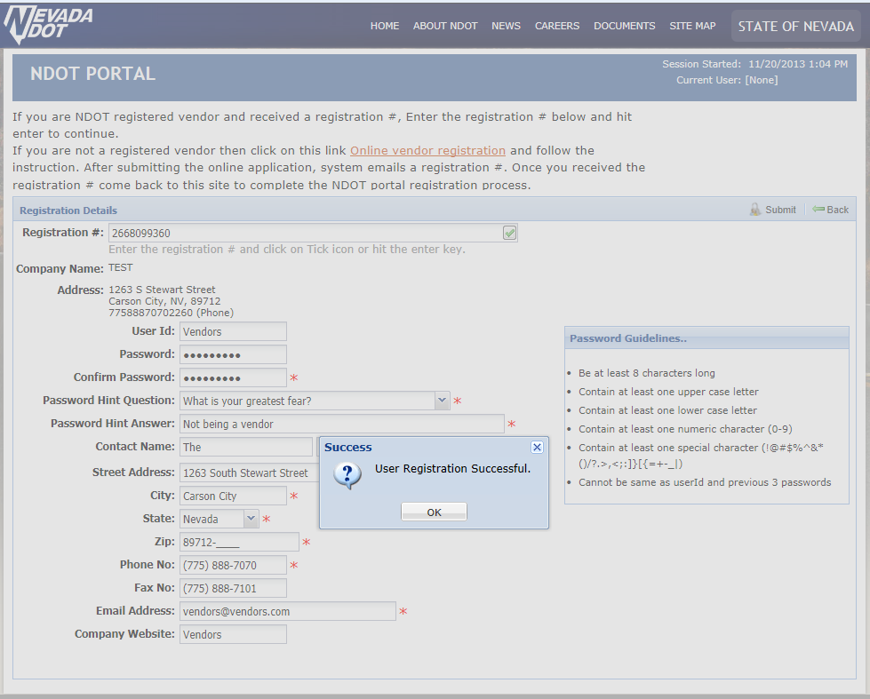
Registration Successful
Click OK

Slide 26
NDOT Portal Home Page
Enter User Id
Enter Password
Click Login

Slide 27
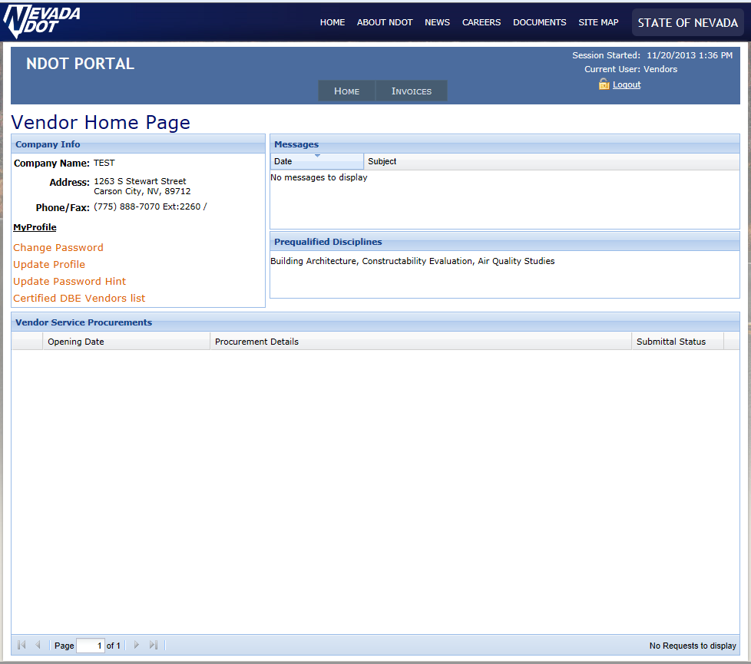
Vendor Home Page

