Slide 1

Disadvantaged Business Enterprise (DBE) Orientation
NEVADA DEPARTMENT OF TRANSPORTATION

Slide 2
DBE Orientation Program
Nevada Department of Transportation (NDOT)
DATE: TBD
Presented By: DBE Staff
www.nevadadbe.com

Slide 3
Welcome to the Nevada Disadvantaged Business Enterprise (DBE) Orientation Program

Slide 4
PURPOSE
The staff of the External Civil Rights Division (ECRD) of NDOT are here to provide small road and highway construction-related companies information regarding the DBE Program and how the program will be of use in managing and growing their business.

Slide 5
Contents
Part 1 – Information about the DBE (USDOT) Program
Part 2 – Some information about the governing regulations
Part 3 – DBE Supportive Services
Part 4 – Doing Business
Part 5 – NDOT External Civil Rights Division

Slide 6
Orientation Program: Part 1
Information about the DBE (USDOT) Program
NDOT DBE Program
NDOT Small Business Enterprise (SBE)

Slide 7
What is the DBE Program?
The DBE program helps businesses that are classified as small, woman-owned or disadvantaged to compete in a fair environment right alongside larger corporations.
The DBE Program is a legislatively mandated United States Department of Transportation (USDOT) program that applies to federal-aid highway dollars expended on federally- assisted contracts issued by USDOT recipients such as the Nevada Department of Transportation (NDOT).
NDOT is strongly committed to a Civil Rights Program to encourage the participation of Certified Disadvantaged Business Enterprises (DBEs) in contracting opportunities.
Notes:
What is the DBE Program?
The Nevada Department of Transportation is committed to a Civil Rights Program to encourage the participation of Disadvantaged Business Enterprises (DBE´s) in contracting opportunities.
The DBE program helps businesses classified as small, woman-owned or disadvantaged to compete in a fair environment right alongside larger corporations.
NDOT´s policy never to exclude any person from participation in, deny any person the benefits of, or otherwise discriminate on the basis of race, color, sex and/or national origin when awarding and administering those contracts.

Slide 8
What is a DBE?
A Disadvantaged Business Enterprise (DBE) is a for-profit small business that is:
  At least 51% owned by one or more individuals who are socially and economically disadvantaged.
  Managed, operated and controlled by one or more of socially and economically disadvantaged owners.
Notes:
What is a DBE?
As you may know a DBE is a for-profit, small business, that is at least 51% owned by one or more individuals who are socially and economically disadvantaged. ; and in addition, it has to be managed, operated and controlled by one or more of the socially and economically disadvantaged owners. So it is very important to know that we need both the social and economic disadvantage and the control factor is crucial in terms of qualifying for and maintaining the DBE Certification.
A DBE includes small businesses that are at least 51% owned by:
Women
Minorities: Black Americans, Hispanic Americans, Native Americans, Asian-Pacific Americans and Subcontinent Asian Americans
Or other individuals on a case-by-case basis

Slide 9
DBE Program Objectives
Ensure nondiscrimination in the award and administration of DOT-assisted contracts.
Create a level playing field on which DBEs can fairly compete.
Ensure that firms fully meet the eligibility standards to participate as DBEs.
Help remove barriers so DBEs can participate in contracting opportunities.
Assist the development of firms that can compete successfully in the marketplace outside the DBE Program.
Provide appropriate flexibility to recipients of federal financial assistance in establishing and providing opportunities for DBEs.
Notes:
Let’s look briefly at the DBE Program Objectives. The goal of the DBE Program is to:
Ensure nondiscrimination in the award and administration of DOT-assisted contracts.
Create a level playing field on which DBEs can fairly compete.
Ensure that firms fully meet the eligibility standards to participate as DBEs.
Help remove barriers so DBEs can participate in contracting opportunities.
Promote the use of DBEs in all types of federally-assisted contracts and procurement activities.
Assist the development of firms that can compete successfully in the marketplace outside the DBE Program.
Provide appropriate flexibility to recipients of federal financial assistance in establishing and providing opportunities for DBEs.

Slide 10
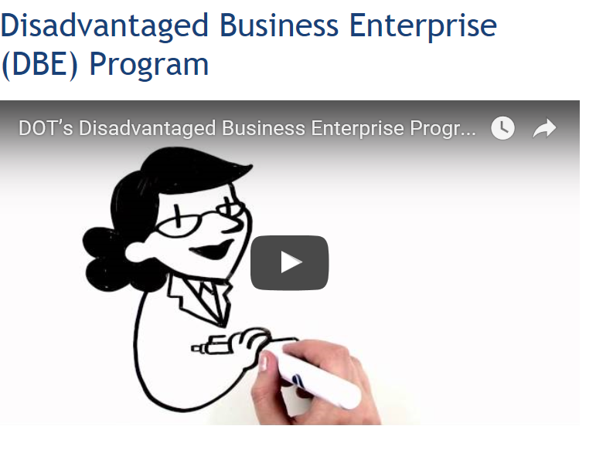
DBE PROGRAM VIDEO RECAP
  This video provides an overview to the DOT’s Disadvantaged Business Enterprise Program:
  https://www.youtube.com/watch?v=5i1vZPLLOXE
For more information, visit:
https://www.transportation.gov/civil-rights/disadvantaged-business-enterprise
Notes:
Video length is approximately 5 minutes.

Slide 11
Small Business Element
49 CFR §26.39 has been added:
State DOT must include a small business element in its DBE program to facilitate participation by small businesses in general, not just DBEs.
Purpose is to assist State DOTs in attaining race-neutral DBE participation.
Notes:
Next, let’s review some more information on recent DBE Program Regulations
Adding the “Small Business Element”
As of February 28, 2012, the DBE Program plan is required to incorporate a small business element to its DBE program to facilitate participation by small businesses generally, not just DBEs.
So, does this mean that NDOT has to have a small business program in addition to its DBE Program? The answer is No. that is not the case because that is not the requirement of this new regulation.
The requirement of including a small business element to the DBE program really contemplates more procedures with respect to the procurement process in making it easier for small business to participate on federally funded contracts.

Slide 12
Small Business Enterprise (SBE) Program
Designed to include all segments of the business community and is open to participation without regard to race, gender, color, sex, religion, national or ethnic origin, age, disability or geographic location.
Designed to create a level playing field on which small businesses can compete fairly.

Slide 13
Small Business Enterprise (SBE) Certification
New applicants - complete an SBE Application Form.
Firms currently certified by the SBA as an 8(a), Small Business (SDB) or DBE automatically qualify to participate in the SBE Program.
Once a firm’s SBE status is verified, the certification is valid for three years as long as there is no change in ownership, control, business size or personal net worth.
Requires annual submittal of Affidavit of No Change and applicable Business Tax Returns.
Notes:
New applicants - complete an SBE Application Form.
Firms currently certified by the SBA as an 8(a), Small Business (SDB) or DBE automatically qualify to participate in the SBE Program. Complete one-page form and provide a copy of their current certificate/letter.
Once a firm’s SBE status is verified, the certification is valid for three years as long as there is no change in ownership, control, business size or personal net worth.
Requires annual submittal of Affidavit of No Change and applicable Business Tax Returns

Slide 14
DBE: No Change Affidavit (NCA)
DBE/SBE certification does not expire, however certified DBE/SBE firms are required to update their certification by completing and submitting an annual No Change Affidavit Application.
Therefore, the DBE/SBE Certification requires annual submittal of Affidavit of No Change and applicable Business Tax Returns.
Complete and submit the NCA Application by logging into your account at www.nevadadbe.com.
NOTE: Please remember to submit your NCA Application prior to the deadline date. You will be notified by e-mail at least 30 days prior to your anniversary date. Next time you are in the system, please remember to check your e-mail address. System technical issues should be directed to the IT phone number on the web page.

Slide 15
Orientation Program: Part 2
Some information about the governing regulations
Congress first authorized the DBE Program in 1983. Since that time, the DBE Program has applied to contracts that include certain Federal-aid highway funds, as set forth in authorization statutes.
Legal policies and regulations
Goals

Slide 16
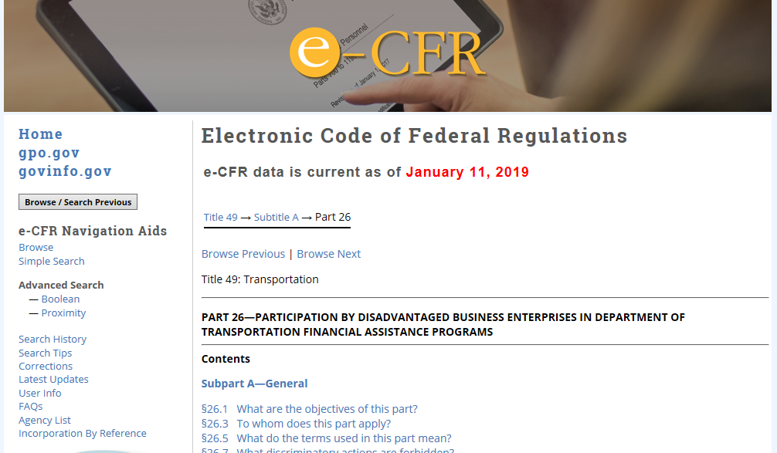
Legal policies and regulations
E-CFR – Code of Federal Regulations
http://www.ecfr.gov/cgi-bin/retrieveECFR?gp=1&SID=d42727f0410d40a279734ddf7f872b28&ty=HTML&h=L&mc=true&n=pt49.1.26&r=PART
Notes:
Below is a link to the E-CFR – Code of Federal Regulations
Available to you online through the US GOP (Government Publishing Office). This document contains all Regulations pertaining to the DBE Program, therefore it is important for you to read it and be aware of the Federal Regulations of your DBE Certification. Here you can see a screenshot of this online document available for print.

Slide 17
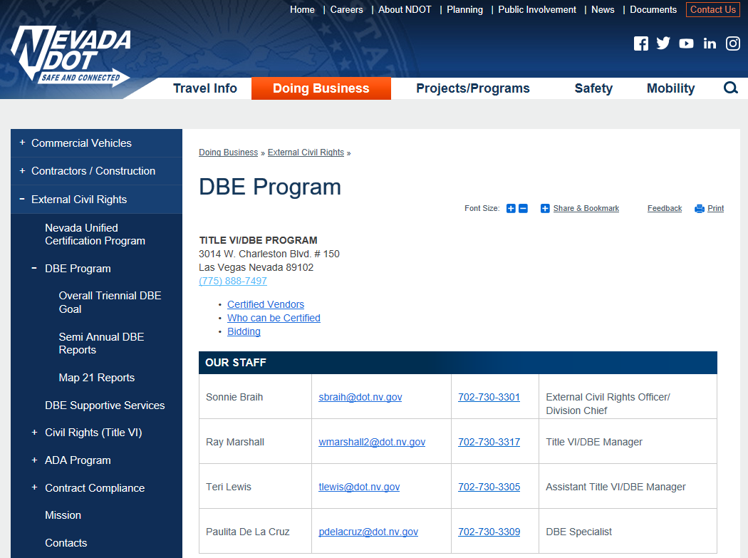
Legal policies and regulations
NDOT DBE Program Plan
https://www.nevadadot.com/doing-business/external-civil-rights/dbe-program
Notes:
Below is a link to the NDOT DBE Program Plan
The NDOT DBE Program Plan contains important information related to your DBE certification process, explanation on DBE Goals, pre-bid, contract, and award procedures including Good Faith Efforts (GFE) to Contract with DBE Goals, and information on Contract Performance.
. Here you can see a screenshot of the online link to the PDF document available for download and print.

Slide 18
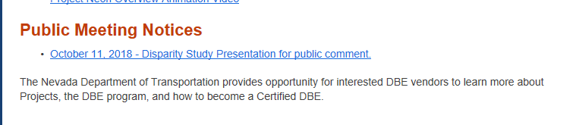
Legal policies and regulations
NDOT DBE Program Disparity Study
https://www.nevadadot.com/doing-business/external-civil-rights/dbe-program
Notes:
Below is a link to the 2013 disparity study.
(SOURCE: Info from Disparity study)
The federal government requires agencies such as the Nevada Department of Transportation
(NDOT) to implement the Federal Disadvantaged Business Enterprise (DBE) Program. NDOT
periodically conducts disparity studies to help it make decisions concerning its future operation of the
Program for its federally-funded contracts. The last such study was completed in 2016. NDOT’s
operation of the federally-required DBE Program is guided by regulations in 49 Code of Federal
Regulations (CFR) Part 26, USDOT guidance and court decisions.
NDOT engaged a team led by Keen Independent Research LLC (Keen Independent) to prepare the
2013 disparity study, which focuses on participation of minority- and women-owned firms (MBEs
and WBEs) in NDOT’s contracts from 2007 through June 2012. The disparity study also analyzes
conditions for MBE/WBEs within the Nevada marketplace. The study examines steps to encourage
utilization of all small businesses in NDOT contracts as well as programs specific to DBEs.
Information from the disparity study will be useful as NDOT:
 Sets an overall annual goal for DBE participation in its FHWA-funded contracts for
the next three years;
 Considers whether or not the overall DBE goal can be attained solely through neutral
measures (or whether race- or gender-based measures are also needed); and
 Determines the specific race, ethnic and gender groups that may be eligible for any race- or
gender-conscious program elements such as DBE contract goals.

Slide 19
DBE Goals
      OVERALL DBE GOAL – Triennial Goal and Methodology.
      CONTRACT GOALS – set on individual contracts.
      GOOD FAITH EFFORTS (GFE) – Contractor’s efforts in attaining an individual project goal.
Notes:
Dbe Goals, HOW WE SET GOALS?
Information on how NDOT sets up these goals is available in the 2013 disparity study report available online.

Slide 20
DBE Goals
RACE-CONSCIOUS/RACE-NEUTRAL
Most States have overall goals that include a combination of race-conscious and race-neutral goals.
Notes:
SOURCE: DBE Program Plan available online
RACE-NEUTRAL METHODS
To obtain the maximum feasible portion of its overall DBE Goal through
race neutral means, NDOT uses the following methods:
• Implementation of the SBE program which will include the use of
SBE goals on federally-assisted contracts without DBE goals
Publicizing construction project notices and consulting requests for
proposal in order to encourage DBEs and other small businesses
to participate;
• Implementing a supportive services program for DBE and other
small businesses to develop record-keeping and business
management skills;
• Providing training to DBE and other small businesses to improve
management, record keeping, financial and accounting capabilities;
• Providing services to DBE and other small businesses to improve
long-term development, ability to handle increasingly significant
projects, and achieve eventual self-sufficiency;
• Assisting DBE and other small businesses to develop their
capability by utilizing emerging technology and conducting business
through electronic media;
• Providing other technical assistance to DBE and other small
businesses as needed
• Review and identify projects that can be unbundled in order to
promote small businesses including DBEs to perform as a prime

Slide 21
DBE: Overall Goals
Overall Goal—the DBE program requires each State to establish an overall DBE goal.
The overall goal represents the gap, or disparity, between the current percentage of DBE participation on transportation projects and the percentage of DBE participation that would be expected based upon availability of DBEs in the relevant market area.
Notes:
DBE: Overall Goals
DBE program requires each State to establish an overall DBE goal
The overall goal represents the gap, or disparity, between the current percentage of DBE participation on transportation projects and the percentage of DBE participation that would be expected based upon availability of DBEs in the relevant market area

Slide 22
Race-Neutral Projection
NDOT must meet maximum portion of overall goal by facilitating race-neutral participation.
NDOT must project how much of the overall goal it expects to meet through race-neutral participation—explain reasons for conclusion.

Slide 23
DBE: Contract Goals
State DOTs with race-conscious goals achieve their goals by imposing DBE goals to Federal-aid contracts.
States are not required to set DBE goals on every Federal-aid contract but must set goals on enough individual contracts to cumulatively reach the overall goal.
States set appropriate, “narrowly tailored,” DBE goals on individual contracts based upon consideration of their overall goal, subcontracting opportunities available for each project, and availability of DBEs to perform the work in the geographic area.
Notes:
Dbe Goals, HOW are they SET UP?
SOURCE: DBE Program Plan available online
Narrative
CONTRACT GOALS
Contract goals will be used to meet the portion of the overall goal not
projected to be met by race-neutral means and will be expressed as a
percentage of the federal portion of USDOT-assisted contracts. If during
the course of the year it becomes apparent that NDOT will exceed its
overall goal based on race-neutral means, contract goals will be reduced
to the extent required so as not to exceed the overall goal. If it appears
the race-neutral portion will not be met, NDOT will increase the amount of
contract goals.

Slide 24
DBE Contract Goals (Continued)
Criteria for developing goals on individual contracts include:
  Availability of qualified DBEs for specific scopes of work.
  Location of the project.
  Type of project.
  Estimated total cost of the project, or portions of the project.
  Number of contract line items with the most DBE subcontracting, service, or supplier potential.
Notes:
Before soliciting bids, the appropriate NDOT personnel and the Contract
Compliance Office personnel will review each contract to determine the
percentage goal, if any, that will be assigned to the contract. Those
contracts with limited or no subcontracting potential will have a zero goal.
Criteria for developing goals on individual contracts include:
• Availability of qualified DBEs
• Location of the project
• Type of project
• Estimated total cost of the project, or portions of the project
• Number of contract line items with the most DBE subcontracting,
service, or supplier potential
Contract goals can be met only by Nevada UCP certified DBEs; goals will
not be subdivided into group-specific goals. The contract goal will pertain
to the entire project.

Slide 25
DBE Contract Goals (Continued)
Two ways to comply with regulations:
  Meet the goal by committing to DBEs sufficiently to at least equal the percentage of the goal set on the project; or
At bid time, if a prime contractor/consultant does not meet the DBE contract goal, it must provide NDOT with documentation to show that it used “good faith efforts” (GFE Justification) in attempting to meet the goal.

Slide 26
DBE: Good Faith Efforts
“Good Faith Efforts” defined:
“…those that one could reasonably expect a bidder to take if the bidder were actively and aggressively trying to obtain DBE participation sufficient to meet the DBE contract goal.”
49 CFR Part 26, Appendix A

Slide 27
Examples of GFE
Solicit certified DBEs as early as possible.
Select portions of the work to be performed by DBEs; economically feasible units.
Providing adequate information.
Providing prospective DBE bidders access to contract plans at a prospective Prime bidder’s facility.
Negotiating in good faith.
May not reject on price alone, if price is reasonable.

Slide 28
Examples of GFE (Continued)
May offer to provide bonding assistance or break bond periods up. (For example, accept 2 smaller successive bonds instead of requiring a single larger bond.)
Break up work into smaller-sized components instead of one larger subcontract.
May not reject because prime chooses to self-perform.
May not reject DBE as unqualified without reason.

Slide 29
DBE: Good Faith Efforts
The External Civil Rights Officer ensures clearance of all GFE Justifications prior to award.
DBE section “clears” all contracts with a project DBE goal prior to award by ensuring all requirements are met.
NOTE: The GFE must not be Pro Forma! It must be an “aggressive” and genuine effort.

Slide 30
Orientation Program: Part 3
DBE Supportive Services
How can NDOT assist you in doing business?
DBE Needs Assessment
Counseling and Mentoring (Local Sources)
Writing a Business Plan
Marketing/Market Research
        DBE Mentor/Protégé Program
        Beyond Mentoring – Networking and Building Relationships

Slide 31
How does NDOT assist DBEs and SBEs in doing business?
The NDOT DBE Supportive Services Program is committed to coordinating, facilitating and evaluating the program as well as providing technical assistance to the DBEs, such as:
  General business management
  Estimating/bidding
  Financial administration
  Insurance and bond readiness
  Website development
  Marketing
Notes:
Technical assistance items as listed on Mentor Protégé Program

Slide 32
NDOT Web-site (www.nevadadot.com)
NDOT’s web-site provides assistance to DBEs. In addition to the Disparity Studies and Program Plan noted in the slides above, there are:
DBE Permanent Program Plan
DBE Trucking Guidelines
Mentor-Protégé Program Guidelines
List of our community partners
Triennial goal and methodologies for FHWA and FTA
Contact information for External Civil Rights Staff
Contract Compliance information
American Disabilities Act information
Links to many other resources

Slide 33
DBE Training Needs Assessment
NDOT offers a needs assessment to assist DBEs with the development of their businesses. Based on the needs assessment, ideas for development are identified in such areas as:
    Marketing aspects of construction industry barriers
    Networking and relationship building
    Government contracting opportunities
    Estimating/Bidding
    Legal policies and regulations
    Be sure to complete or update your needs assessment at Survey Monkey.
Notes:
Source: SUMNU Needs Assessment
The Nevada Department of Transportation (NDOT) conducted a needs assessment to assist DBEs with the development of their businesses.
The results from the assessment identified business and industry barriers that should be addressed as part of your business development plan. The resources made available to you in the section below will assist you with your business needs and concerns in the areas of:
Marketing aspects of construction industry barriers
Networking and relationship building
Government Contracting and Bidding
Legal policies and regulations

Slide 34
Business Counseling
Four of the many local sources for getting help to start, market and manage your business:
  The Small Business Administration (SBA)
  The Service Corps of Retired Executives (SCORE)
  The Nevada Small Business Development Center (SBDC)
  Procurement Technical Assistance Center (PTAC)
Notes:
Technical assistance including small business training i s widely available
throughout Nevada. Programs primarily provide general information and
assistance for business start-ups and growing businesses but al so include
industry-specific training. Examples range from general support providers
such as SCORE to industry-specific training opportunities such as the
Nevada Governor's Office of Economic Development Procurement Outreach
Program.
Other programs focus on market development assistance and use of
electronic media and technology. These assistance programs are available
through the Nevada Business Development Center and Procurement
Technical assistance Centers throughout the state. More locally-focused
programs include the Ci ty of Reno My Quick Coach Program, and the Urban
Chamber of Commerce Busines s Success Center.

Slide 35
Business Counseling
US Small Business Administration (SBA) sba.gov
Independent agency of the federal government which aids, counsels and assists small business with startups and expansions.
The SBA offers a variety of online courses, publications and other forms of technical assistance.
Courses are self-paced and take about 30 minutes to complete. A brief online registration is required.

Slide 36
Business Counseling
SCORE/ Service Corps of Retired Executives
(www.scorelv.org)
Nonprofit association dedicated to educating entrepreneurs and assisting with the formation, growth, and success of small business.
SCORE mentors can provide practical action plan, education and tools you need to open doors and establish a customer base.
Some events are either available free of charge, or at a nominal cost.

Slide 37
Business Counseling
Nevada Small Business Development Center (NSBDC)
www.nsbdc.org/education-training
Business assistance outreach program providing free and low-cost information, assistance, counseling and training for Nevada businesses.
The purpose of the Nevada Small Business Development Center is to guide and assist entrepreneurs in starting and growing their businesses in today's dynamic market.
Some events are either available free of charge, or at a nominal cost.

Slide 38
Business Counseling
Procurement Technical Assistance Center (PTAC) diversifynevada.com
Attracts and retains business via business assistance programs, technology resources, training programs and other incentives.
Under the Procurement section of the website, you can find the calendar to upcoming Procurement Technical Assistance Center (PTAC) events.
Some events are either available free of charge, or at a nominal cost.

Slide 39
Individualized Company Development Plan (ICDP)
Once you have determined what your needs are to develop your business, you should put together a development plan for you and/or other key staff in your company that will serve to enhance your business and to further support realization of your business plan.
Each ICDP should move you, and your company, a little further down the path to fulfilment of your business plan. The ICDP should never be inflexible and should allow for changes, including additional developmental steps, as your business grows.

Slide 40
Individualized Company Development Plan (ICDP) – SAMPLE
Objective:
Succeed in attaining company growth-goals and to increase company’s market competitiveness through developing key company employees’ knowledge and skills in order to match staff’ experience and development level to industry environment and standards on a community as well as state- and nationwide level.

Slide 41
Individualized Company Development Plan (ICDP) – SAMPLE (Continued)
Actions to Achieve Objective:
Complete a skills-gap survey to determine developmental needs.
Develop a strong business plan or refine an existing business plan.
Develop an effective company capabilities statement.
Complete training and other action items identified in the skills-gap survey.
Complete a final assessment.
Notes:
Complete a skills-gap survey to determine developmental needs
Skills-gap surveys are completed on-line and are used to determine training and development needs to enhance strengths and eliminate weaknesses you perceive in the company.
Develop a strong business plan or refine an existing business plan
A business plan is the owner’s preview of success. A good business plan describes how you expect to run your business, your expectations, rewards, risks and obstacles you expect to encounter. A business plan not only provides a guideline to the owner regarding his/her business, it provides others insight into what the business is about.
Develop an effective company capabilities statement
Much like the company itself, the capabilities statement speaks for the company, and its owner, when no other company representative is present. It is a visual image of the company imparting information that must be focused, direct, and impactful to demonstrate the company’s capabilities to deliver a quality product or superior service in a timely manner.
Complete training and other action items identified in the skills-gap survey
Complete training and other remedial actions that will eliminate perceived weaknesses noted during the skills-gap survey (see item 1 above).
Get involved in the NDOT DBE Mentor-Protégé program
There is no substitute for experience; whether yours or your mentor’s. Pairing an inexperienced owner (in general or for a specific need) with a more experienced company, enables the Protégé to learn more about the nature of work, what competencies need to be developed, and what specific processes must be mastered, especially in the road construction industry. The NDOT DBE Mentorship program representative will match you with the best available mentor consistent with your company’s current objectives and goals. Mentors are expected to be hands-on with their proteges in order to provide the protégé first-hand experience and observation of effective business practices.
Complete a Final Assessment
A final assessment of your company is always a good idea before starting another IDCP. It should include another skills-gap survey to provide you insight as to your next business-growth steps: even, perhaps, to your next IDCP. No matter how experienced you are, there usually is always room to grow.

Slide 42
Writing a Business Plan
Do you have a business plan?
Creating a comprehensive business plan can be a long process and you need good advice
The SBA and its resource partners, including Small Business Development Centers, Women’s Business Center, Veterans Business Outreach Center, and SCORE, have the expertise to help you craft a winning business plan. The SBA also offers online templates to get you started
Notes:
Do you have a business plan?
Changing your mind about a business name, the type of business entity or the type of goods or services you will offer may cost you time and money.
Creating a comprehensive business plan can be a long process, and you need good advice. The SBA and its resource partners, including Small Business Development Centers, Women’s Business Centers, Veterans Business Outreach Centers, and SCORE, have the expertise to help you craft a winning business plan. The SBA also offers online templates to get you started.
(Distribute handout on SBA Guidelines on Writing a Business Plan)
In general, a good business plan contains:
Introduction
• Give a detailed description of the business and its goals.
• List the skills and experience you bring to the business.
• Discuss the advantages you and your business have over competitors.
Marketing
• Discuss the products and services your company will offer.
• Identify customer demand for your products and services.
• Identify your market, its size and locations.
• Explain how your products and services will be advertised and marketed.
• Explain your pricing strategy.
Financial Management
• Develop an expected return on investment and monthly cash flow for the first year.
• Provide projected income statements and balance sheets for a two-year period.
• Discuss your break-even point.
• Explain your personal balance sheet and method of compensation.
• Discuss who will maintain your accounting records and how they will be kept.
• Provide “what if” statements addressing alternative approaches to potential problems.
Operations
• Explain how the business will be managed day-to-day.
• Discuss hiring and personnel procedures.
• Discuss insurance, lease or rent agreements.
• Account for the equipment necessary to produce your goods or services.
• Account for production and delivery of products and services.
Concluding Statement
Summarize your business goals and objectives and express your commitment to the success of your business. Once you have completed your business plan, review it with a friend or business associate and professional business counselor like SCORE, WBC or SBDC representatives, SBA district office economic development specialists or veterans’ business development specialists.
Remember, the business plan is a flexible document that should change as your business grows.

Slide 43
Building a Capabilities Statement
Do you have a Capabilities Statement?
Much like the company itself, the capabilities statement speaks for the company and its owner when no other company representative is present. It is a visual image of the company that imparts information that must be focused, direct, and impactful to demonstrate the company’s capabilities to deliver a quality product or superior service in a timely manner.

Slide 44
Building a Capabilities Statement (Cont.)
Things to remember regarding your Capabilities Statement:
Include your contact information and contractor license number.
List your Dun and Bradstreet number (DUNS). It will show you have the ability to do federal jobs.
List the services you offer in short descriptive phrases (for example, asphalt paving). Include the NAICS codes.
State your bonding capacity and insurance.
You should submit your capability sheet to primes when you submit your bid.
If invited to interview, prepare and practice! Identify your firm’s strengths and what differentiates you from the rest. Demonstrate your value!

Slide 45
NDOT Mentor-Protégé Program
NDOT started its Mentor-Protégé Program to provide DBEs the help they need to build their businesses and successfully compete for work in transportation-related contracts.
By working with experienced prime consultants and contractors (“Mentors”) on NDOT projects, DBEs (“Protégés”) can learn how to run their companies more efficiently and submit more competitive bids and qualifications for contracts outside the program.
Notes:
The NDOT Mentor-Protégé Program was started to give Disadvantaged Business Enterprises (DBEs) the help they need to build their businesses and successfully compete for work in transportation related contracts.
By working with experienced prime consultants and contractors (“Mentors”) on NDOT projects, DBEs(“Protégés”) can learn how to run their companies more efficiently and submit more competitive bids for contracts outside the program.

Slide 46
NDOT Mentor-Protégé Program
WHAT’S IN IT FOR ME?
The Mentor/Protégé Program is designed to increase the statewide capacity and availability of DBEs and help the prime consultant or contractor develop relationships that foster DBE participation on projects.
Mentors are able to “pass on” what they have learned about business and DBEs receive assistance to foster their business development.
Although a contractual relationship is not required for the program, the Mentor/Protégé team does sometimes work together on projects.

Slide 47
NDOT Mentor-Protégé Program
COMMON TYPES OF ASSISTANCE
Assistance could include, but are not limited to the following:
    General business management
    Financial administration
    Insurance and bond readiness
    Website development
    Business development/marketing
Notes:
The major categories of Supportive Services could include, but are not limited to the following:
• General business management;
• Financial administration;
• Insurance and bond readiness;
Website development; and
• Business development/marketing

Slide 48
Network and Building Solid Relationships
Why is networking and building solid business relationships important?
Most business owners prefer to do business with companies they know, with solid reputations in the community, and those that will bring value to the contract.
Building relationships builds trust and familiarity and networking builds relationships.
You can connect with other businesses. Some are competitors but almost all are potential partners. The more you connect, the more information about other companies you will have which will help you to know more about business in the area.

Slide 49
Network and Building Solid Relationships
(Continued)
Working on positive business relationships is key in building a solid business and is a “best” management practice because it:
Increases effective communications
Breaks down barriers to effective communications
Increases network effectiveness and vitality
Builds bridges to agreements and concessions

Slide 50
Network and Building Solid Relationships
(Continued)
Increases the prospect of better and more business partnerships.
Makes you and your company look cooperative and friendly to potential contract owners and prime contractors and consultants.

Slide 51
Orientation Program: Part 4
Doing Business
Doing Business with –
Government Contracting – Federal Agencies
eMarketing
NDOT

Slide 52
Marketing Your Business With Federal Agencies
Registering your business is not enough. To attract federal agencies you will need to market your business. Tips for good marketing are:
  Determine which federal or state agencies buy your product or service and get to know them.
  Identify the contracting procedures of those agencies.
  Focus on opportunities in your niche and prioritize them.
  You should identify the PSC (Product Services Code) and/or a FSC (Federal Supply Classification), which describes your business.
Notes:
Registering your business is not enough. To attract federal agencies you will need to market your business. Tips for good marketing are:
Determine which federal agencies buy your product or service, and get to know them;
Identify the contracting procedures of those agencies;
Focus on opportunities in your niche and prioritize them.
You should identify the PSC (Product Services Code) and/or a FSC (Federal Supply Classification), which describes your business. These codes provide additional information about the services and products your business offers.

Slide 53
Government Contracting
Government contracts can offer significant opportunities for small businesses but selling goods and services to the government requires a very different approach than to the commercial sector.
Registering your business is not enough to obtain a contract; you will need to do some research on government contracting.

Slide 54
Government Contracting (Continued)
There are two ways of contracting with the Public Sector:
Directly to the Public Entity, you bid as a prime, supplier, or service provider.
Directly to the prime contractor, where you, as a small business, act as a subcontractor, supplier, or service provider.
Notes:
There are two ways of contracting with the Public Sector:
Directly to the Public Entity, you bid as a prime, supplier, or service provider.
Directly to the prime contractor, where you as a small business act as a subcontractor, supplier, or service provider.
Comment: If a DBE is a professional service provider, they can submit a qualifications package to a Public Entity during their open SOQ period and will be included in the rankings amongst other consultants. Rankings are good for 2-year period.

Slide 55
SBA Contracting Programs
Determine if you are eligible for some of the contracting programs available/
HUBZone: helps small businesses located in distressed urban and rural communities gain access to federal set-aside contracts.
8(a) Business Development Program: helps socially and economically disadvantaged entrepreneurs gain access to the economic mainstream of American society.
Small Disadvantaged Business (SDB) Firms self-certify as SDB in the federal data base called the System for Award Management (SAM) without submitting any application to the SBA; however, firms approved by the SBA into the 8(a) Business Development Program are automatically certified as an SDB.
Notes:
HUBZone The Historically Underutilized Business Zones (HUBZone) program helps small businesses located in distressed urban and rural communities gain access to federal set-aside contracts.
8(a) Business Development Program is an essential instrument for helping socially and economically disadvantaged entrepreneurs gain access to the economic mainstream of American society.
Small Disadvantaged Business (SDB) Firms self-certify as SDB in the federal data base called the System for Award Management (SAM) without submitting any application to the SBA; however, firms approved by the SBA into the 8(a) Business Development Program are automatically certified as an SDB.

Slide 56
Resource Centers and Video Libraries
Nevada Department of Business and Industry
http://business.nv.gov/Resource_Center/The_Learning_Center/
College of Southern Nevada (CSN) Workforce and Economic Development Division
http://sites.csn.edu/workforce/

Slide 57
The Nevada Government eMarketplace (NGEM) https://www.ngemnv.com/
NGEM allows contractors and suppliers to register in one central location to receive requests for bids or proposals from all participating entities. Examples of Government agencies that use NGEM:
McCarran Airport
https://www.mccarran.com/DoingBusiness/Purchasing.aspx
Clark County
http://www.clarkcountynv.gov/administrative-services/purchasing/pages/default.aspx
NOTE: NDOT DOES NOT USE NGEM,
NDOT USES ITS OWN E-BIDDING PORTAL!!!
Notes:
The Nevada Government eMarketplace (NGEM) is a cooperative effort among various institutions, including but not limited to the McCarran airport and Clark county.
NGEM allows contractors and suppliers to register in one central location to receive requests for bids or proposals from
all participating entities.

Slide 58
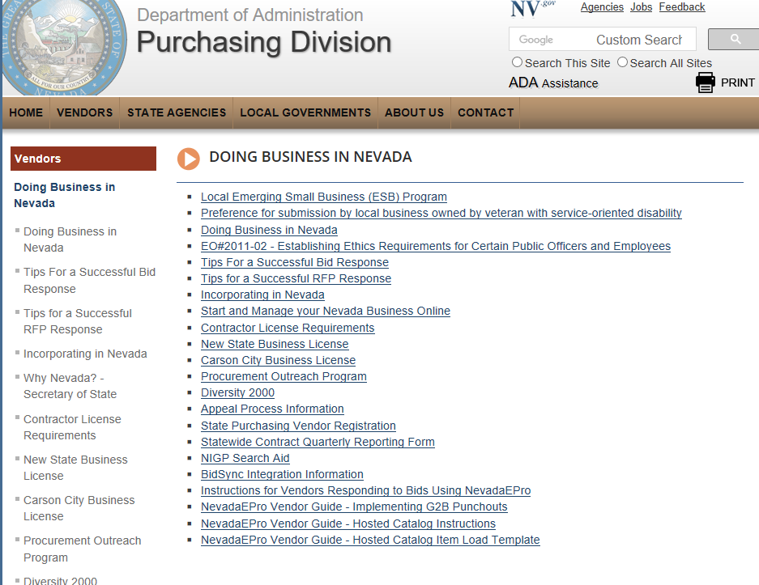
http://purchasing.nv.gov/vendors/DBINV/
Doing Business with NDOT
Notes:
The Nevada Government eMarketplace (NGEM) is a cooperative effort among various institutions, including but not limited to the McCarran airport and Clark county.
NGEM allows contractors and suppliers to register in one central location to receive requests for bids or proposals from
all participating entities.

Slide 59
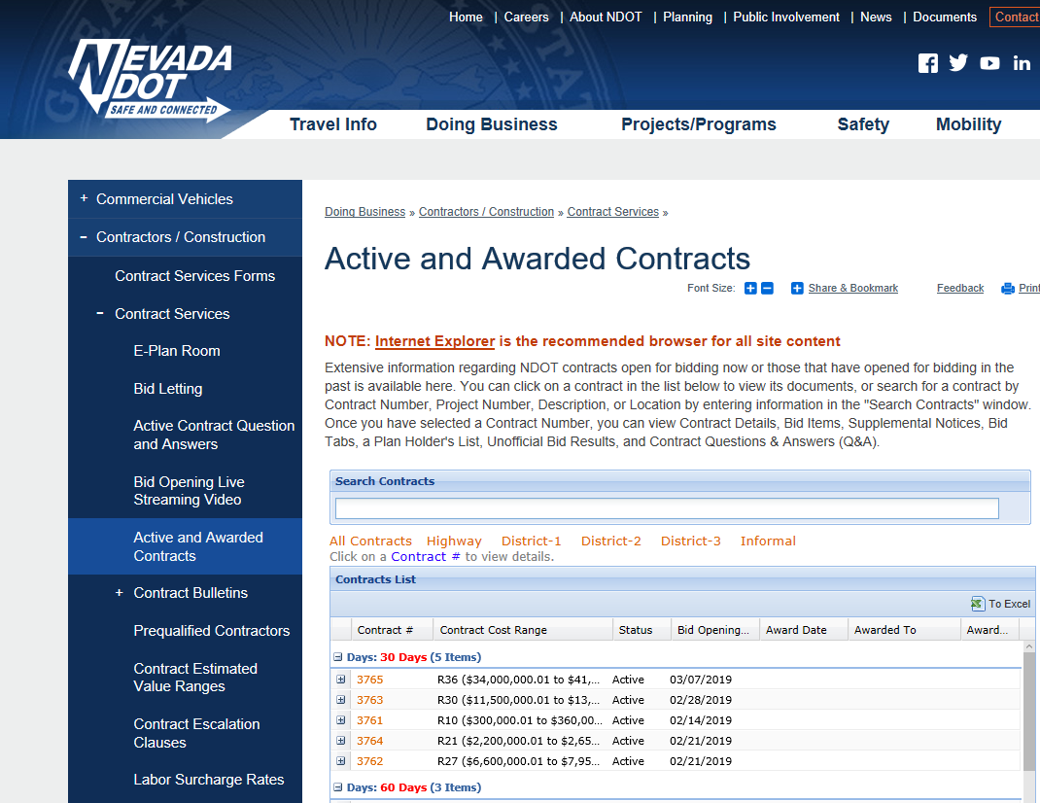
NDOT E-Bidding Portal
Doing Business with NDOT>Contractors>Contractor Services
  https://www.nevadadot.com/doing-business/contractors-construction/contract-services/active-and-awarded-contracts

Slide 60
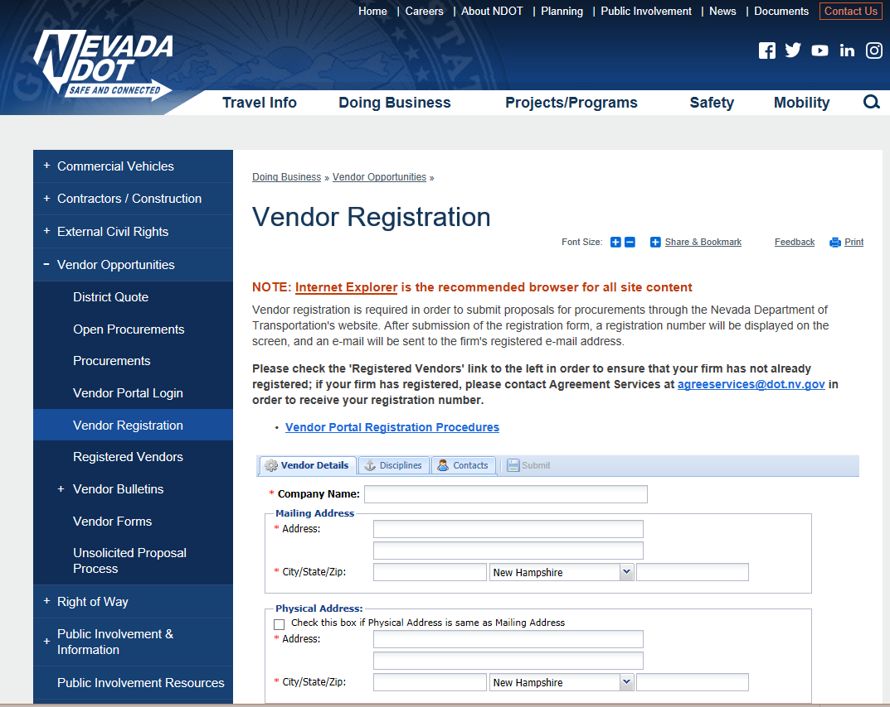

Vendor Registration With NDOT
Register Here!

Slide 61
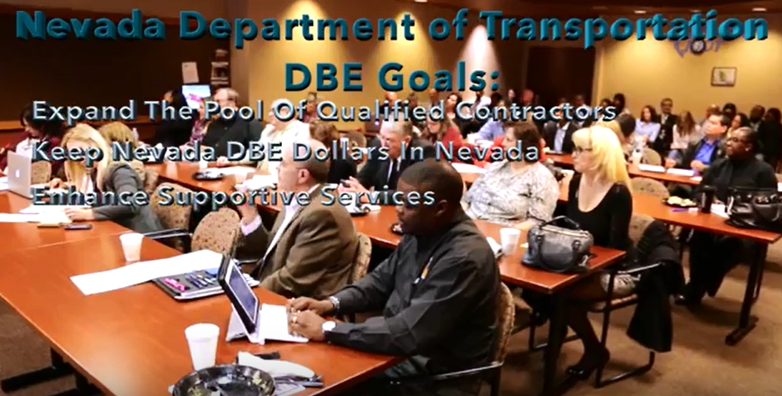
NEVADA DBE PROGRAM VIDEO
NDOT Certified Disadvantaged Business Enterprise Industry Workforce Connections
https://www.youtube.com/watch?v=OieCsJWF6Ko
Notes:
Video length – approximately 5 minutes. The Nevada Department of Transportation provides opportunity for interested DBE vendors to learn more about Projects, the DBE program and how to become a Certified DBE. NDOT supports unique opportunities for interested DBE firms to meet with the proposers individually to introduce themselves, their company and what services they provide.

Slide 62
NDOT Bidding
Two-step process for finding bidding opportunities
Step 1. E-Plan Room – DBEs go to the E-Plan Room to review all posted ads for jobs offered by contractors/primes; DBEs reach out to contractors prior to the contractor’s submission of a Request for Proposals (RFP) to NDOT
Step 2. Request for Proposals (RFP) – after developing the plan (that includes pre-selected DBEs), contractors that possess the qualifications and abilities to perform the job submit a Request for Proposals (RFP) to bid on NDOT contract.
;

Slide 63
Step 1. E-Plan Room Bidding
Now that your business is certified as a DBE, how do you find business opportunities to bid on?
DBEs can find business opportunities available through the E-Plan Room portal available on the NDOT website. To access current bidding opportunities, you should do the following:
Go to the NDOT website: www.NevadaDot.com
While on the HOME page, scroll down to the Business Resources section and select, the third option: E-Plan Room

Slide 64
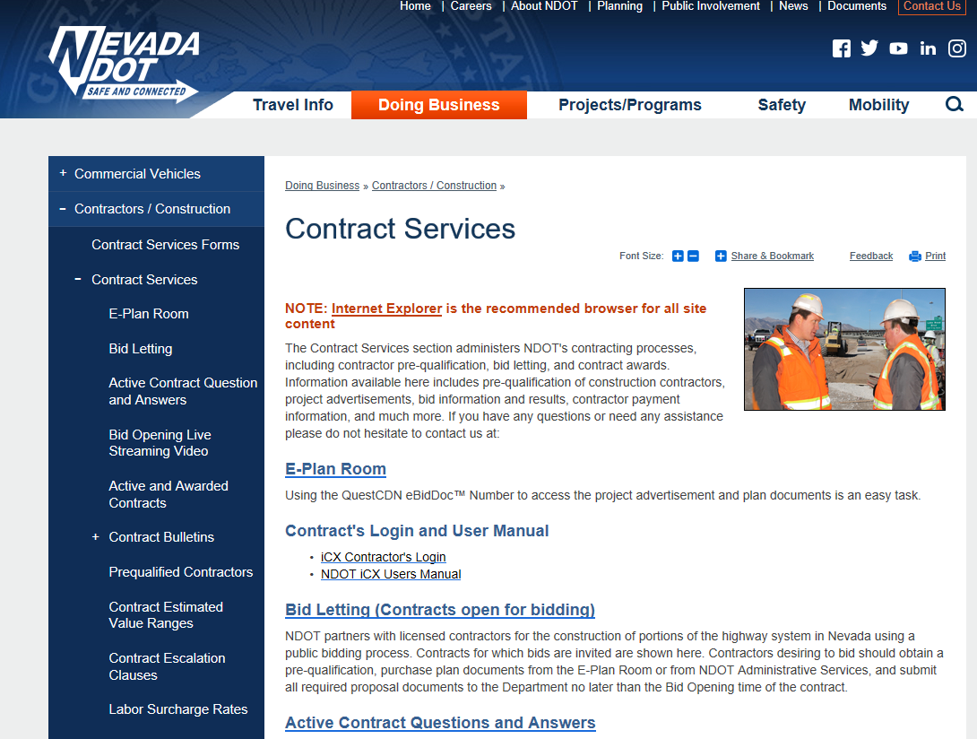
Step 1. E-Plan Room Bidding
NDOT Contract Services

Slide 65
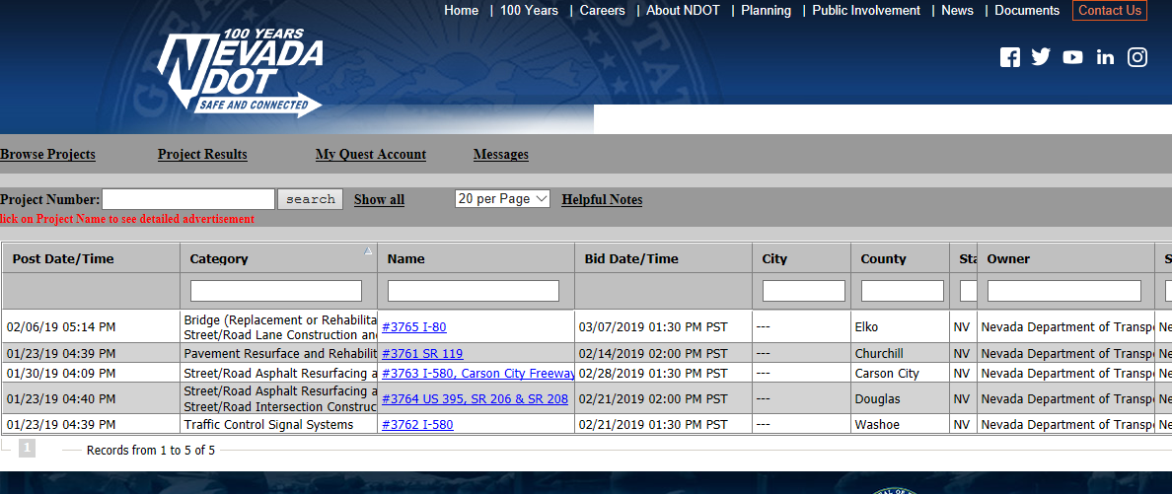

Step 1. E-Plan Room Bidding
  When the E-Plan Room window opens you can access the current bidding opportunities available as displayed below
  Next, click on a Project Name (text in blue) to see the project’s ad.

Slide 66
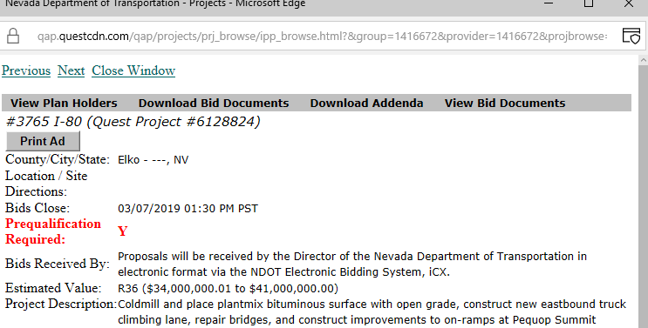

Step 1. E-Plan Room Bidding
A new window will pop-up with information related to the selected bidding opportunity. Next, click on View Plan Holder to access the Prime bidder contact information.

Slide 67
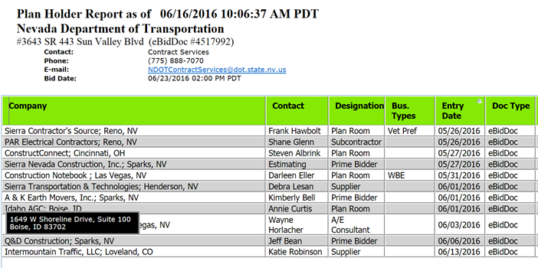
Step 1. E-Plan Room Bidding
  After you click on the View Plan Holder you can hover your mouse over the Contact’s name (e.g. Frank Hawbolt) to see the contact’s phone number and e-mail address. If you hover your mouse over the Company’s name, you can get the Prime Bidder/ Subcontractor’s physical address. As a DBE, your responsibility is to reach out to the Prime Bidder/Subcontractor, make yourself known, market your product or services and establish a point of contact that may result in a professional working relationship and a contract for you.

Slide 68
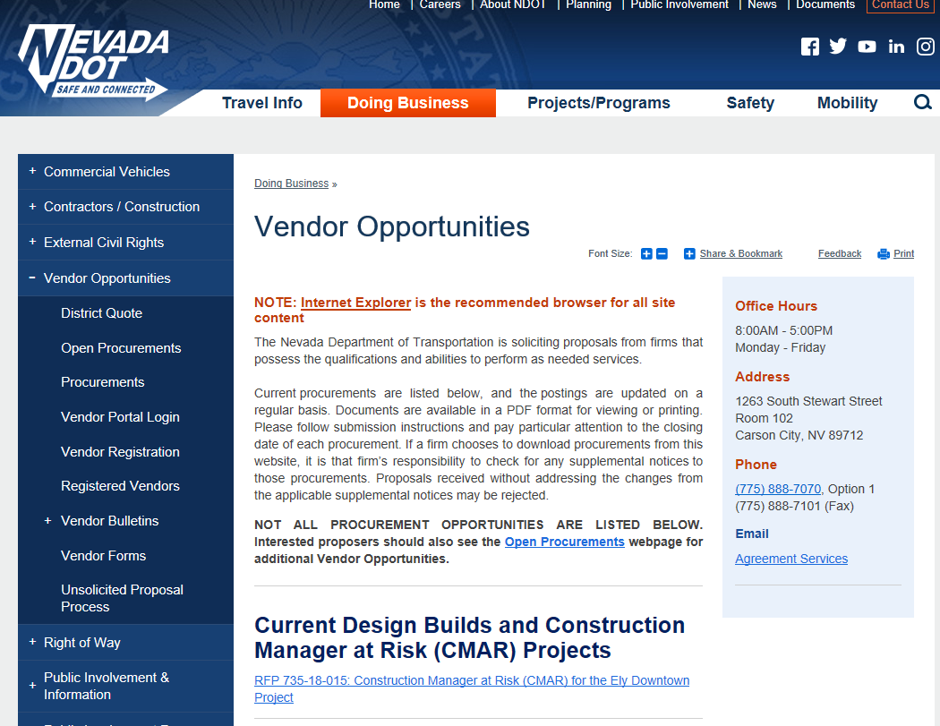
Step 2. Request for Proposals (RFP)
Additional business opportunities are available through the Vendor Opportunities section of the NDOT website. To access current procurements listed on the NDOT website, you should do the following:
  Go to the NDOT website: www.NevadaDot.com and hover your mouse over the second bar menu option called DOING BUSINESS
Notes:
After searching the E-Plan Room, DBEs can find additional business opportunities available through the Vendor Opportunities section of the NDOT website. To access current procurements listed on the NDOT website, you should do the following:
Go to the NDOT website: www.NevadaDot.com and hover your mouse over the second bar menu option called DOING BUSINESS

Slide 69
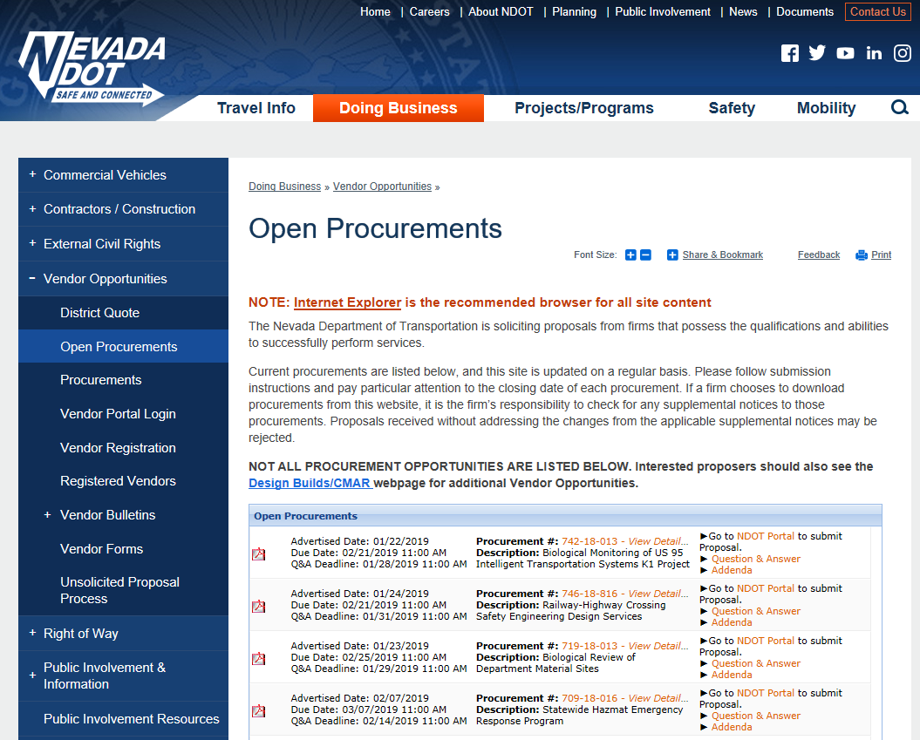
Step 2. Request for Proposals (RFP)
  To view current Request For Proposals (RFPs) and to log into the NDOT Portal, select Open Procurements' on the left side of this page.
Notes:
Comment: These are qualification-based. Only negotiate cost once the contract is awarded.

Slide 70
Old Bids
To see a list of NDOT contracts, go to:
https://www.nevadadot.com/doing-business/contractors-construction/contract-services/active-and-awarded-contracts

Slide 71
Orientation Program: Part 5
NDOT External Civil Rights Division
There are four sections in the NDOT External Civil Rights Division:
Administration
American Disabilities Act (ADA)
Contract Compliance
DBE/Title VI

Slide 72
External Civil Rights Organization Chart
Director
North
Admin Assistant
North
External Civil Rights Officer
South
ADA
North
DBE Specialist
South
Title VI/DBE Manager
South
Title VI/DBE Assistant Manager
South
Contract Compliance Manager
North
Contract Compliance
South
ADA Coordinator
North
Deputy Director
South
Contract Compliance
North
Prevailing Wage
North

Slide 73
Administration
The External Civil Rights Division’s Administration Section Consists of the External Civil Rights Officer and the Administrative Assistant.
The Civil Rights Officer is responsible for the whole Division and is the Advisor for all Title VI and related issues for NDOT.
The Administrative Assistant provides administrative support for the Division.

Slide 74
Americans with Disabilities Act Section
Americans with Disabilities Act
The Nevada Department of Transportation has a responsibility, under Title II of the Americans with Disabilities Act and Section 504 of the Rehabilitation Act, to ensure its services, facilities, and public rights-of-way are readily accessible to and useable by individuals with disabilities to the fullest extent possible.

Slide 75
Americans with Disabilities Act Section
Continued)
Americans with Disabilities Act (Continued)
The Americans with Disabilities Act (ADA) prohibits discrimination on the basis of disability. NDOT will ensure that qualified individuals shall not, solely on the basis of their disability, be excluded from participation in, denied the benefits of, or subjected to discrimination under any of its programs, services, or activities as provided by Section 504 of the Rehabilitation Act of 1973 and the Americans with Disabilities Act of 1990 (ADA).

Slide 76
Contract Compliance
Contract Compliance is responsible for ensuring Federal-aid contracts are performed in a non-discriminatory manner.
As a contractor on State or Federally funded projects over $250,000.00, you are subject to laws regarding prevailing wages and Title VI (EEO) provision requirements.
As a DBE contractor on a highway construction-related contract, you should attend all relevant meetings regarding the contract such as pre-bid conferences, pre-construction conferences and progress meetings (when applicable).

Slide 77
Commercially useful Function (CUF)
A DBE must always perform a commercially useful function (CUF). NDOT is required to evaluate whether a DBE is performing a CUF on a particular contract every time the DBE is listed to work on a contract. A business performs a CUF when it is:
Responsible for the execution of a distinct element of work in the contract.
Carrying out its obligation by actually performing, managing, and supervising the work involved.
Performing work that is normal for its business, services, and function.
Performing or exercising responsibility for at least 50 percent of the total contract with its own work force and is not further subcontracting a portion of the work that is greater than that expected to be subcontracted by normal industry practice.

Slide 78
Commercially useful Function (CUF) (Continued)
Additional requirements apply to trucking operations: Title 49 CFR 26.55 (d) — The following factors are used in determining whether a DBE trucking company is performing a commercially useful function:
The DBE must be responsible for the management and supervision of the entire trucking operation for which it is responsible on a particular contract, and there cannot be a contrived arrangement for the purpose of meeting DBE goals.
The DBE must itself own and operate at least one fully licensed, insured, and operational truck used on the contract.

Slide 79
Commercially Useful Function (CUF)
(Continued)
The DBE receives credit for the total value of the transportation services it provides on the contract using trucks it owns, insures, and operates using drivers it employs.
The DBE may lease trucks from another DBE firm, including an owner-operator who is certified as a DBE. The DBE who leases trucks from another DBE receives credit for the total value of the transportation services the lessee DBE provides on the contract.

Slide 80
Commercially Useful Function (CUF)
(Continued)
NOTE: If a DBE is not performing a CUF on a project, credit cannot be given for the work performed and the Prime may not attain the goal set on the project nor be capable of providing justification for Good-Faith-Effort which would put them in non-compliance with the contract.

Slide 81
Fraud
NDOT must report any false, fraudulent, or dishonest conduct in connection with the DBE program to the USDOT Office of the Inspector General (OIG) for appropriate action. The OIG looks at ten key indicators, or “red flags,” in determining whether to investigate a contractor for DBE fraud. These red flags include:
DBE firm’s owner lacking background, expertise or equipment to perform subcontract work
Employees shuttling back and forth between prime contractor and DBE-owned business payrolls
Business names on equipment and vehicles covered with paint or magnetic signs

Slide 82
Fraud (Continued)
Orders and payment for necessary supplies made by individuals not employed by DBE- owned business
Prime contractor facilitated purchase of DBE-owned business
DBE owner never present at job site
Prime contractor always uses the same DBE
Financial agreements between prime and DBE contractors
Joint bank accounts (prime/DBE)
Absence of written contracts

Slide 83
Fraud (Continued)
Under 49 CFR, Part 26.107, businesses working in the DBE program who engage in the conduct may be subject to suspension or debarment, enforcement actions under 49 CFR Part 31, Program Fraud and Civil Remedies, or criminal prosecution. USDOT OIG makes investigating and prosecuting DBE fraud a priority. The OIG, working with U.S. Attorney’s offices has helped to create successful criminal prosecution for fraudulent conduct in the DBE program. Anyone who becomes aware of fraud, waste, or abuse in these programs should inform the OIG as well as NDOT staff.

Slide 84
Fraud (Continued)
Reporting Fraud
When you suspect fraud, waste or abuse, report it immediately in one of two ways:
Call the OIG Hotline at: 1-800-424-9071 (toll free), E-mail, hotline@oig.dot.gov
Call the NDOT External Civil Rights Officer at: (702) 730-3301

Slide 85
DBE - Certifications
NDOT is a certifying agency and a member of the Nevada Unified Certification Program (NUCP) Committee. The Committee meets monthly and considers DBE Certification applicants. Successful applicants are placed in the DBE Directory which is found on-line at www.nevadadbe.com.
Only NUCP Certified DBEs who are performing a CUF on the project may be credited toward a Contractor’s DBE goal attainment. A DBE’s failure to perform a CUF on the contract could result in the Prime Contractor being in non-compliance on the contract.

Slide 86
DBE – Certifications (Continued)
The DBE certification program is open to all small businesses who qualify under 49 CFR. Many agencies as well as private employers review the list of contractors and consultants who might be interested in bidding and submitting qualifications on their jobs. But NDOT is primarily interested in companies involved in highway construction-related work such as:
Asphalt Cement Oil
Augmentation Services
Concrete Work
Demolition
Dust Control
Electrical
Erosion Control
Fencing
Gravel and Stone
Guardrail
Hauling
Landscape
Professional Services (Consulting)
Pollution Control
Reinforcing Steel
Signs
Striping and Marking
Suppliers
Traffic Control
Trucking
Utilities (Wet and Dry)
Environmental Monitoring

Slide 87
DBE – Certifications (Continued)
  North American Industry Classification System (NAICS) Codes additions
NDOT uses NAICS codes to determine basic qualifications for work performed on road construction contracts. Now that you are certified, you may add different lines of work (as demonstrated by NAICS codes) to your business. It may be that you can expand the codes that have been entered in your file if you can adequately perform the work on the contract as determined by your background and experience in that code.
You should contact the DBE Office if you want to expand the NAICS codes in your DBE file.

Slide 88
DBE - OUTREACH
The Division has a very active outreach program which is used to provide information about our DBE program and its benefits. For example, three Local and Regional Annual Events are:
Las Vegas Metro Chamber of Commerce Business Expo
  http://web.lvchamber.com/events
PTAC Procurement Outreach Events
  http://business.nv.gov/Business/Event_Calendar/Calendar_of_Events/
Annual Governor's Conference on Business, hosted by the State of Nevada Department of Business and Industry.
http://business.nv.gov/GCB/Home/
Notes:
Las Vegas Metro Chamber of Commerce Business Expo -is the Las Vegas Metro Chamber of Commerce’s annual high-energy, high traffic trade show, attracting about 2,000 attendees and 175 exhibitors in a dynamic business-to-business atmosphere. This signature event of the Metro Chamber is a great opportunity to get new leads and customers and give your brand visibility in the marketplace. It is also an ideal venue to introduce a new product or service, or reacquaint the business community with your company.
http://web.lvchamber.com/events
PTAC Procurement Outreach Events –PTAC provides Networking Assistance to enhance visibility for business prospects, encourage opportunity teaming arrangements, identify other resources and create alliances to pursue industry specific programs such as set-asides, hi-tech, etc
http://business.nv.gov/Business/Event_Calendar/Calendar_of_Events/
Annual Governor's Conference on Business, hosted by the State of Nevada Department of Business and Industry.
This comprehensive business resource and networking event is designed for entrepreneurs seeking to launch a new venture or business owners that want to grow their business.
http://business.nv.gov/GCB/Home/

Slide 89
Title VI Program
The Division’s Title VI program is charged with ensuring nondiscrimination on NDOT projects and in the conduct of business related to the Highway Program.
The Division is responsible for providing guidance and training to all agencies receiving federal funding for highway projects.
The Division is responsible for reviewing the processes and practices of all agencies receiving federal funding for highway projects to ensure non-discrimination.
The Division is charged with investigating all allegations regarding EEO Discrimination related to the program.

Slide 90
FOR MORE INFORMATION, CONTACT:
Sonnie Braih, Civil Rights Officer (702) 730-3301
Ray Marshall, DBE Manager (702) 730-3317
Teri Lewis, Asst. DBE Manager (702) 730-3305
Paulita De La Cruz, DBE Specialist (702) 730-3309
Visit our website at: www.nevadadot.com
Inquiries may also be directed to Christy Echols, Paragon Development Group, NDOT DBE Supportive Services Consultant, at (702) 839-4647 or e-mail at cechols@gopdg.net

Slide 91
QUESTIONS?

Slide 92

  THANK YOU!

