Slide 1

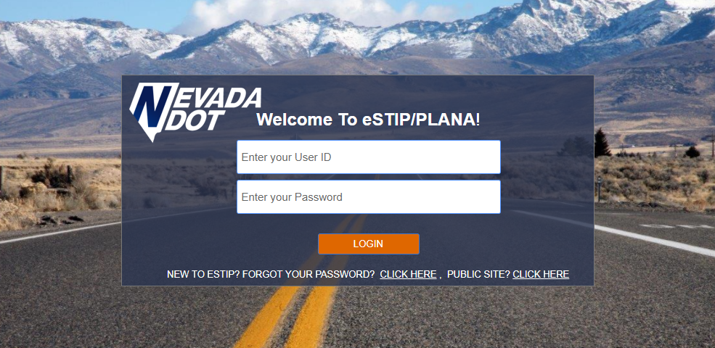
PLANA
Planning and Needs Assessment

Slide 2

Access is granted by the PLANA team in Program Development
Login through the eSTIP module, if you have access to both select “my PLANA list” in the “Project Tools” dropdown

Slide 3
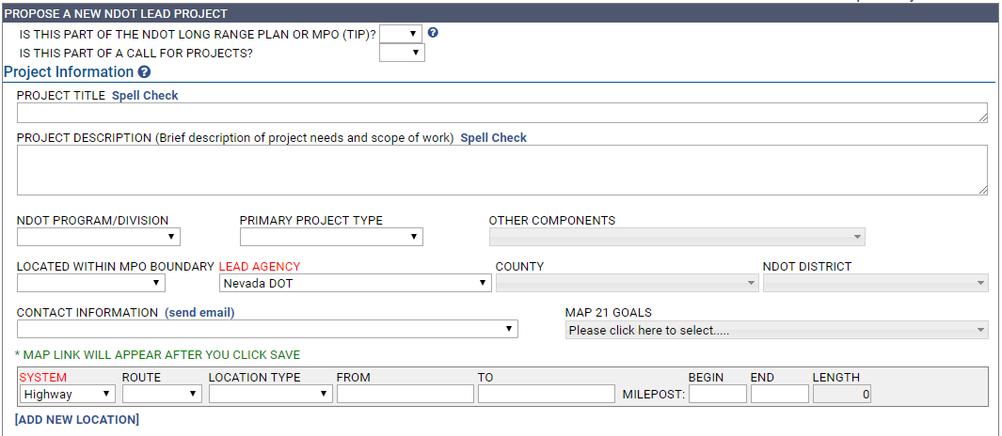
Add New PLANA
First box includes title, simple scope of project and location, SAVE HERE!

Slide 4
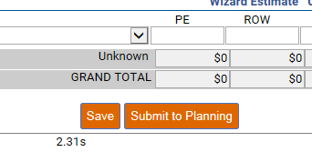
Save the PLANA after completing the first box

Slide 5
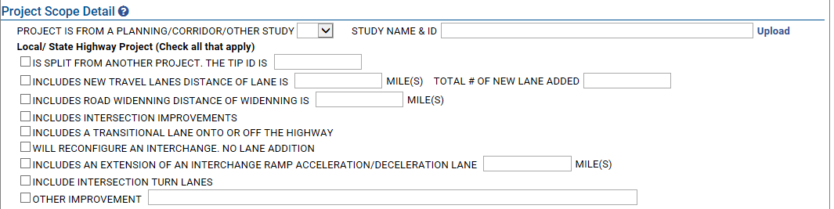
Project Scope Box includes a location to upload planning/study documents, interchanges and route widening
If none are applicable, select ‘other improvement’

Slide 6
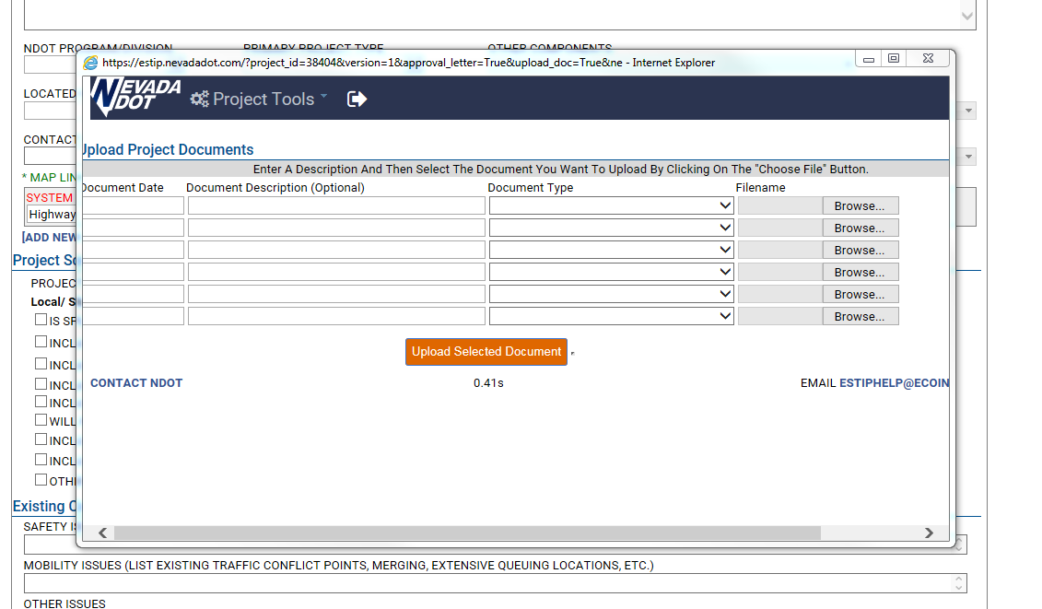
Upload documents menu
Select document type with the ‘document type’ dropdown

Slide 7
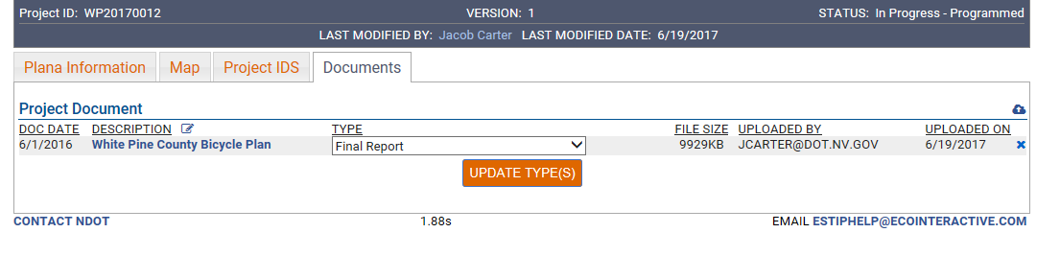
Manage documents using the document tab at the top of the screen

Slide 8
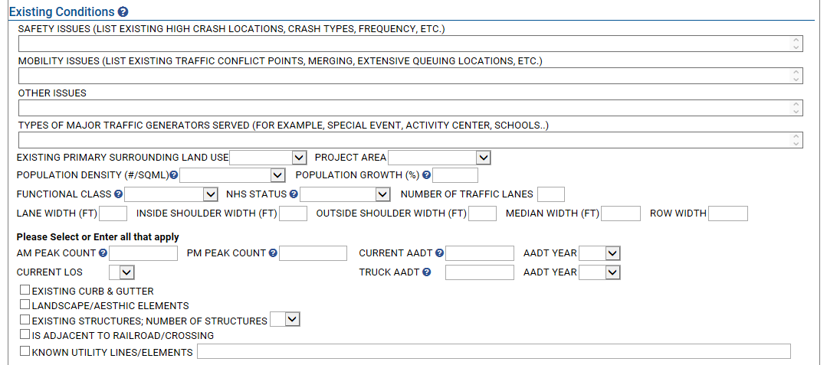
The Existing Conditions Box includes links to fill in database information, and fillable fields for project details
PLANAs must be as complete as possible

Slide 9
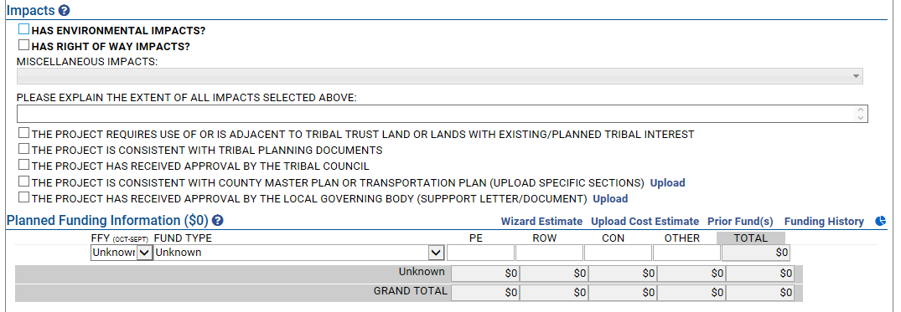
When impact boxes are checked, the section will expand so impact details can be entered

Slide 10
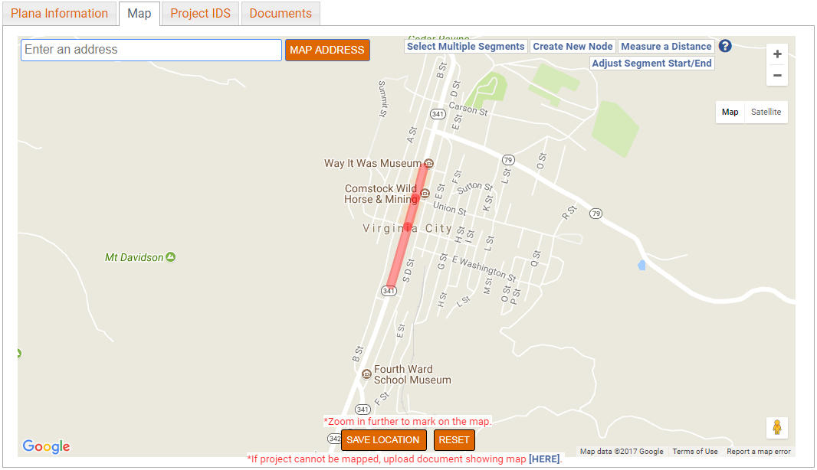
The Map tab at the top of the page opens map tool to set project location
Click on applicable roadways to set project location
Selected roads turn red
Be sure to hit SAVE!

Slide 11
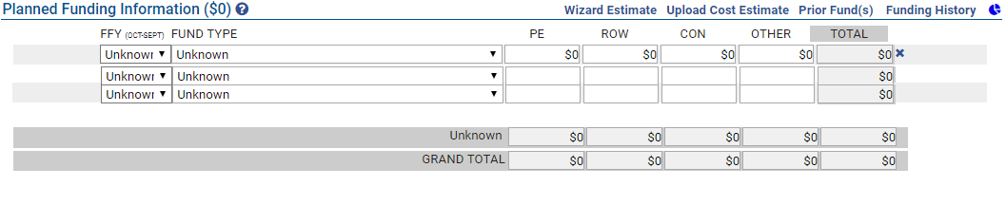
Cost estimates can be entered and uploaded in the Planned Funding Information Box
A link to the NDOT Wizard estimation tool includes a tutorial and a blank Wizard document

Slide 12

Before Submitting to Planning ensure that the PLANA is as complete as possible
The Planning staff will be in contact as the PLANA moves through the project initiation system

Slide 13
Next Steps…
Improve program process in conjunction with Scoping Division
Improve process for prioritization into Long Range Plan
Create communication protocol with submitting entity

Slide 14
Questions about PLANA?
Contact:
NDOT Program Development
Emel Hassanein
(775) 888-7360
ehassanein@dot.nv.gov

Slide 15



