Slide 1
Transportation Board of Directors
NDOT Director’s Report
Kristina Swallow, P.E., Director
March 8, 2021

Slide 2

Safety

Slide 3
COVID Traffic Impacts

Slide 4
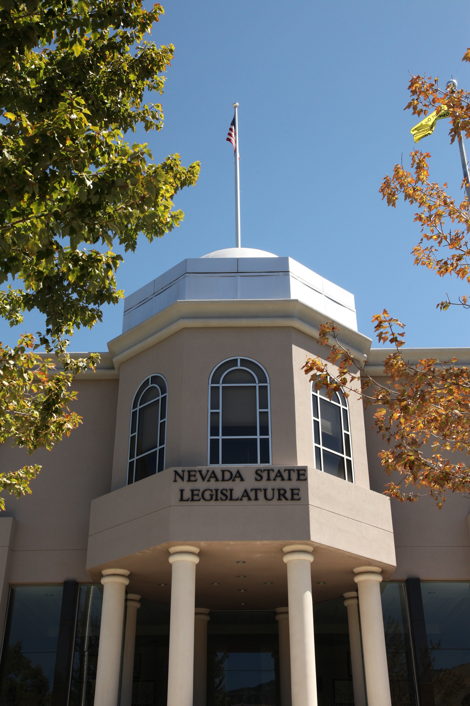
2021 Nevada Legislative Session

Slide 5
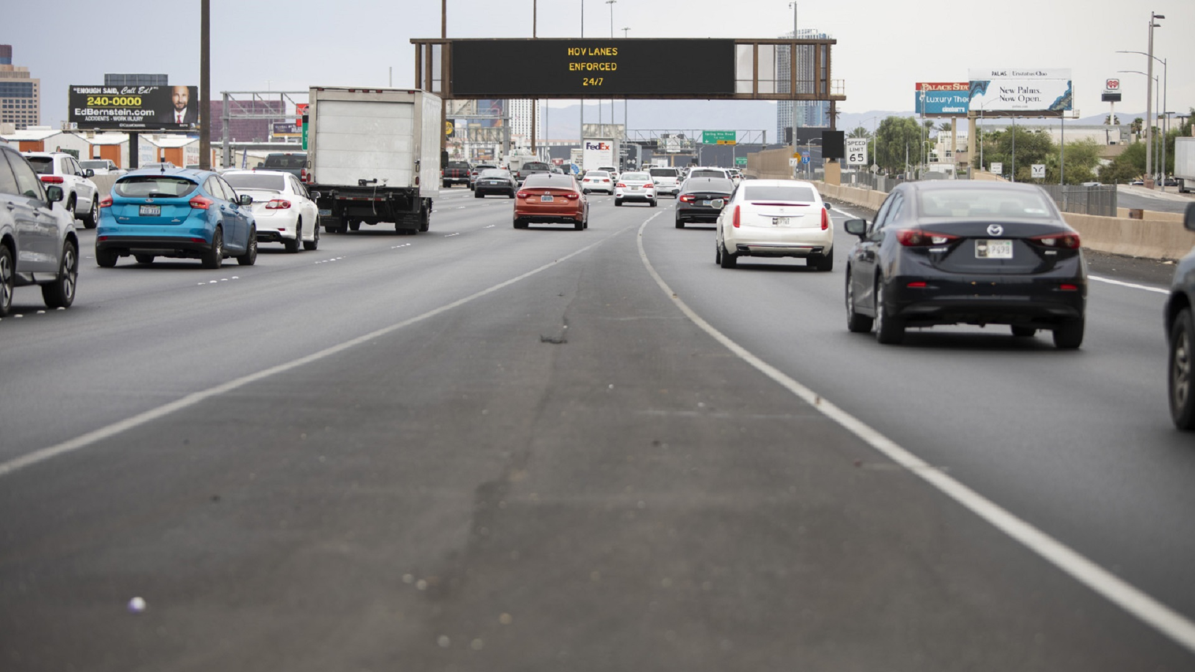
HOV Study

Slide 6
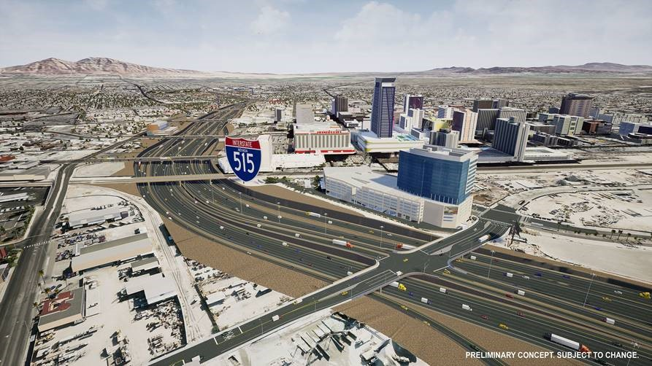
Downtown Las Vegas Improvements

Slide 7
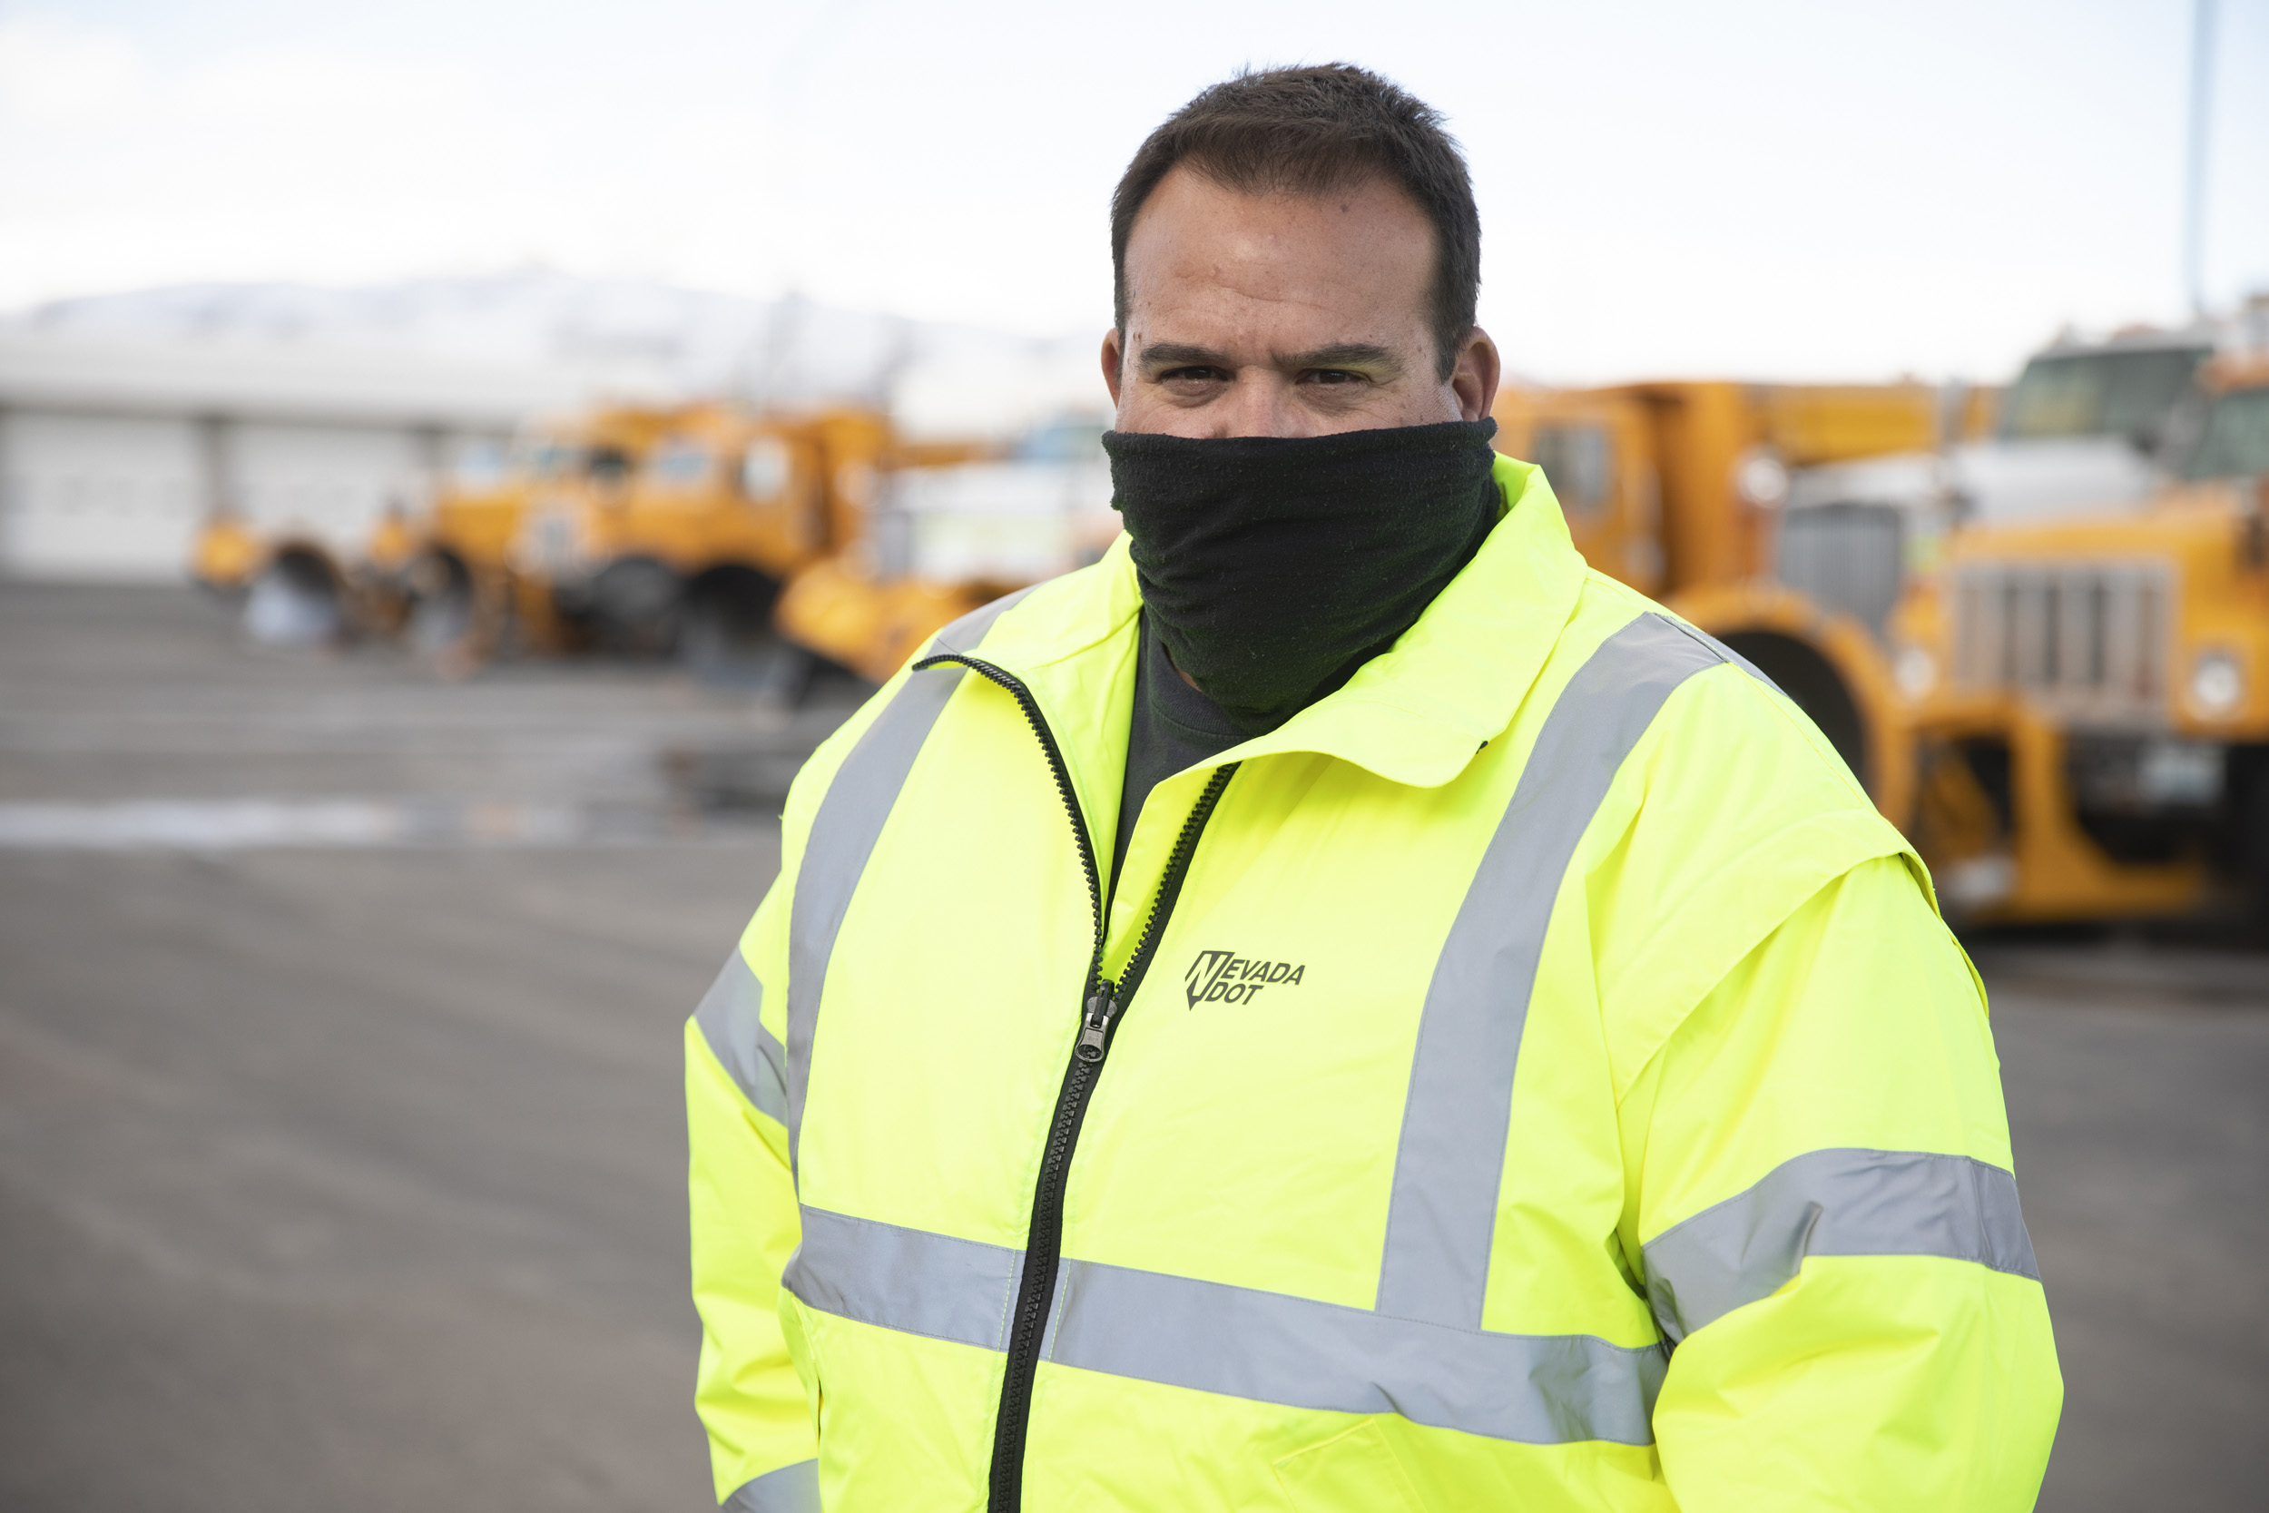
Contributing to the Workforce

Slide 8
Kristina Swallow, P.E., NDOT Director kswallow@dot.nv.gov| (775) 888-7440

