Slide 1
ApplicationXtender
v16.3

Slide 2
Accessing ApplicationXtender
A login to NDOT’s remote is required:
Email request for User credentials (Automatic Send, SUBMIT button)
Approval Process:
You will receive a DocuSign document
Once the document is signed, it will go through the IT approval process
Once approved, Username/Password will be supplied
You will be required to enter in a new Password
Happy Searching

Slide 3
Logging in:
Logging In:
Link: https://remote.dot.state.nv.us/
Enter the provided Username/Password
You will be asked to enter a Password
Link to AX will be displayed

Slide 4
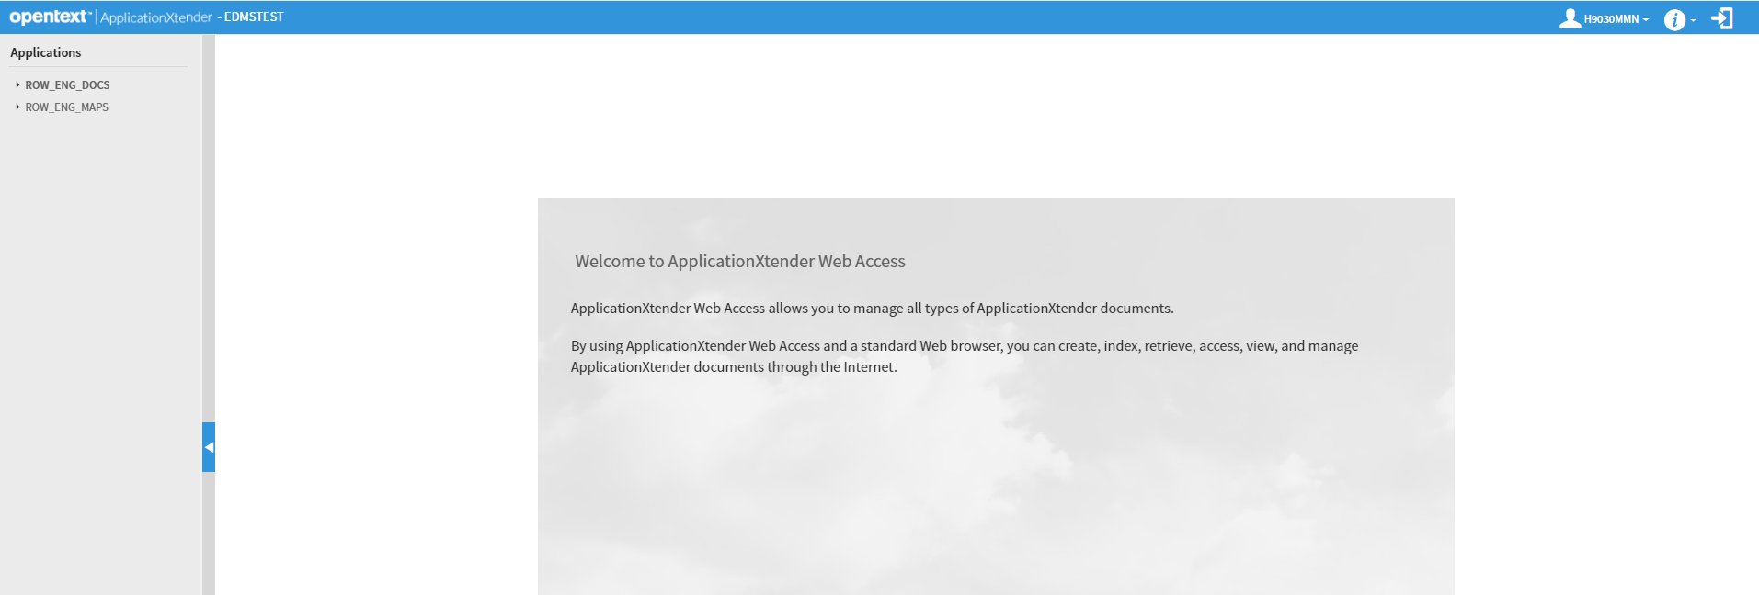
Look & Feel

Slide 5
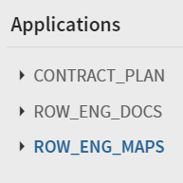
Search - Single Application
Click on the Folder
Contract Plan folder pending approval
Click on the New Query

Slide 6
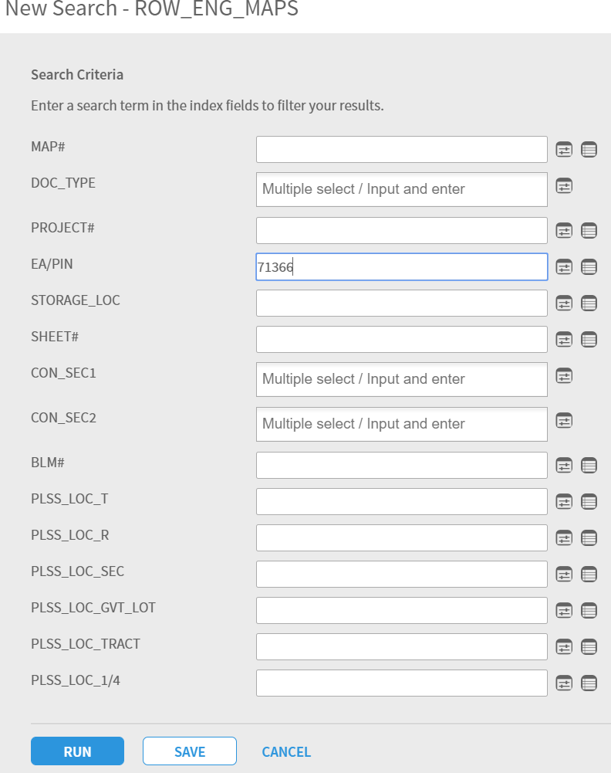
Search – Single Application (cont’d)
Enter appropriate data

Slide 7
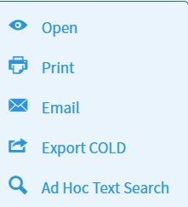
Search – Single Application (cont’d)
Click on the RUN button
List of qualifying documents will be displayed.
Click on the down arrow next to the document you desire.

Slide 8
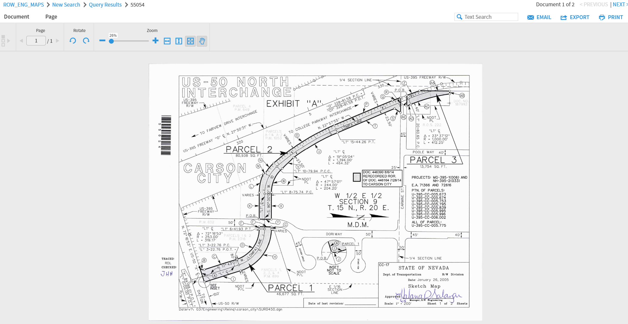
Search – Single Application (cont’d)
Click the Open

Slide 9
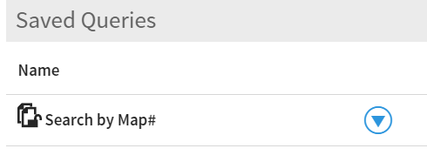
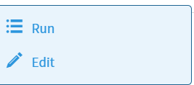
Search – Multiple Application
Multiple Application searches are pre-define saved queries
Click on the down arrow next to the saved query
Click on the Edit(Run will search for the last Map# searched)

Slide 10
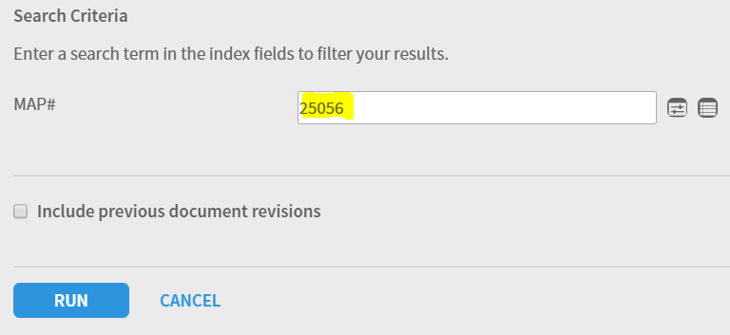
Search – Multiple Application (cont’d)
Enter a Map #
Click the RUN button

Slide 11
Search – Multiple Application (cont’d)
Query results consist of the selected Map and all supporting documents (Deeds, agreements, etc.)
Options(click the box above the select and select all documents)
Open
Print
Export
Email(be aware of your email size limits)

Slide 12
View
Access choices
Views
Document can be displayed as a whole document(Fit to page)
Rotate the document
Fit by height
Fit by width
Pan Mode – Only works when the document is expanded larger then the page.
Browse page to page
View attribute data
Print – Uses your local printer configured to your PC
Export – Configured to save as a pdf
Email – document can be emailed as a pdf document(be aware of your email size limits)

