Slide 1
Public Information Meeting US 50 Dayton Operational Study
May 11, 2021
5:30 pm – 7:00 pm

Slide 2
Agenda
Welcome and Opening Remarks
Horse Fencing Update
Study’s Purpose and Goals
Existing Conditions
Potential Alternative Visions
Next Steps
Please type in questions about the presentation or study in the Q&A box and they will be addressed at the end of the presentation.

Slide 3
Horse Fencing Update
19 crashes related to horses from July 2013 – July 2018
Limits:
Area 1 – SR 341 to River Street (near “Our Park” in west Dayton)
Area 2 – Fortune Drive to Occidental Drive (West)
Area 3 - Six Mile Canyon Road to Chaves Road (tie into existing)
Four strand, four-foot high livestock fencing
Advertise for construction in 2021
For more information contact:
775-888-7000
info@dot.nv.gov (enter US 50 Horse Fencing in the subject line)

Slide 4
Study Purpose and Goals
Study Limitations – External to NDOT
Development approval process (decisions made locally)
Purpose
Collaborate with local partner agencies to define and provide a corridor vision for future long-term development and improvements of the US 50 corridor
Corridor plan to be a useful tool for future roadway projects and short-term improvements
Study initiated to define vision so any intersection improvements constructed are appropriate and compatible with future vision
Goals
Long-term vision
All agencies to include in future development & roadway plans.
Corridor Consistency
All future development & roadway improvements follow corridor vision

Slide 5
Study Partners
Lyon County
Storey County
CAMPO
Carson City
General Public

Slide 6
Operational Study Expectations
What does an operational study include?
Understand existing conditions throughout the corridor: What priorities are we trying to address?
Establish a vision for the corridor: What do you want to see the corridor look like?
Develop an action plan for improvements, including interim fixes and longer-term changes
Planning
Existing conditions/ needs assessment
Community visioning
Evaluation of alternatives
Action plan/ recommended improvements
Environmental
Environmental study (state or NEPA process)
Preliminary engineering
Agency issues decision
Design
Detailed corridor design
Right-of-way, utilities, and other impacts
Construction plans, permits, and funding secured
Construction
Build and deliver
WE ARE HERE

Slide 7
Study Schedule
Existing Conditions
Identify Concerns and Priorities
Planned Development
Vision & Alternative Development
Refine Vision and Concepts
Forecasting Operations
Alternative Recommendation
Short-Term Needs
Traffic Analysis
Public Meeting #1
Corridor Inventory
Data Collection
Concept Screening
Cost Estimating
Funding Sources
Policy Needs
Existing Operations
Concept Development
Benefit Cost Analysis
Long-Term Needs
Prioritization
February 2020 – June 2020
June 2020 – May 2021
May 2021 – July 2021
We are here
Schedule Subject to Change

Slide 8
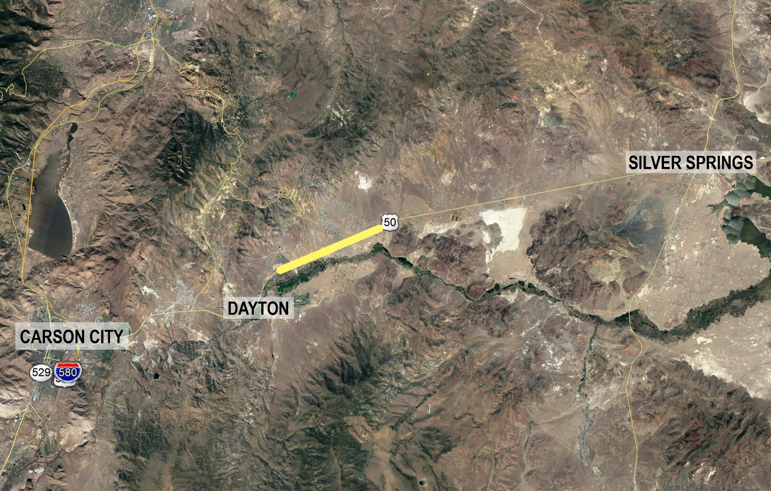
Project Limits
Neigh Road
Study Limits
Pine Cone Road
Lyon County, NV

Slide 9
Planned Corridor Development
N
Heritage Ranch
Pinecone Rd
Gold Country
Estates
Traditions Master Plan
Six Mile Canyon Rd
Sage Vista
Dayton Pioneer
Woodbridge Estates
Segala Rd
Chavez Rd
Ft. Churchill Rd

Slide 10
Corridor Conditions Crash Data – Top Crash Locations
 | Crashes | Injuries | Fatalities
Fortune Drive | 20 | 12 | 0
Riverboat Road/Cardelli Road | 15 | 16 | 0
Retail Road | 14 | 10 | 0
Six Mile Canyon Road/Fort Churchill Road | 8 | 2 | 0
Occidental Road (East) | 7 | 1 | 0
Occidental Road (West) | 6 | 5 | 0
Ambrose Lane | 3 | 3 | 2
Crashes based on crash data from 7/1/13 to 7/1/18

Slide 11
Corridor Conditions Delay and Congestion
Intersection /Scenario | 2020 Existing |  | 2040 No-Action
 | AM | PM | AM | PM
US 50 and Pine Cone Road | 26.8 (D) | 25.4 (D) | F | F
US 50 and Retail/River Road | 15.3 (C) | 13.2 (B) | F | F
US 50 and Fortune Drive* | 16.2 (B) | 13.8 (B) | 151.8 (F) | 66.3 (E)
US 50 and Enterprise Way | 25.9 (D) | 16.9 (C) | F | F
US 50 and Occidental Drive West | 13.6 (B) | 11.4 (B) | F | F
US 50 and River Boat Road/Cardelli Road | 25.7 (D) | 67.5 (F) | F | F
US 50 and Occidental Drive East | 25.9 (D) | 48.9 (E) | F | F
US 50 and Six Mile Canyon Road/Fort Churchill Road | 16.1 (C) | 25.5 (D) | F | F
US 50 and Lafond Avenue | 10.5 (B) | 11.5 (B) | F | F
US 50 and Mark Twain Avenue | 11.1 (B) | 9.9 (A) | F | F
US 50 and Rainbow Drive West | 12.8 (B) | 17.2 (C) | F | F
US 50 and S Pinenut Drive | 12.1 (B) | 15.1 (C) | F | F
US 50 and Rainbow Drive East | 11.7 (B) | 18.1 (C) | F | F
US 50 and Bryce/Chaves Road | 10.0 (B) | 17.2 (C) | F | F
* Signalized Intersection
Delay shown in seconds – time delays not shown have a movement delay in excess of 5 minutes (300 seconds)

Slide 12
Corridor Vision & Alternative Concepts
Three concepts with varying levels of access
Arterial
Signalized access and high-T intersections
Similar access to existing access
Six lane facility (three each direction)
11 signals
Posted speed 45 mph
Parkway
Utilize less use of traffic signals and more use of high-t intersections
Minor reduction in access points
Reduced number of lanes east of Six Mile Canyon Road (six lanes reduced to four)
6 signals
Posted speed 45-60 mph
Controlled Access
Use of grade-separated crossing and
right-in/right-out type movements
Maximize use of frontage roads
Minimize access points to US 50
Six lanes west of Fortune Drive then reduced to four
2 signals
Posted speed 45-65 mph
Notes:
Public survey overview and its importance

Slide 13
Corridor Vision & Alternative Concepts
Overall Alternatives
Intersections
Notes:
Public survey overview and its importance

Slide 14
Corridor Vision & Alternative Concepts 2040 Traffic Operations
Intersection/Scenario | Arterial |  | Parkway |  | Controlled Access
 | AM | PM | AM | PM | AM | PM
US 50 and Pine Cone Road | 20.8 (C) | 15.4 (B) | 217.3 (F) | 27.9 (D) | 217.3 (F) | 28.7 (D)
US 50 and Retail/River Road | 22.7 (C) | 21.4 (C ) | 24.5 (C) | 36.9 (D) | 36.4 (D) | 36.4 (D)
US 50 and Fortune Drive | 40.3 (D) | 30.1 (C) | 41.4(D) | 30.1 (C) | 39.3 (D) | 30.1 (C)
US 50 and Seagale Rd/Transitions Pkwy | 22.6 (C) | 24.4 (C) | 29.0 (C) | 24.5 (C) | 26.3 (C) | 16.9 (B)
 |  |  |  |  | 17.7 (B) | 9.0 (A)
US 50 and Enterprise Way | 39.5 (E) | 21.3 (C) | 39.5 (E) | 21.3 (C) | _
US 50 and Occidental Drive West | 11.0 (B) | 9.4 (A) | 10.7 (B) | 9.3 (A)
US 50 and River Boat Road/Cardelli Road | 26.4 (C) | 22.5 (C) | 27.5 (C) | 22.9 (C)
US 50 and Occidental Drive East | 20.7 (C ) | 8.7 (A) | 34.5 (D) | 31.1 (D)
US 50 and Six Mile Canyon Road/Fort Churchill Road | 9.0 (A) | 25.8 (C) | 35.4 (D) | 33.3 (C) | 26.7 (C) | 34.4 (C)
 |  |  |  |  | 37.4 (D) | 36.3 (D)
US 50 and Lafond Avenue | 12.1 (B) | 7.6 (A) | 20.6 (C) | 16.6 (C) | _
US 50 and Mark Twain Avenue | 20.8 (C) | 18.1 (C) | 18.2 (C) | 15.8 (C)
US 50 and Rainbow Drive West | 22.2 (C) | 18.5 (C) | 19.1 (C) | 16.1 (C)
US 50 and S Pinenut Drive | 19.2 (B) | 20.1 (C) | (F) | (F)
US 50 and Rainbow Drive East | (F) | (F) | 19.0 (C) | 16.5 (C)
US 50 and Bryce/Chaves Road | 29.2 (C) | 27.1 (C) | 33.7 (C) | 29.4 (C) | 35.6 (D) | 25.0 (C)
 |  |  |  |  | 39.0 (D) | 31.2 (C)
Notes:
Public survey overview and its importance

Slide 15
Corridor Vision & Alternative Concepts Traffic Operations
Measure of effectiveness | 2020 Existing |  | 2040 No-Action
 | AM | PM | AM | PM
Total Distance Traveled-VMT (miles) | 7,613 | 9,293 | 22,239 | 27,390
Total Travel Time-VHT (Hours) | 167 | 255 | 6,280 | 7,605
Total Network Delay (Hours) | 20 | 74 | 5,863 | 7,091
Measure of effectiveness | Arterial |  | Parkway |  | Controlled Access
 | AM | PM | AM | PM | AM | PM
Total Distance Traveled-VMT (miles) | 22,241 | 27,495 | 22,155 | 27,421 | 22,980 | 29,079
Total Travel Time-VHT (Hours) | 642 | 774 | 730 | 907 | 535 | 658
Total Network Delay (Hours) | 140 | 156 | 252 | 304 | 119 | 131
Notes:
Public survey overview and its importance

Slide 16
Corridor Vision & Alternative Concepts Predicted Crashes
Year | No-Action | Arterial | Parkway | Controlled Access
2020 | Baseline | +1 | -2 | -5
2040 | +141 | +135 | +136 | +108
Numbers represent yearly predicted crashes per Interactive Highway Safety Design Model.
Notes:
Public survey overview and its importance

Slide 17
Survey Info
Your input matters
Need feedback on your concerns and corridor priorities for the future
Why the survey?
Identify recommended alternative
Strike a balance between agencies and public feedback
NDOT still must address baseline needs
Official survey will appear at the end of the meeting. If it does not appear, you are calling in, or have any other issues please go to the website at www.dot.nv.gov/us50dayton and a link will be there.
Notes:
Public survey overview and its importance

Slide 18
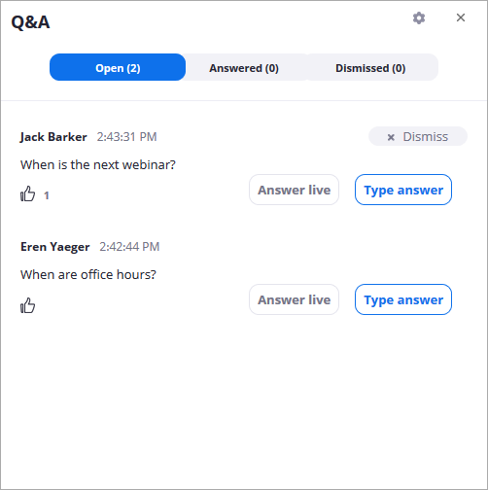
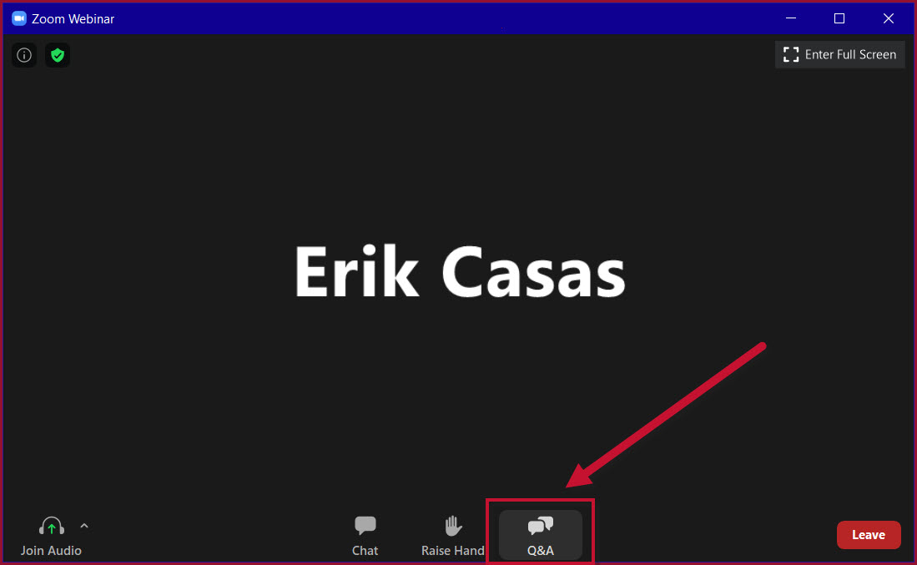
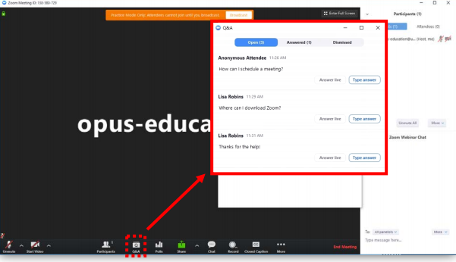
Do You Have a Question?
If you have a question about the presentation or study, we’d appreciate hearing from you
Please use the Q&A feature
Notes:
Please type in questions about the presentation or study in the chat box and they will addressed at the end of the presentation.

Slide 19
Public Information Meeting Feedback
Link to meeting materials, concerns, and survey to be at www.dot.nv.gov/us50dayton
Public comment and survey responses accepted until 11:59 pm June 1st, 2021
Final Report July 2021
Contact Information for the US 50 Operational Study and tonight’s presentation:
NDOT Public Information 775-888-7000
Email: NDOTus50dayton@c-agroup.com or info@dot.nv.gov (enter US 50 Operational Study in the subject line)
Website – www.dot.nv.gov/us50dayton
Horse Fencing – info@dot.nv.gov (enter US 50 Horse Fencing in the subject line)
Response to tonight’s posted questions

