Slide 1
Nevada Freight Advisory Committee
Tim Mueller, NDOT Freight Program Manager
November 2, 2021

Slide 2
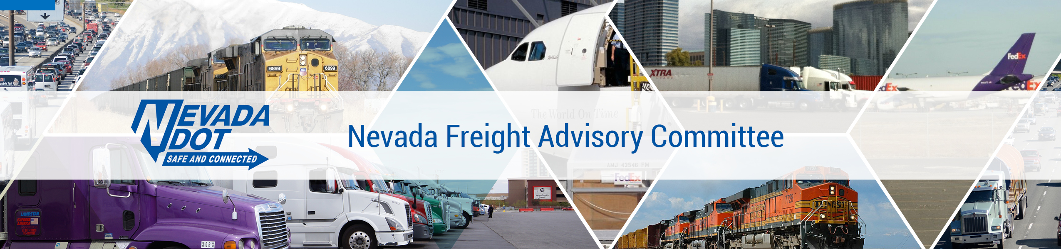
Nevada Freight Advisory Committee
Meeting Agenda
Welcome and Introductions
Role of Freight Advisory Committee
Re-Designation of the Primary Highway Freight System (PHFS)
Nevada State Freight Plan Update
RTC of Southern Nevada Freight Plan Overview
Open Discussion/Other Items

Slide 3
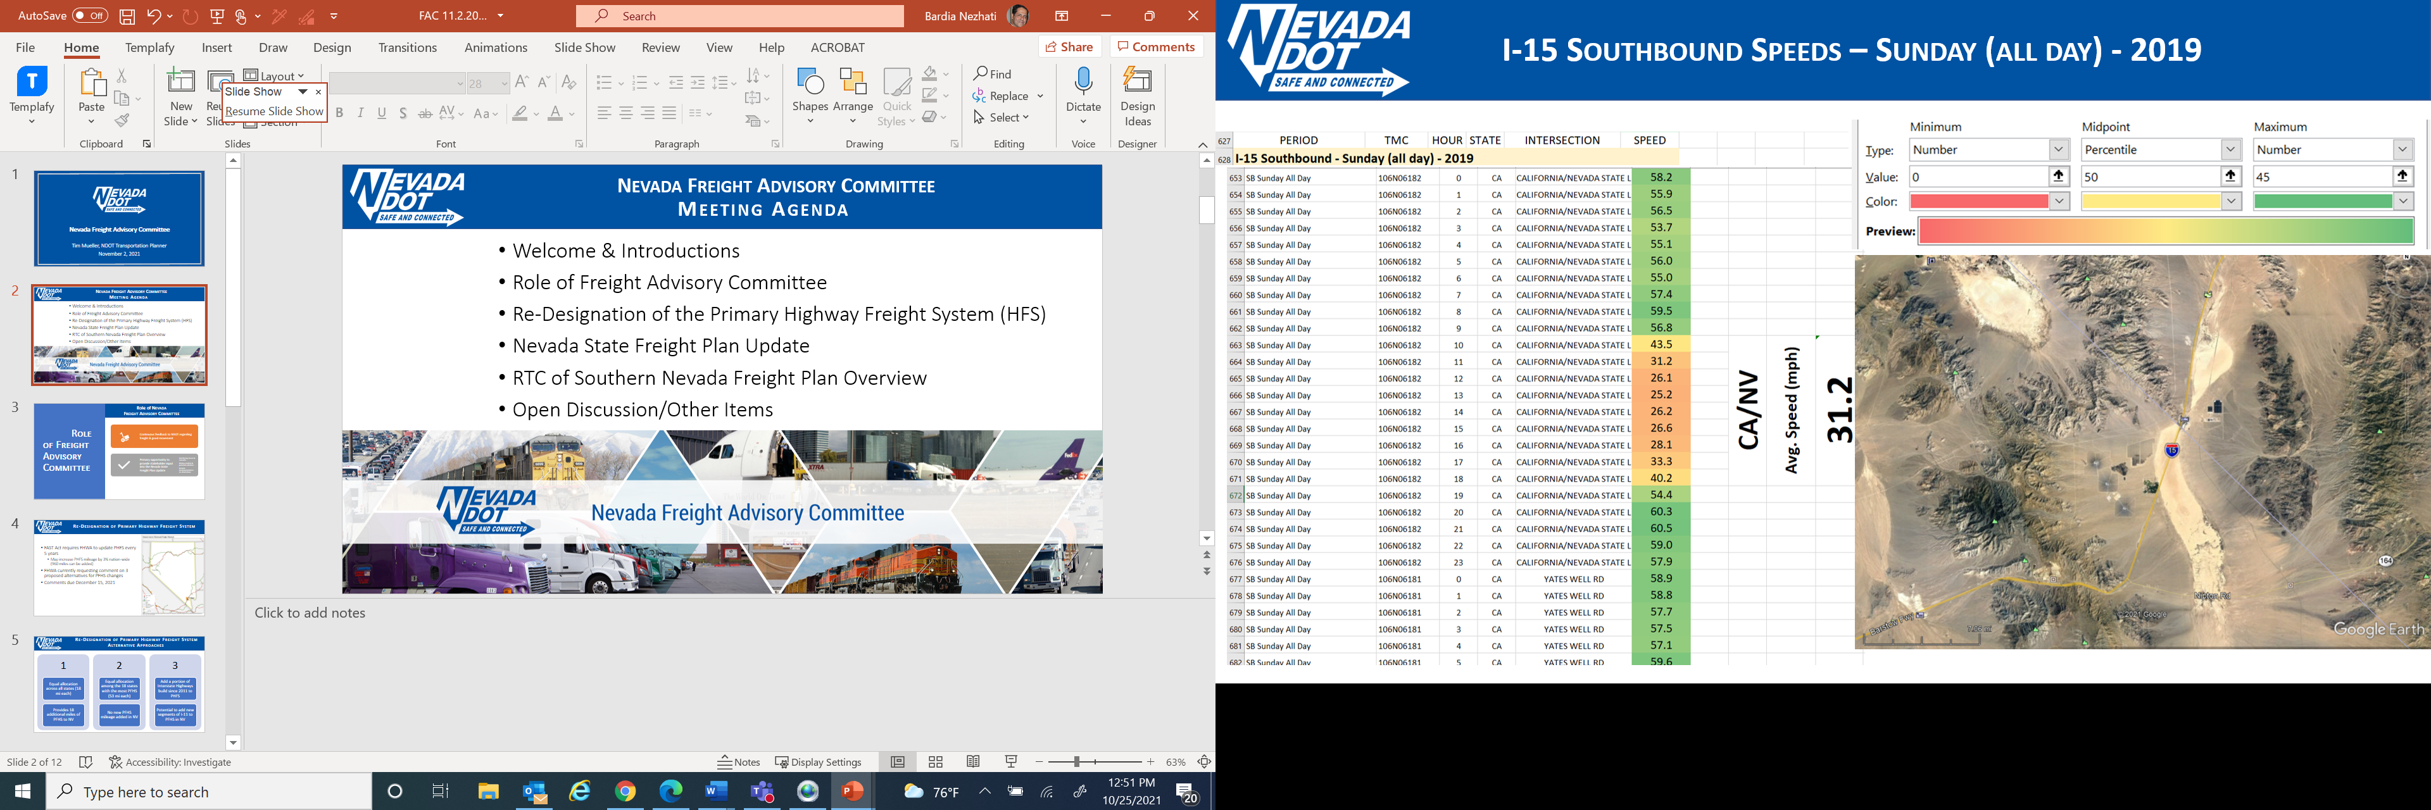




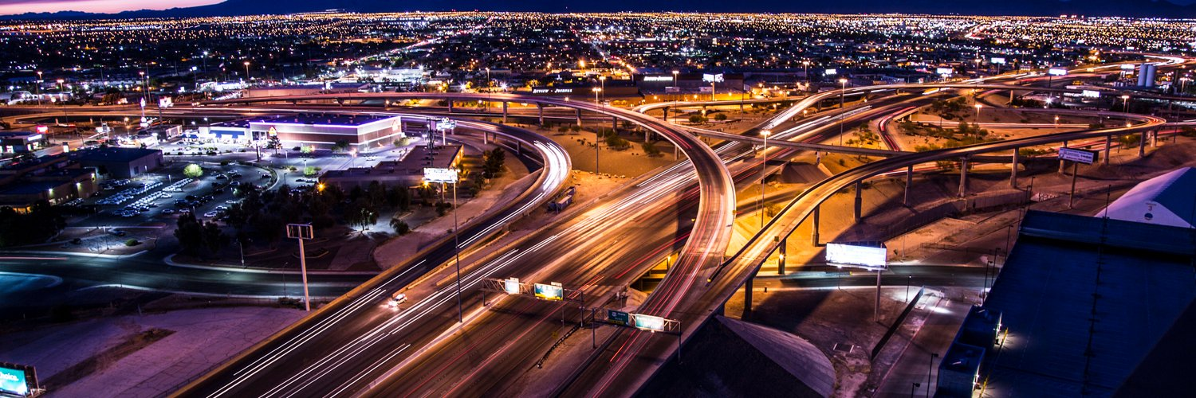

Role of FAC
Role of Freight Advisory Committee
Continuous feedback to NDOT regarding freight and goods movement
Primary conduit to provide stakeholder input into the Nevada State Freight Plan Update
Identify key freight issues and concerns
Review analysis and potential solutions
Provide recommendations on options and solutions

Slide 4
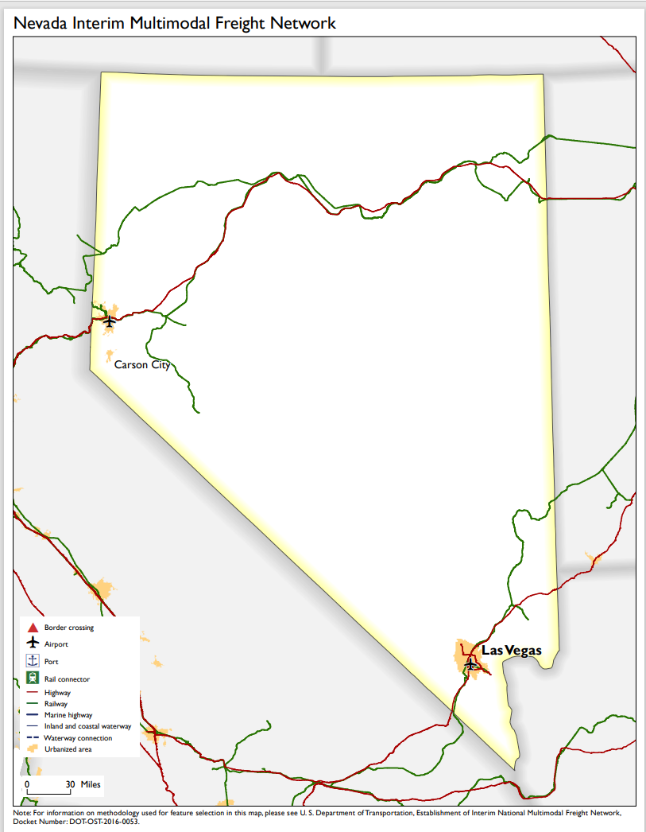
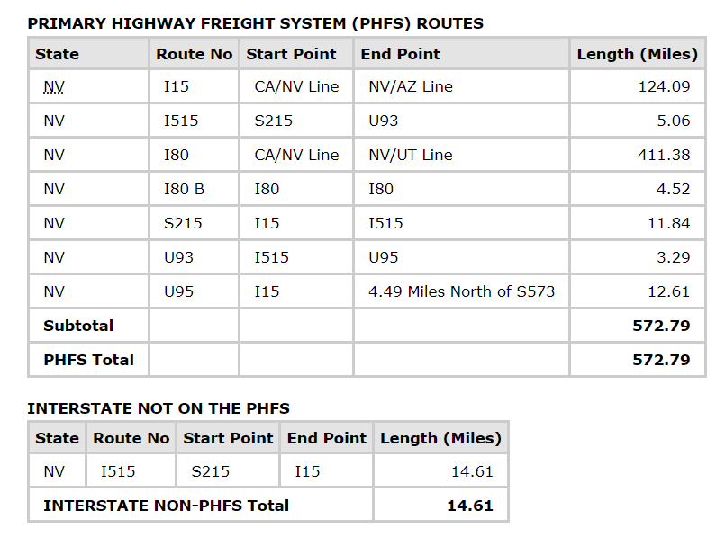
Re-Designation of Primary Highway Freight System
FAST Act requires FHWA to update PHFS every 5 years
  May increase PHFS mileage by 3% nation-wide (960 miles can be added)
FHWA currently requesting comment on 3
proposed alternatives for PFHS changes
Comments due December 15, 2021

Slide 5

Re-Designation of Primary Highway Freight System
Alternative Approaches
OPTION
OPTION
OPTION
1
Equal allocation across all states (18 miles each)
Provides 18 additional miles of PFHS to NV
2
Equal allocation among the 18 states with the most PFHS (53 miles each)
No new PFHS mileage added in NV
3
Add a portion of Interstate Highways built since 2011 to PHFS
Potential to add new segments of I-11 to PFHS in NV
NDOT Team’s Preliminary Recommendation:
The best option for NDOT is probably Option 1 because it guarantees each state additional mileage.
Option 3 would be the second-best option because NDOT has new Interstate on I-11 to add, but this option lacks certainty since it will compete with 1,500 other miles of new Interstate across the U.S.
Option 2 is the worst option since Nevada would not receive any additional milage.

Slide 6
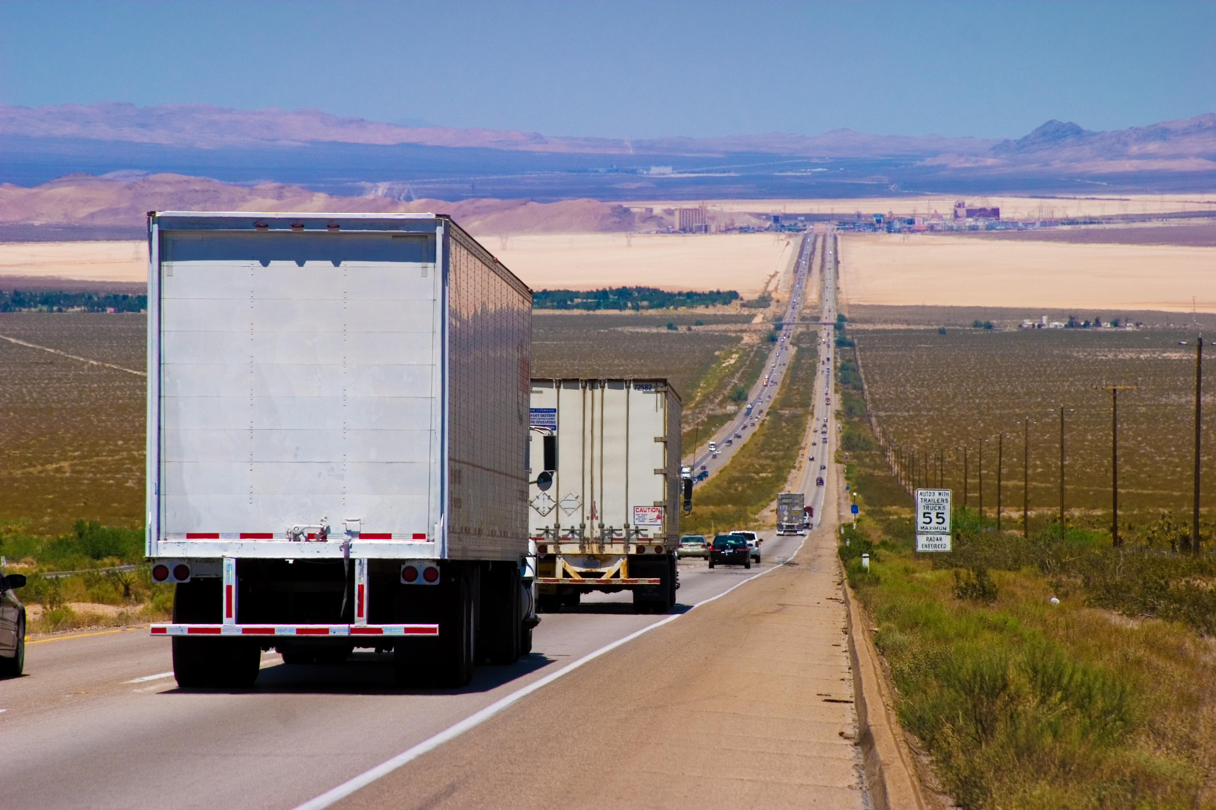
Nevada State Freight Plan Update Objectives
Why Update the Freight Plan?
Meet FAST Act requirements
Support eligibility for federal funding
Identify key freight infrastructure investments
Reflect recent improvements
  Completion of Project Neon
  Initiation of Reno Spaghetti Bowl Xpress
  Other key projects/actions

Slide 7
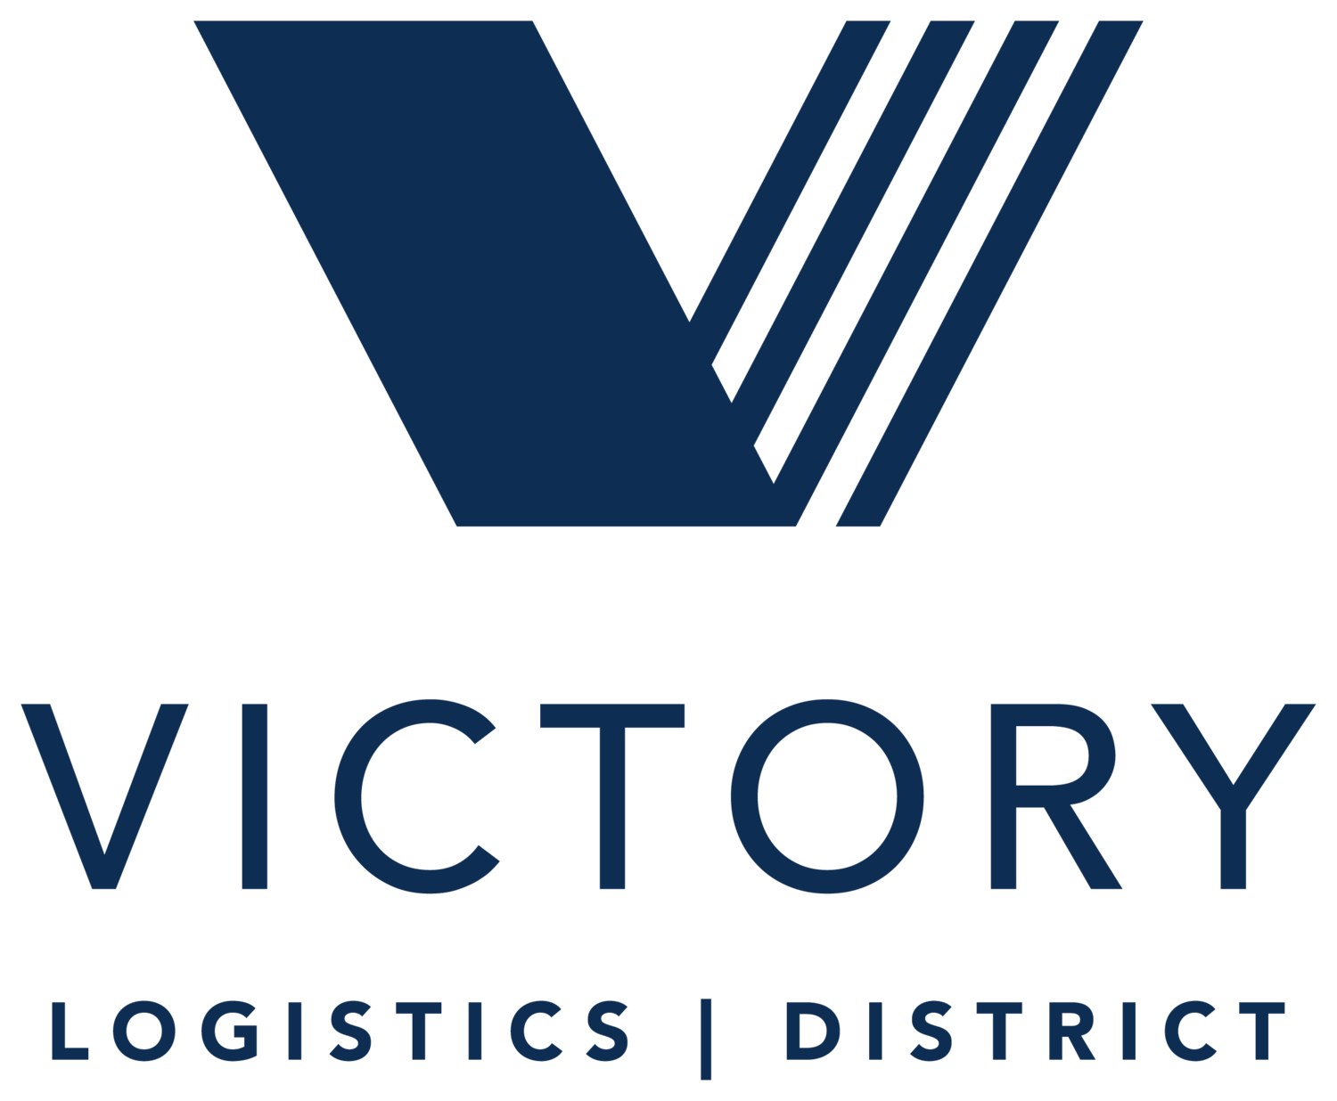
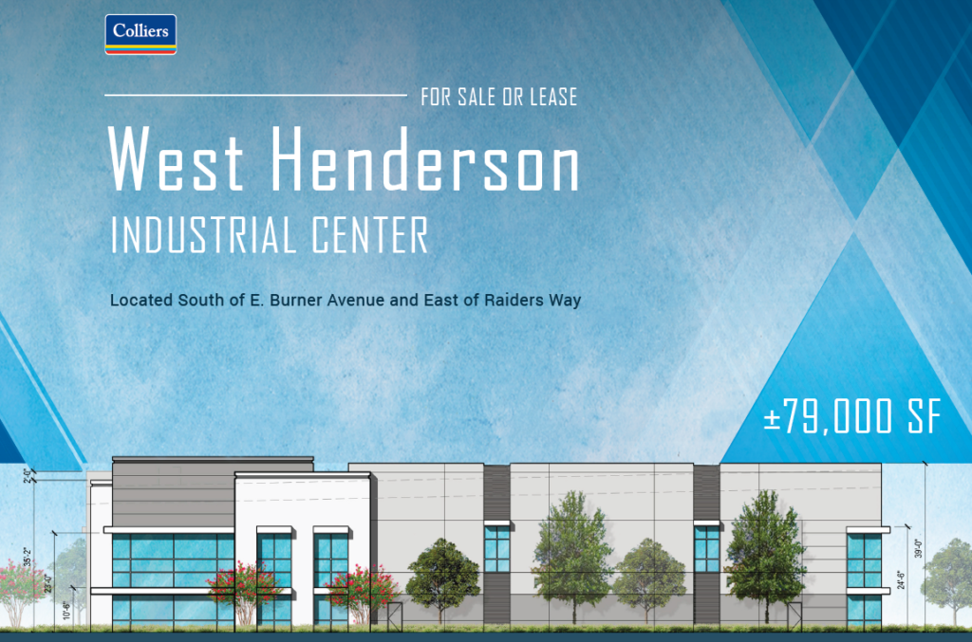
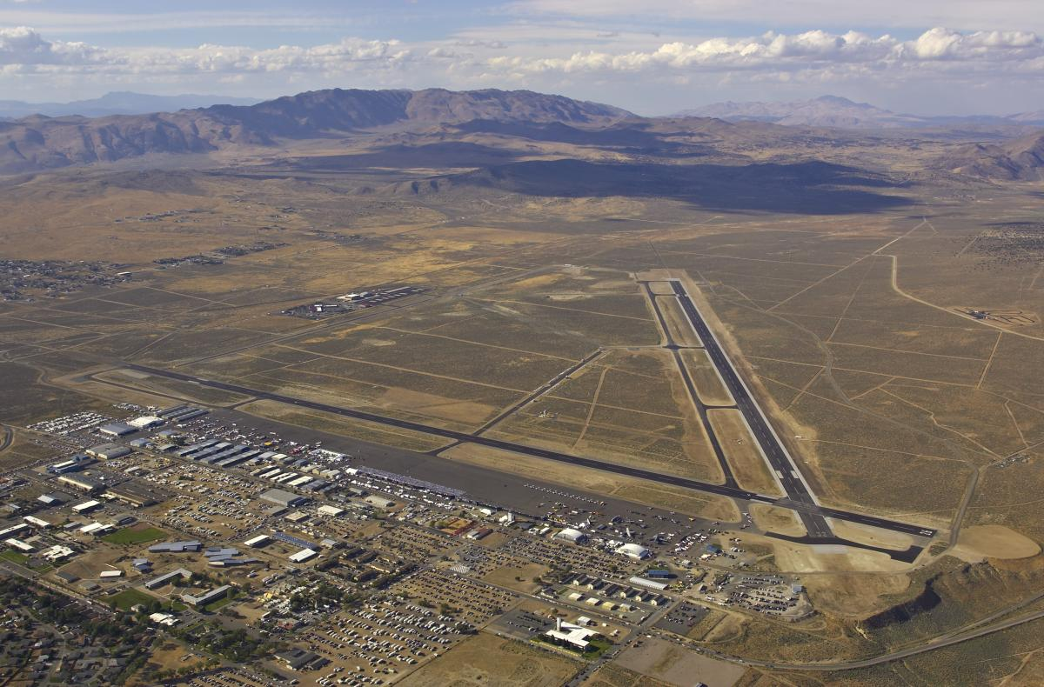
Nevada State Freight Plan Update
Why Update the Freight Plan?
Address changing needs
  Diversification of economy to expand manufacturing, logistics and distribution sectors
  Impacts of COVID-19
    Increasing e-commerce and shipping needs
    Impacts to supply chain
  National focus moving freight out of CA ports
  Focus on sustainability & climate action
    Reducing GHG and emerging vehicle technologies
    Supporting State climate goals
  Others for discussion?
Reno-Stead Airport

Slide 8
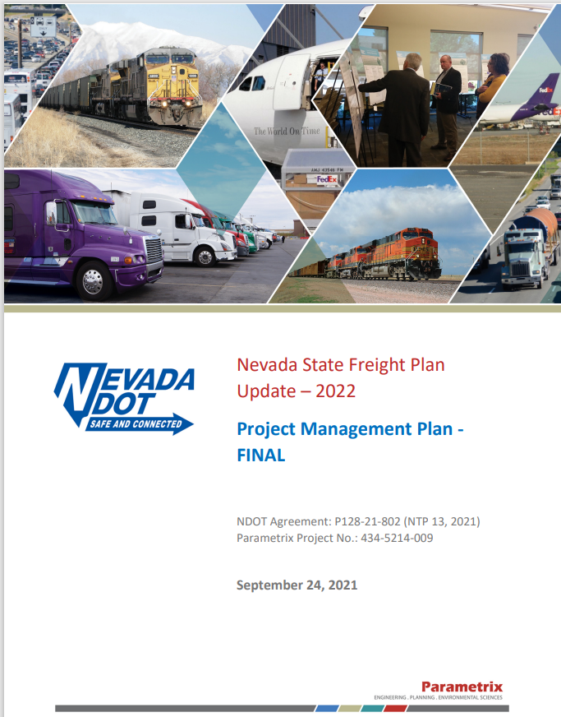
Nevada State Freight Plan Update
Key Tasks
Stakeholder Outreach
Freight Supply Chain
  Key location, infrastructure and trends
Sustainable Freight Transportation
Freight Performance Reporting and Needs Assessment
Risk-Based Management
  Scenario analysis to study supply chain impacts, vehicle mode and route, and truck parking plan implementation
Freight Plan Strategies and Investment Plan

Slide 9
Nevada State Freight Plan Update
Schedule
WE ARE HERE
MUST FINISH

Slide 10
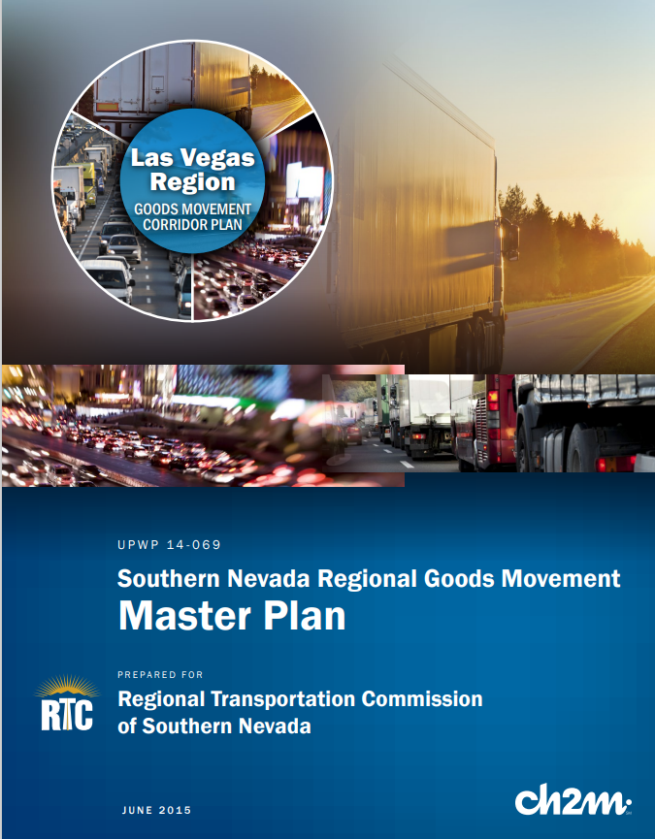
RTC of Southern Nevada Freight Plan
Plan update currently under development
  Initiated December 2020
Purpose of plan:
  Develop transformational policies and infrastructure improvements needed to integrate SNV into global supply chains and strengthen the economy

Slide 11
Open Discussion/Other Items
Discussion among FAC members

Slide 12
Tim Mueller, Freight Program Manager tmueller@dot.nv.gov | 775-888-7351

