Slide 1
Nevada 511 Update
FAC Meeting
November 2nd, 2022

Slide 2
01
Nevada 511 Background
02
Nevada 511 Update
03
Future Updates
04
Questions

Slide 3
01
Nevada 511 Background

Slide 4
Nevada 511 Background
What is Nevada 511?
Nevada 511 is a free phone and web service that brings together traffic and transportation information into a one-stop resource for commuters and motorists in Nevada
Nevada 511 provides motorist information about crashes, construction, road conditions , emergency alerts and weather
Users can access Nevada 511 through 3 interfaces:
The nvroads.com website
Dialing “511” by phone from anywhere in Nevada
The Nevada 511 mobile app
Web
Phone
App

Slide 5
Nevada 511 Background
Available Features...
Traffic Speeds
Road Closures
Weather Alerts
Traffic Incidents
Construction
Special Events
Waze Reports (New!)
Road Conditions
Weather Radar (New!)
Rest Areas
Welcome Centers
Truck Parking
Trip Planner
Custom Alerts
Access to ITS Device Data...
Traffic Cameras
Weather Sensors
Dynamic Message Signs

Slide 6
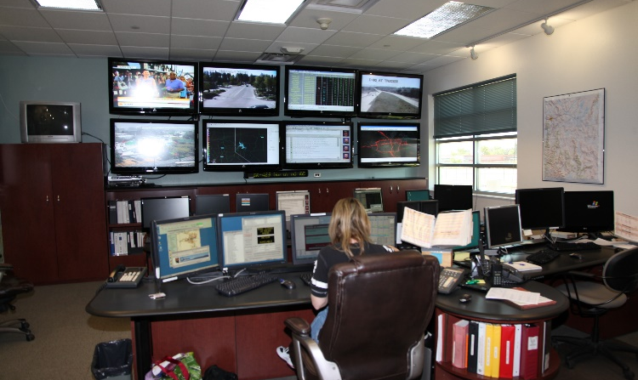
Nevada 511 Background
Where Data Comes From
ROC Operator Entries
ITS Device Data
Third Party Data
Nevada 511

Slide 7
Nevada 511 Update
Update Goals
User Friendly
Modern Design
Secure
Accessible
High Availability
The previous Nevada 511 System has been in operation since 2013
In 2020 NDOT Traffic Operations division began the process of procuring a contract to update the system
NDOT Traffic Operations employed a hands-on demo evaluation for the first time as part of the procurement
Procurement committee included representatives from all three Road Operation Centers

Slide 8
02
Nevada 511 Update

Slide 9
Nevada 511 Update
Previous Nevada 511
What’s New?
Enhanced Trip Planner
Improved Navigation and Base Map: Waze Reports and Google/Apple Map Data
Trucker Mode: Website and Mobile App
Updated interface for Web, Phone, and App – Cloud-based
Mobile App: Push Notifications & Drive Mode
New Nevada 511
New Nevada 511

Slide 10
Enhanced Trip Planner

Slide 11
Saving Favorite Cameras

Slide 12
Waze Reports

Slide 13
Trucker Mode

Slide 14
Setting Up My511 Notifications

Slide 15
Nevada 511 Upgrade
Mobile App Updates
While driving, the app will automatically go to Drive Mode, which helps to conserve both battery and data usage while still providing audio alerts
Access to both your saved cameras and routes, which are automatically synchronized from the 511 website
The Traffic Alert feature will check a Saved Route for traffic events at a specified time and send you a notification each day to let you know if there are any issues on your route

Slide 16
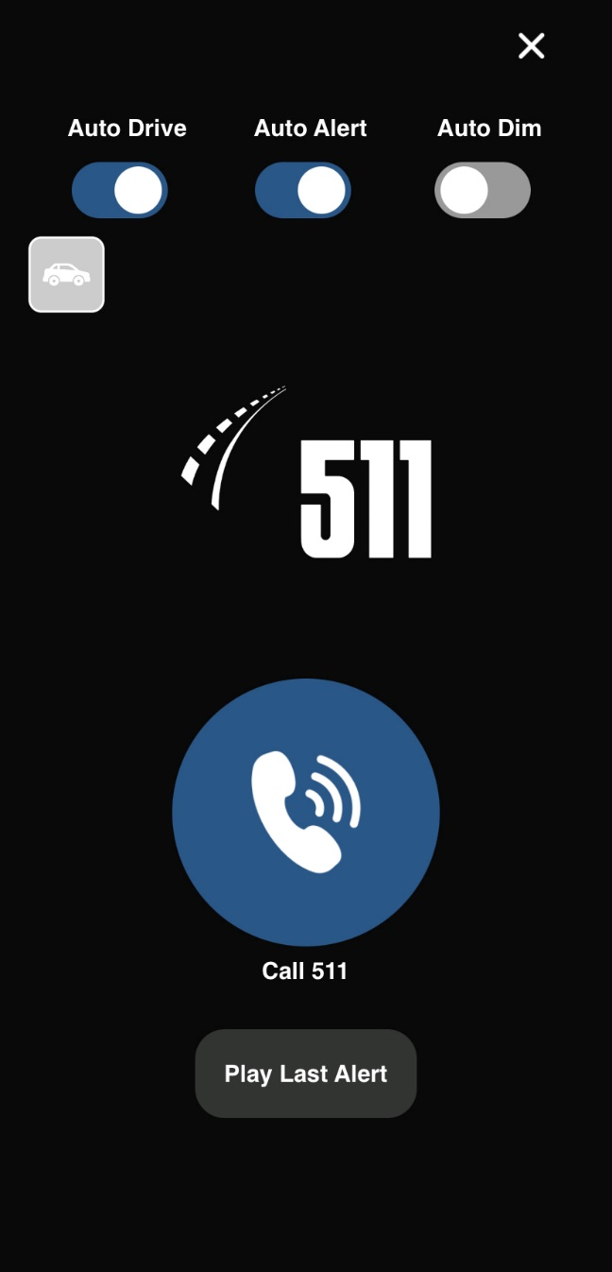

Slide 17
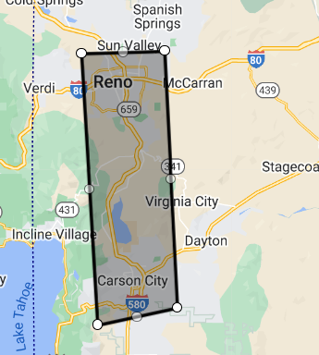
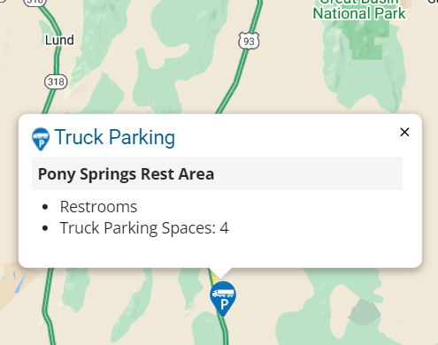
Other & Future Updates
Other new features:
Weather Radar
Light/Dark mode on website and mobile app
My Area notifications
Future updates:
Improved Trucker Mode Information:
Low Clearance
Restricted Route
Spring Thaw-Frost Restrictions

Slide 18
Weather Radar

Slide 19
04
Questions?

Slide 20
LaShonn Ford, PE
Senior ITS Project Manager
lford@dot.nv.gov
775-888-7566
Sonia Jacinto Acosta
ITS Project Manager
sjacintoacosta@dot.nv.gov775-888-7864

Slide 21
Nevada Freight Plan Update
Nevada Freight Advisory Committee Meeting
November 2, 2022

Slide 22
1.
Study Schedule
2.
Key Tasks
3.
Critical Freight Corridors
4.
Next Steps

Slide 23
Nevada Freight Plan Update Study Schedule
Based on discussions with FHWA and to maintain eligibility for federal freight funding, NDOT approached the Freight Plan Update in two-steps:
Step #1 - prepared an Interim/Immediate Update to the Nevada Freight Plan – Approved by FHWA
Step #2 - is to prepare an amended Final Update by January 2023

Slide 24
Freight Plan Update Key Tasks
Will meet FAST Act/BIL requirements
Support eligibility for federal funding
Identify key freight infrastructure investments
Include interaction with the MPOs
Include analysis of truck GPS data
Update to the critical urban and critical rural freight corridors

Slide 25
Critical Freight Corridors
These are public roads in urbanized areas which provide access and connection to the PHFS and the Interstate. Connections with public transportation facilities, ports, or other intermodal transportation facilities.
States and in certain cases, MPOs, are responsible for designating public roads for the Critical Rural Freight Corridors (CRFCs) and Critical Urban Freight Corridors (CUFCs) in accordance with section 1116 of the FAST Act.
Data-driven approach for designation of CRFCs and CUFCs:
Input Layer:
Current critical corridors
Recommendations by MPOs
Recommendations by NDOT Districts
Validation Layer:
Truck GPS Data
HPMS Data (Truck AADT)
Truck Travel Time Reliability Index
Prioritization Layer:
Identify limits using data
Focus of 8-year priorities

Slide 26
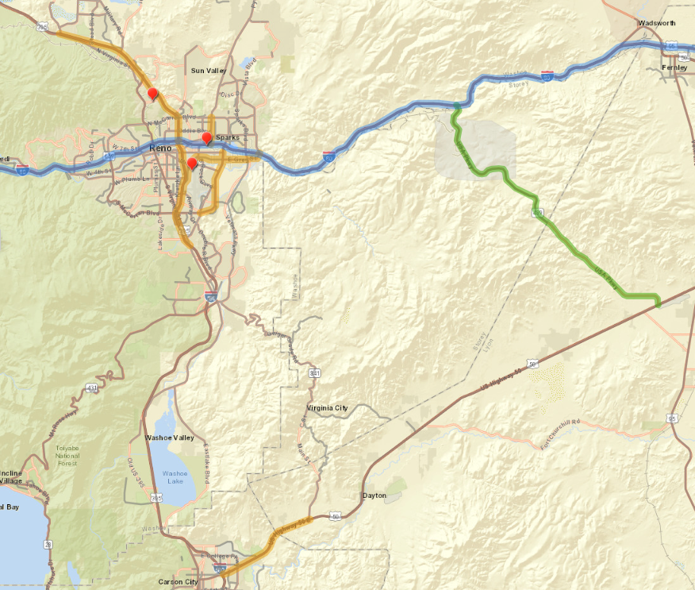
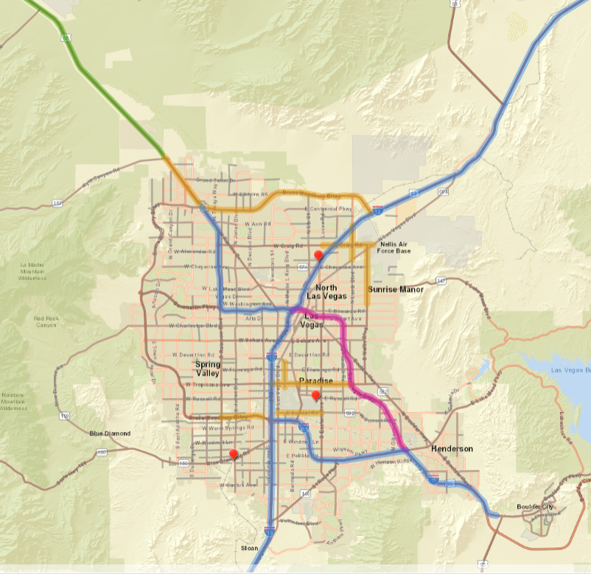
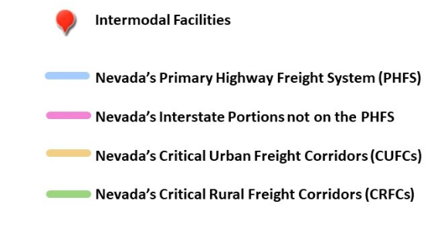
Existing Freight Network Designations

Slide 27
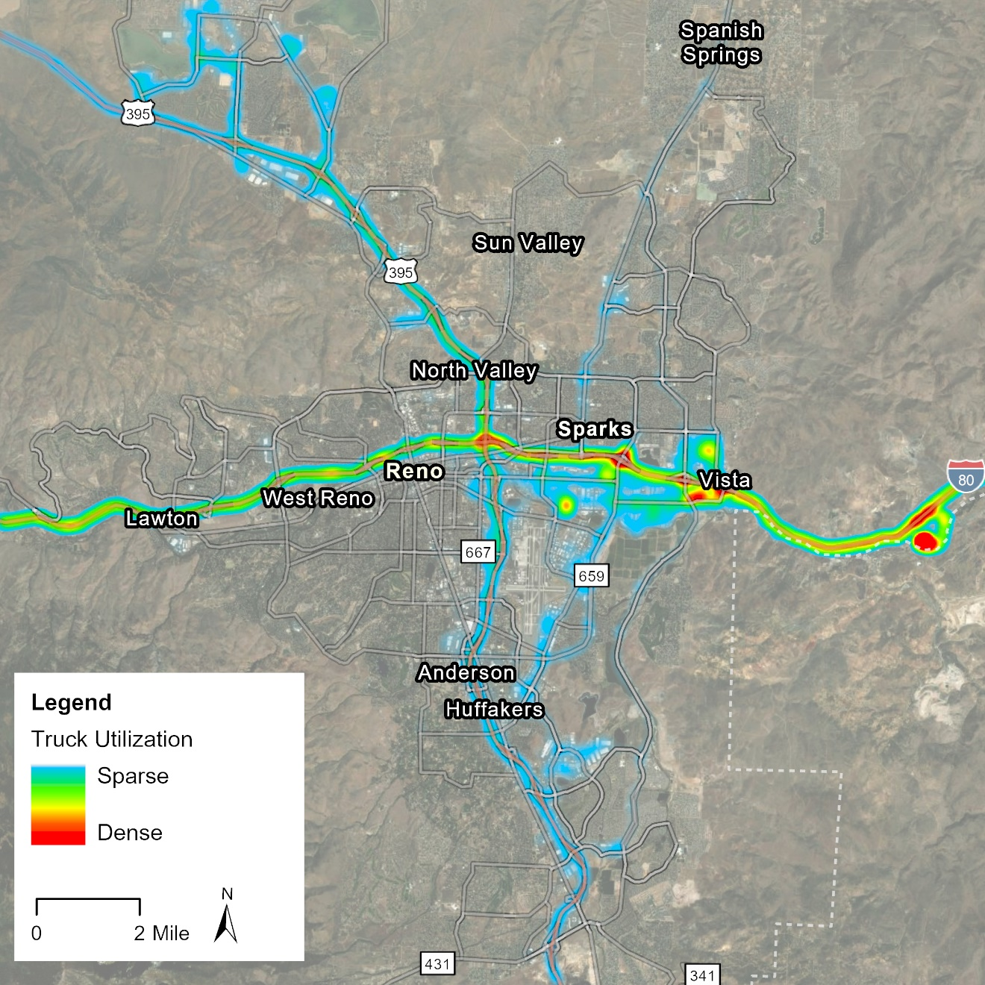
Critical Urban Freight Corridors
Working with Washoe RTC to identify urban freight corridors in Reno/Sparks Metro Area:
Review segments of Military Road, Moya Boulevard, Lemmon Drive, or Red Rock Road
Review McCarran Boulevard priority area from Greg Street to Prater Way
Review segments of Sparks Boulevard or Vista Parkway

Slide 28
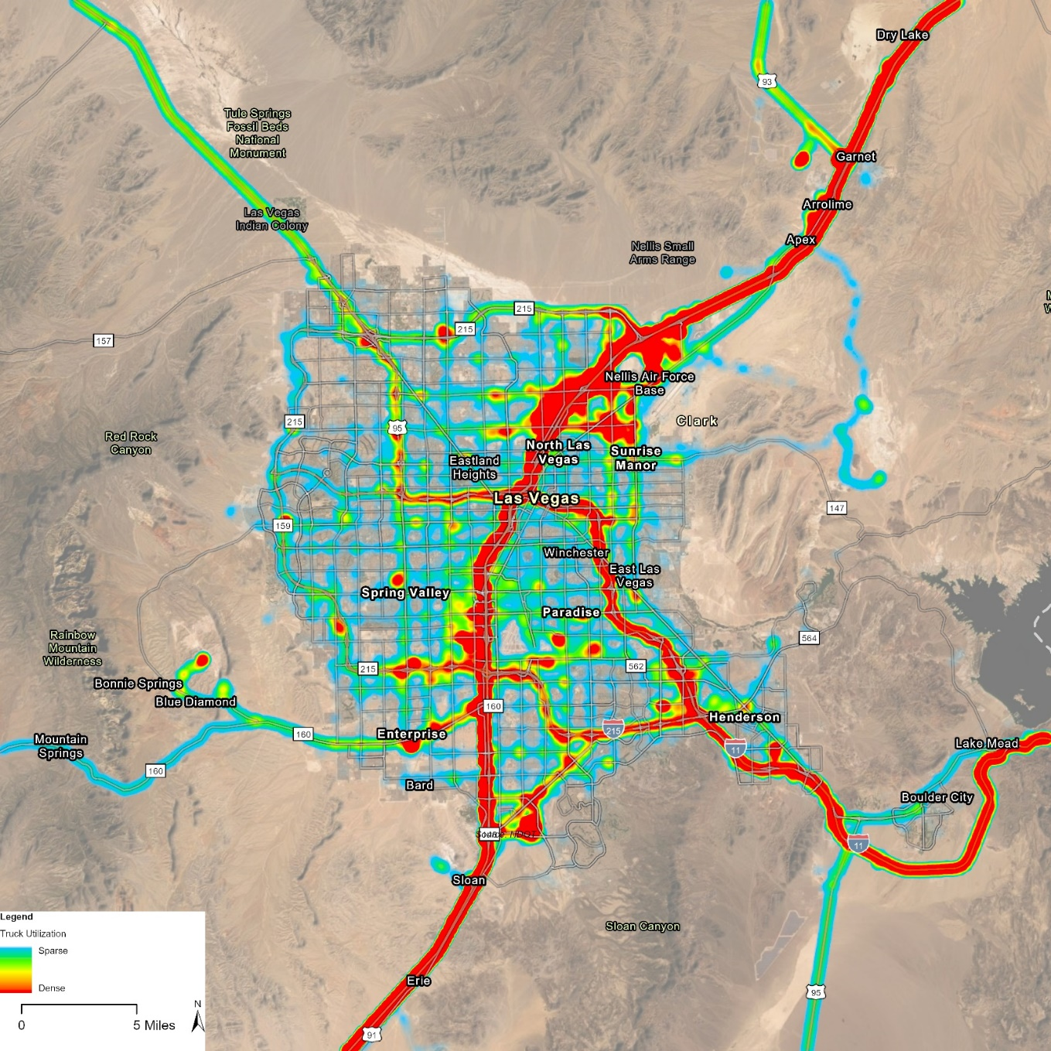
Critical Urban Freight Corridors
Working with RTC SNV to identify urban freight corridors in Las Vegas Metro Area:
Truck GPS data shows truck utilization is consistent with major corridors identified in Southern NV Freight Plan Update

Slide 29
Critical Urban Freight Corridors
Working with RTC SNV to identify urban freight corridors in Las Vegas Metro Area:
Truck GPS data shows truck utilization is consistent with corridors identified in Southern NV Freight Plan
Source: Southern Nevada Freight Plan Update, RTCSNV, April 26, 2022

Slide 30
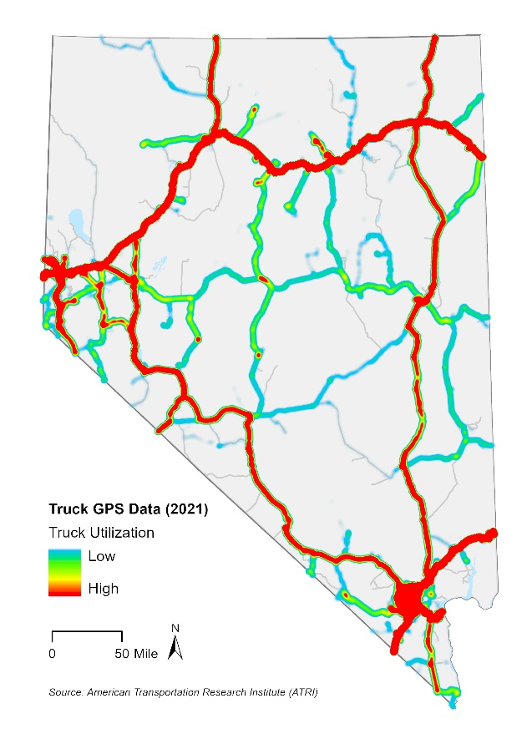
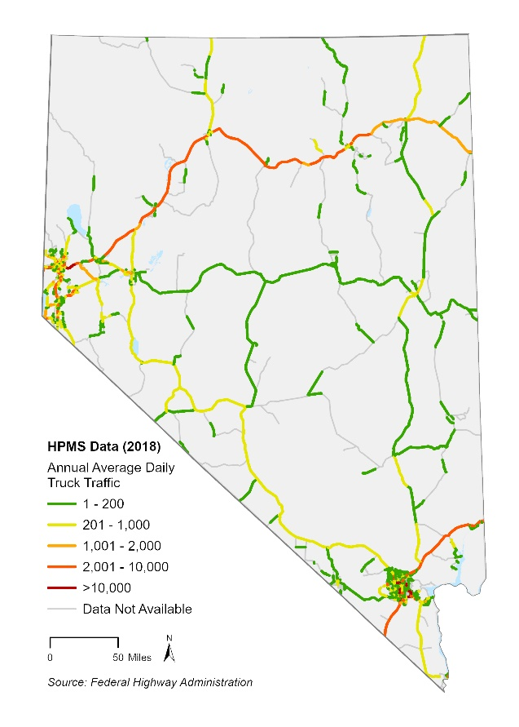
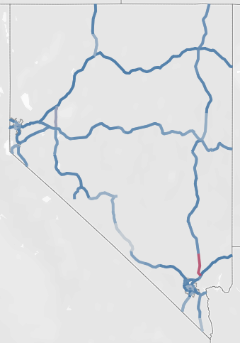
Critical Rural Freight Corridors
Working with NDOT Safety Division and the Districts to identify critical rural freight corridors:
Considering multiple datasets, including Truck GPS data, Highway Performance Monitoring System (HPMS) data and Truck Reliability Index

Slide 31
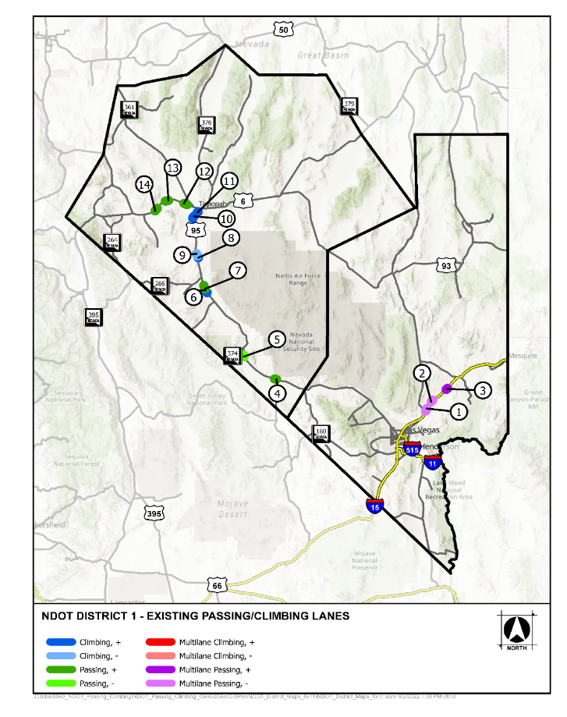
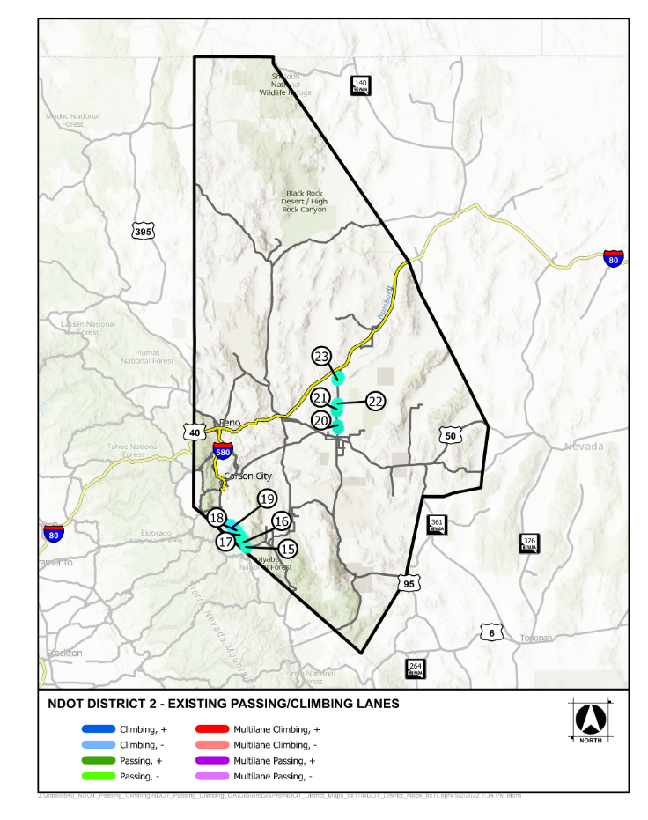
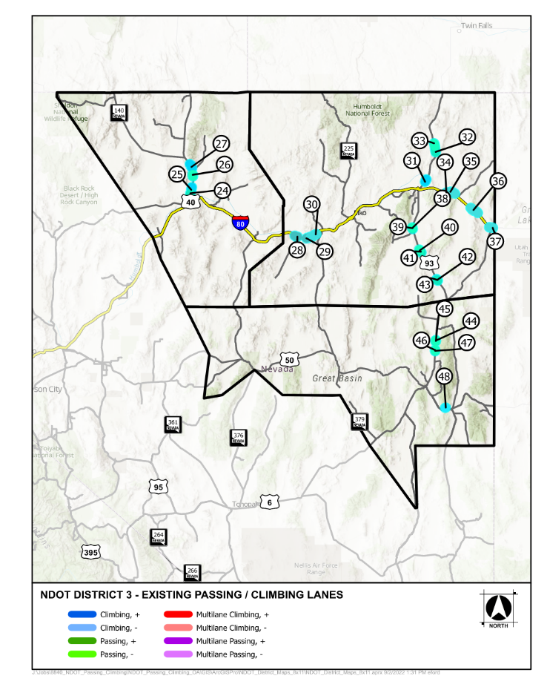
Critical Rural Freight Corridors
Working with NDOT Safety Division and the Districts to identify critical rural freight corridors:
Input from Passing and Climbing Lanes Prioritization Study (currently on-going)
draft
draft
draft

Slide 32
Next Steps
Coordinate with NDOT Districts on existing rural freight corridors
Provide NDOT with recommendations for changes to the CUFCs and CRFCs
Finalizing CUFCs and CRFCs by including them in the Final Nevada Freight Plan and submitting an official letter to FHWA identifying the location and length of each CUFC and CRFC
Identify critical projects for the 8-year freight investment plan
Submit updates to the Nevada Freight Plan to FHWA for approval

Slide 33
Thank You!

Slide 34
Tim Mueller & Nate Brown NDOT Freight Program Team freight@dot.nv.gov
November 2, 2022

