Slide 1
US 50 East Shore CMP
Transportation Board Update
3/11/2024

Slide 2
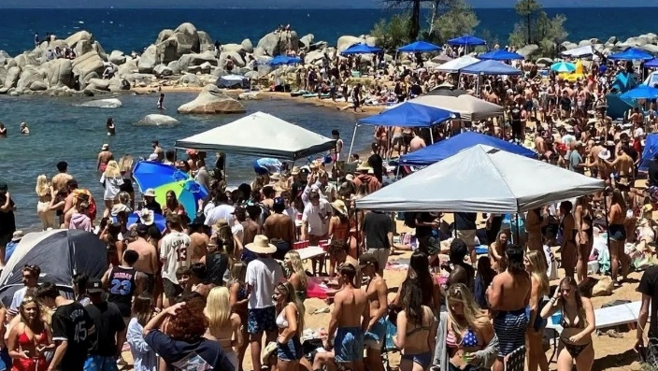
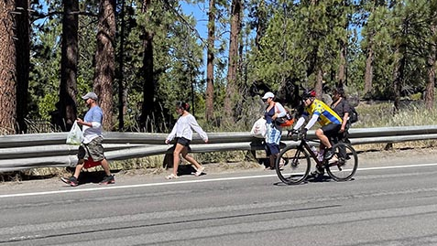
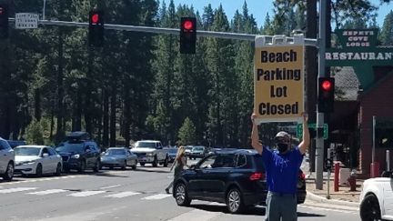
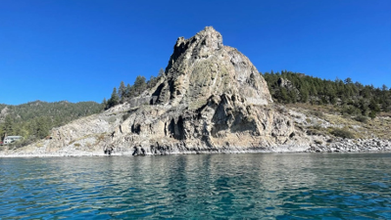
Study Purpose and Need
Safety
Recreation
Multimodal
Technology
Environment
Notes:
Safety – The corridor averages over 100 crashes per year and 85% of the 13-mile corridor exceeds statewide average crash rates for similar facilities
Multimodal - Only 8% of the corridor contains sidewalks or is served by transit, only 19% has bike facilities
Recreation - Demand for recreation access and parking far exceeds capacity during peak periods and management strategies are critical
Environment - Heavy visitation negatively impacts the environment and degrades water quality
Technology - There are significant communication gaps and lack of traveler information such as dynamic parking information

Slide 3
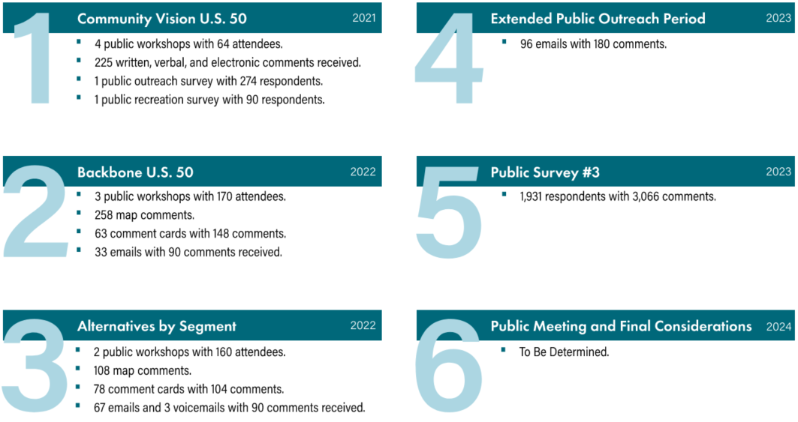
Public Outreach & Engagement
Notes:
Add numbers to #6 by board meeting

Slide 4
CMP Safety Recommendations
Pavement marking and edge striping countermeasures.
Eliminate all on-highway parking on U.S. 50.
Improved pedestrian crossings.
New signs including speed feedback and edge-lit speed limit signs.
Extending the Tahoe East Shore Trail.
Establishment of a multi-agency Safety and Operations Committee.
Interconnecting signals and adding dilemma zone protection.
Lane reduction recommendations are no longer included.
Notes:
The CMP identifies 10 early action safety improvements. These are easily advanced or implemented over the next 2-3 years to start making a difference quickly. These include…
Another 16 safety improvements are identified for critical safety areas or those portions of the corridor that have the most safety and operational challenges. Examples include…

Slide 5
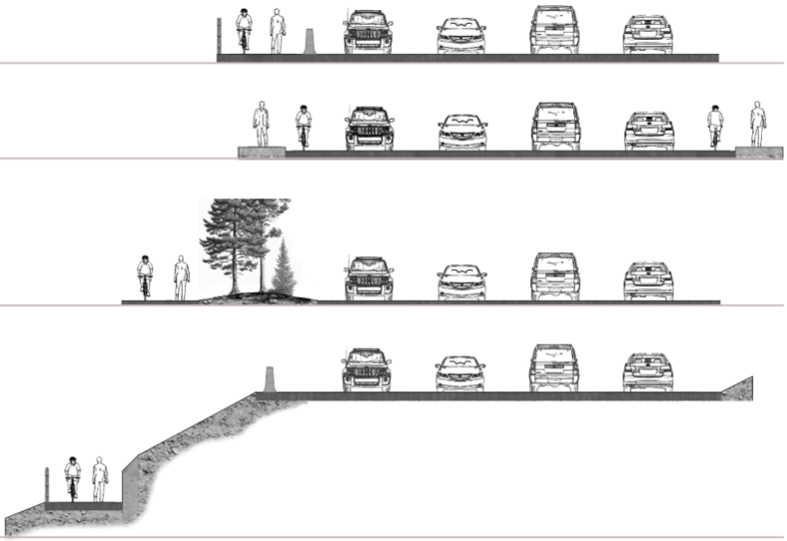
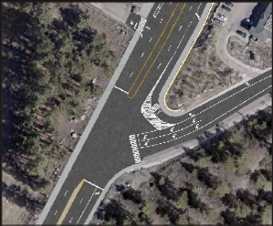
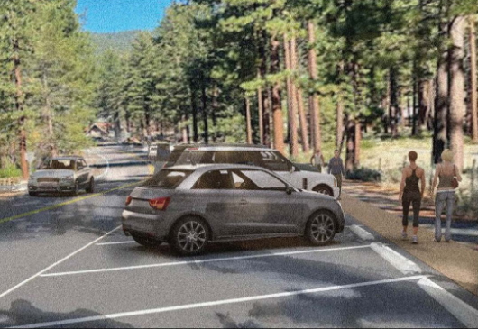
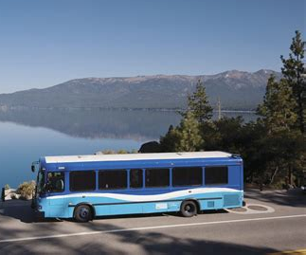
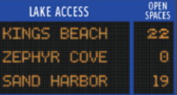
CMP Recommendations
Tahoe East Shore Trail Extension
Intersection Improvements
Parking Strategies
Transit Expansion
Technology, ITS, Comm.
Notes:
The CMP also identifies a range of supporting recommendations and strategies to improve safety, operations, mobility, and achieve the CMP goals

Slide 6
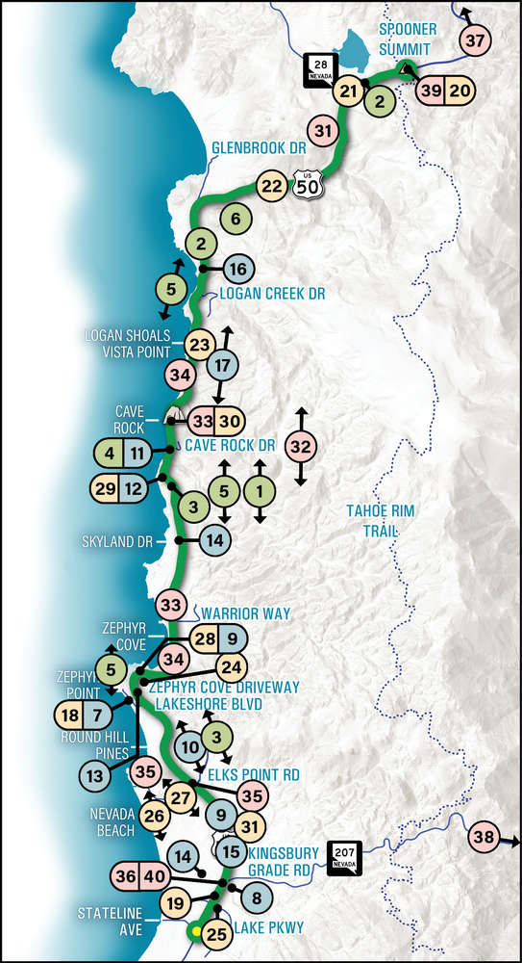
Implementation Matrix
Early Action (1-2 years)
Short-Term (2-5 years)
Mid-Term (5-10 years)
Long-Term (10+ years)
All recommendations pending further development, environmental analysis, and funding.

Slide 7
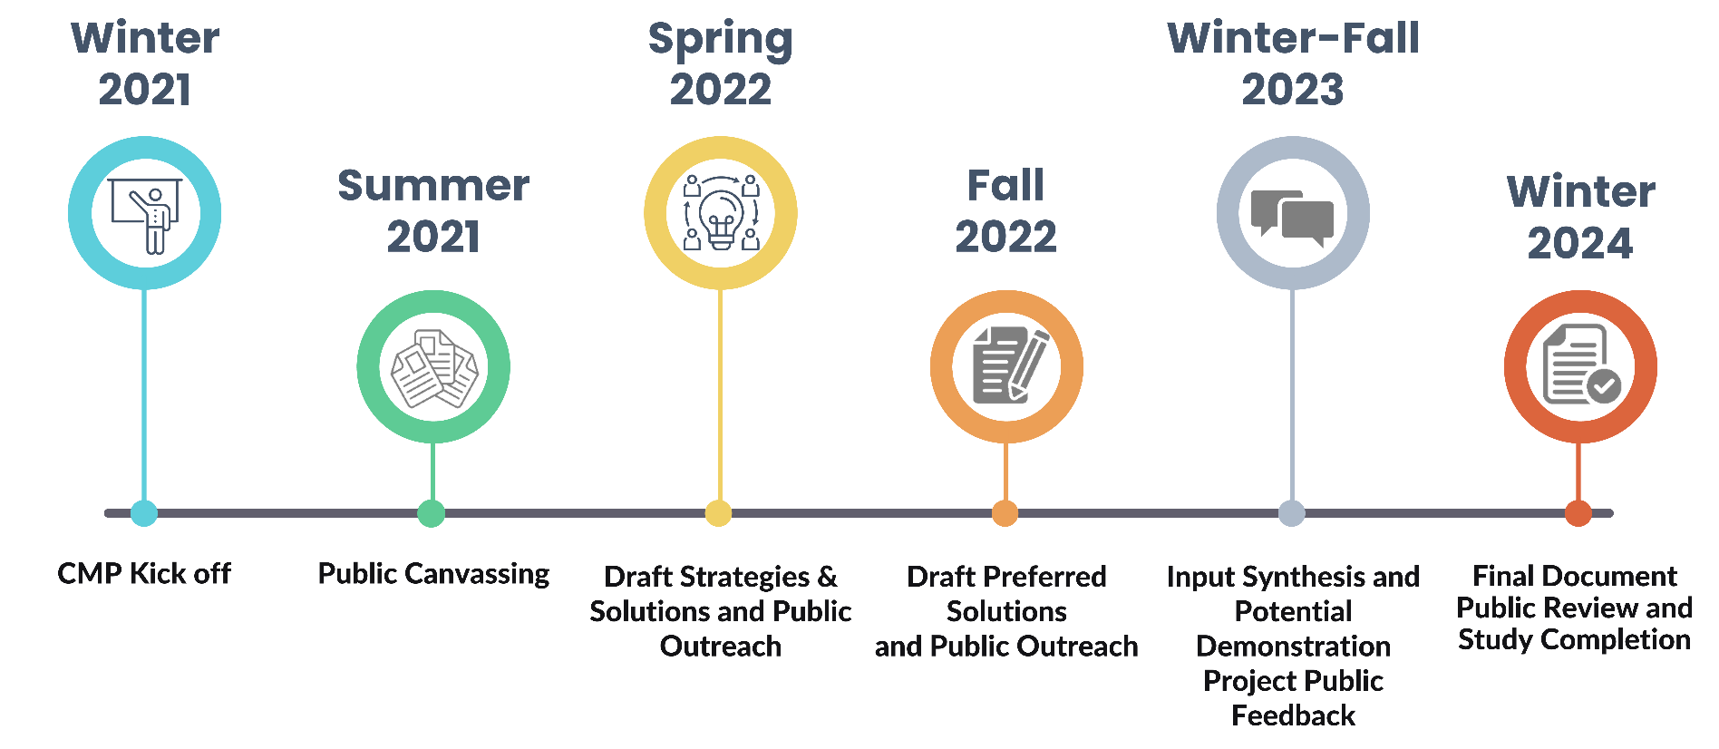
Study Timeline

