Slide 1
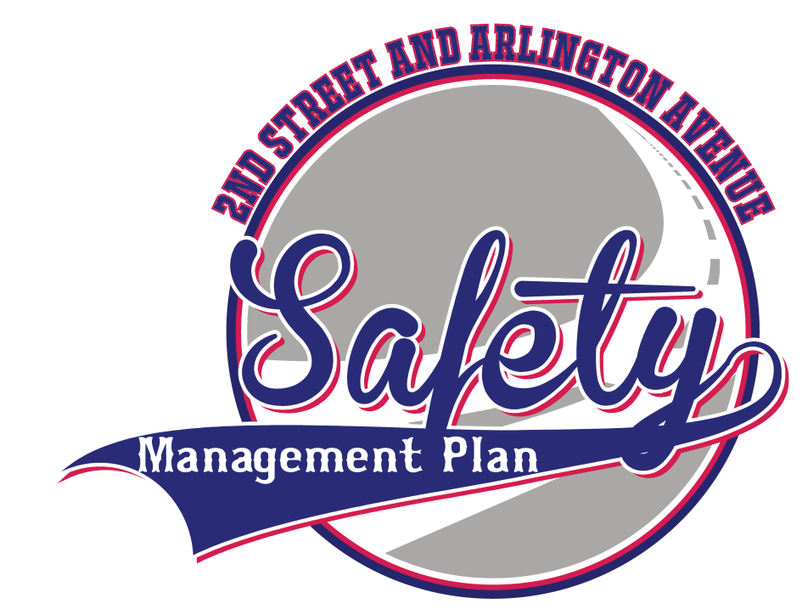


Safety Management Plan
2nd Street and Arlington Avenue
Stakeholder Working Group Meeting #1

Slide 2
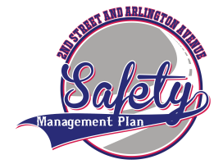
Agenda
Introductions
What is a SMP???
Corridor Overview
Other Area Projects & Plans
Crash Data Analysis
Sample Recommendations
Summary of RSA Recommendations
Study Process & Outreach
Adjourn

Slide 3
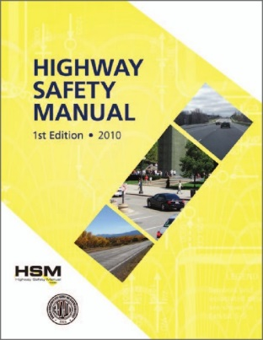
What is a SMP??
Transportation corridor study focused on safety over traffic operations / capacity analysis
Incorporates Highway Safety Manual methodologies
  Calculate estimated crash reduction
  Prioritization based on crash reduction
Final product is a planning document

Slide 4
SMP Goals
Improve Safety Through Overall Crash Reduction
Better Utilize Existing Infrastructure Across All Modes
Enhance Livability and the Users Transportation Experience

Slide 5
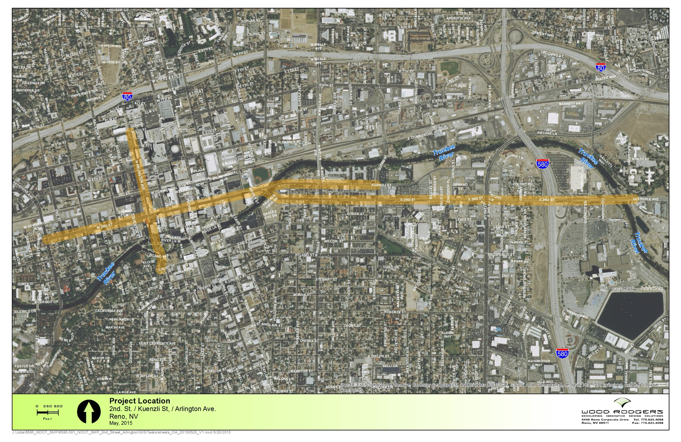
Corridor Overview
2nd Street – Keystone Ave to Galletti Way
Downtown Reno Core
Couplet System
Kietzke / I-580 Area

Slide 6
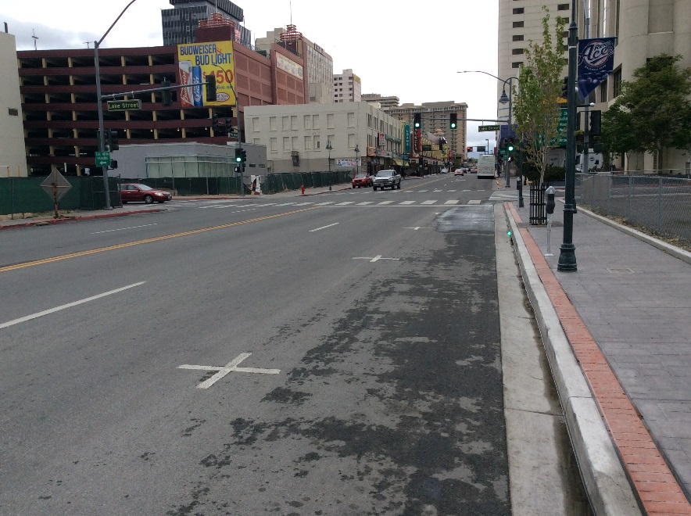
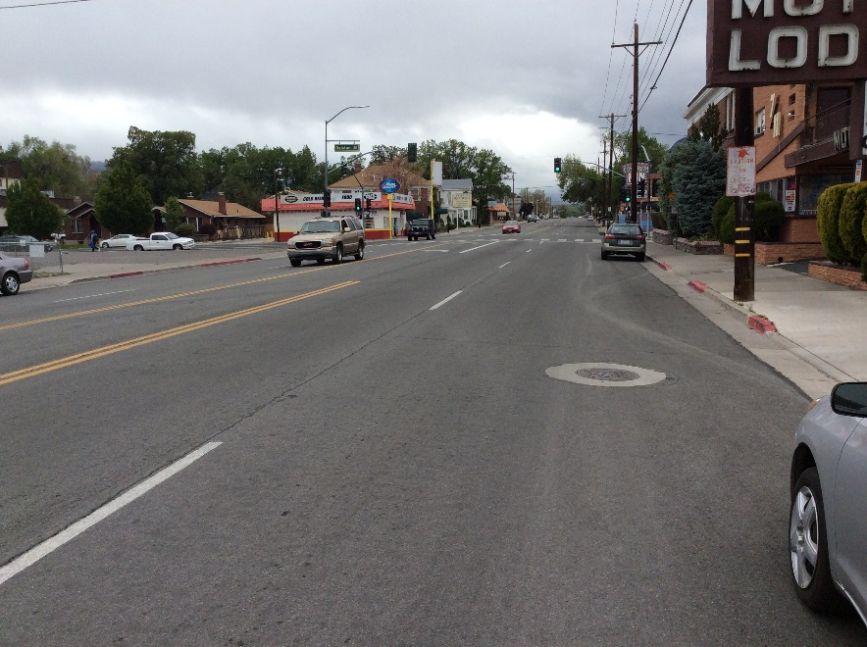
Downtown Reno Core
Keystone to Kuenzli
6300 AADT
4800 AADT

Slide 7
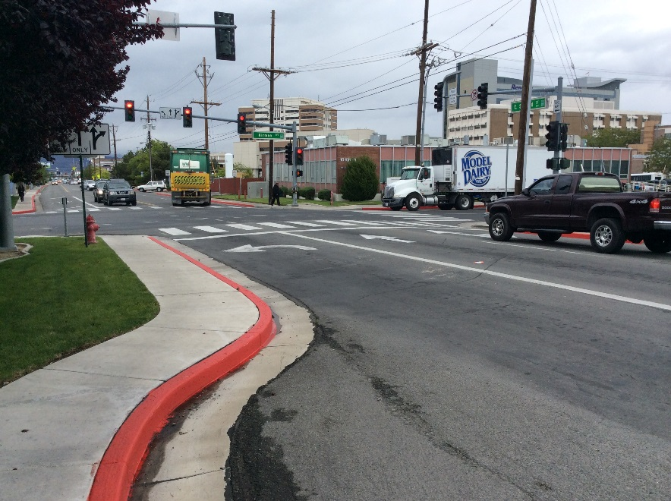
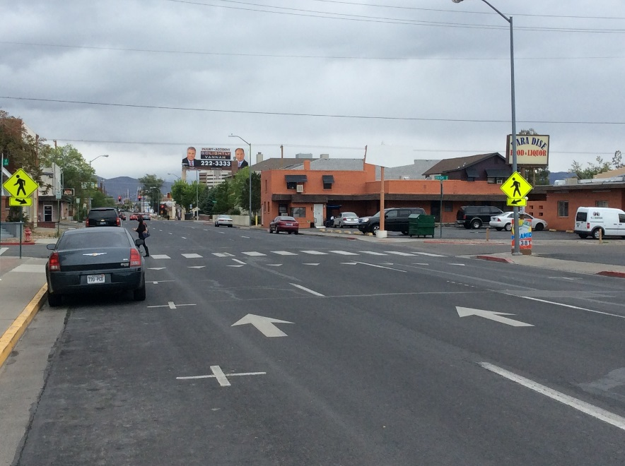
Couplet System
Kuenzli to Giroux
3200 AADT

Slide 8
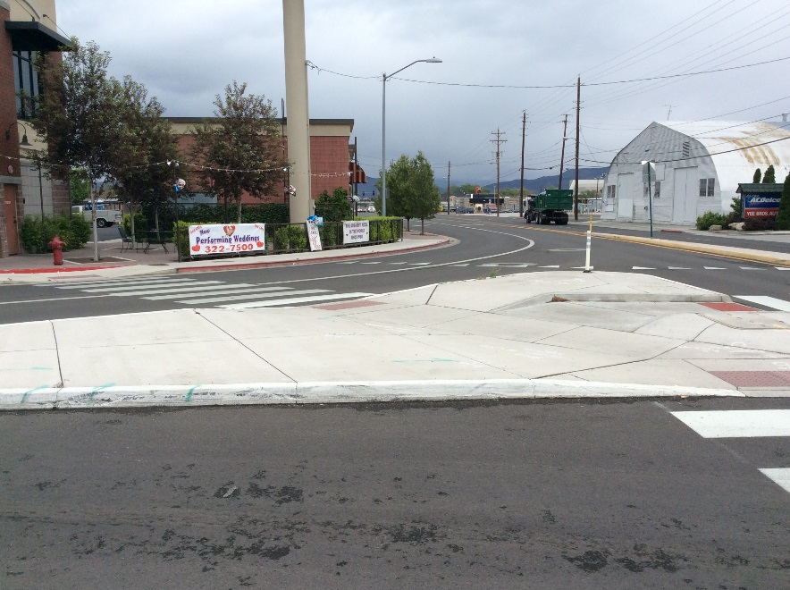
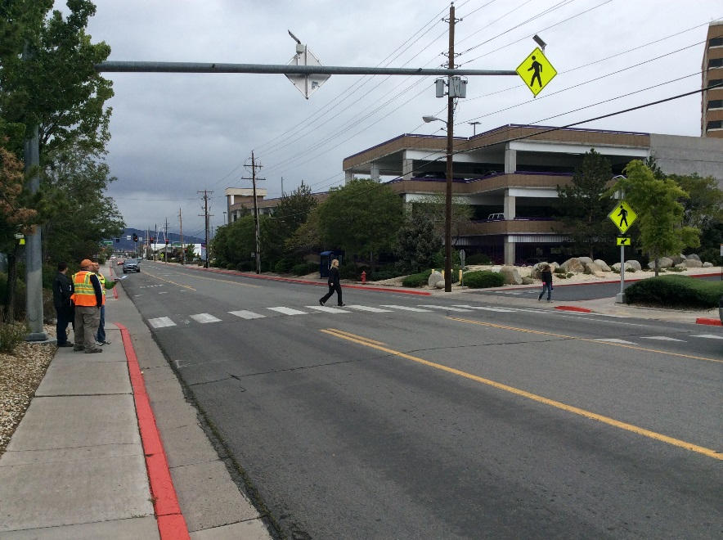
Couplet System
Kuenzli to Giroux
13500 AADT

Slide 9
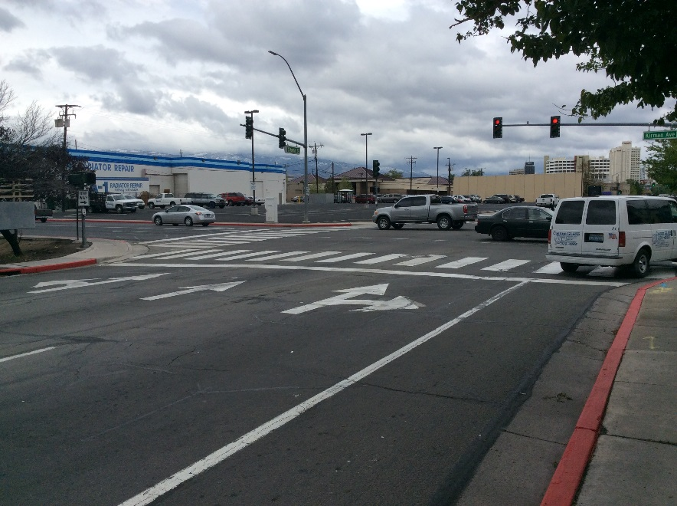
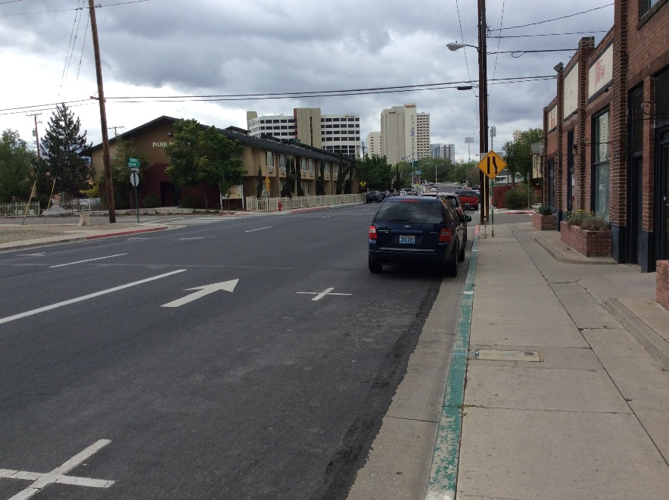
Couplet System
Kuenzli to Giroux
2600 AADT
4100 AADT

Slide 10
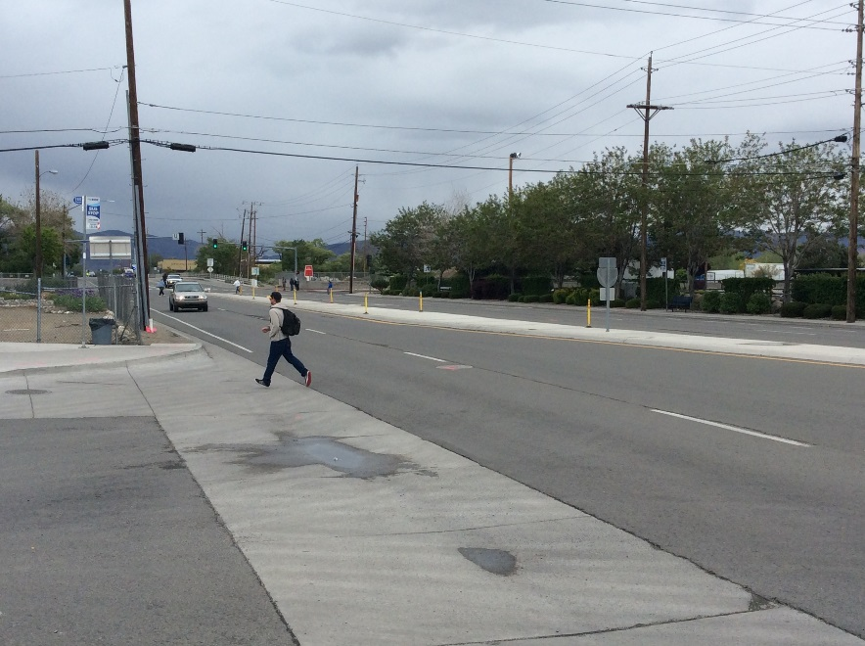
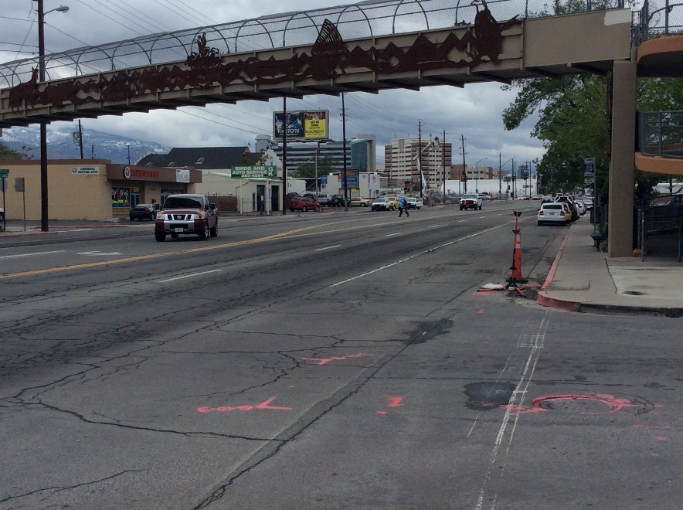
Kietzke/I-580 Area
Kuenzli to Giroux
14000 AADT
17000 AADT

Slide 11
Transit System

Slide 12
Other Area Project and Plans
Kietzke Lane SMP
Keystone Ave Corridor Study
Glendale Improvement Project
4th Street / Prater Way Corridor Study
City of Reno Masterplan Update
Oddie Blvd/Wells Ave Corridor Study
Regional Transportation Plan
Reno-Sparks Bike/Ped Plan
Others???

Slide 13
Crash Data Analysis
Keystone to Kirman

Slide 14
Crash Data Analysis
Wells to Galletti

Slide 15
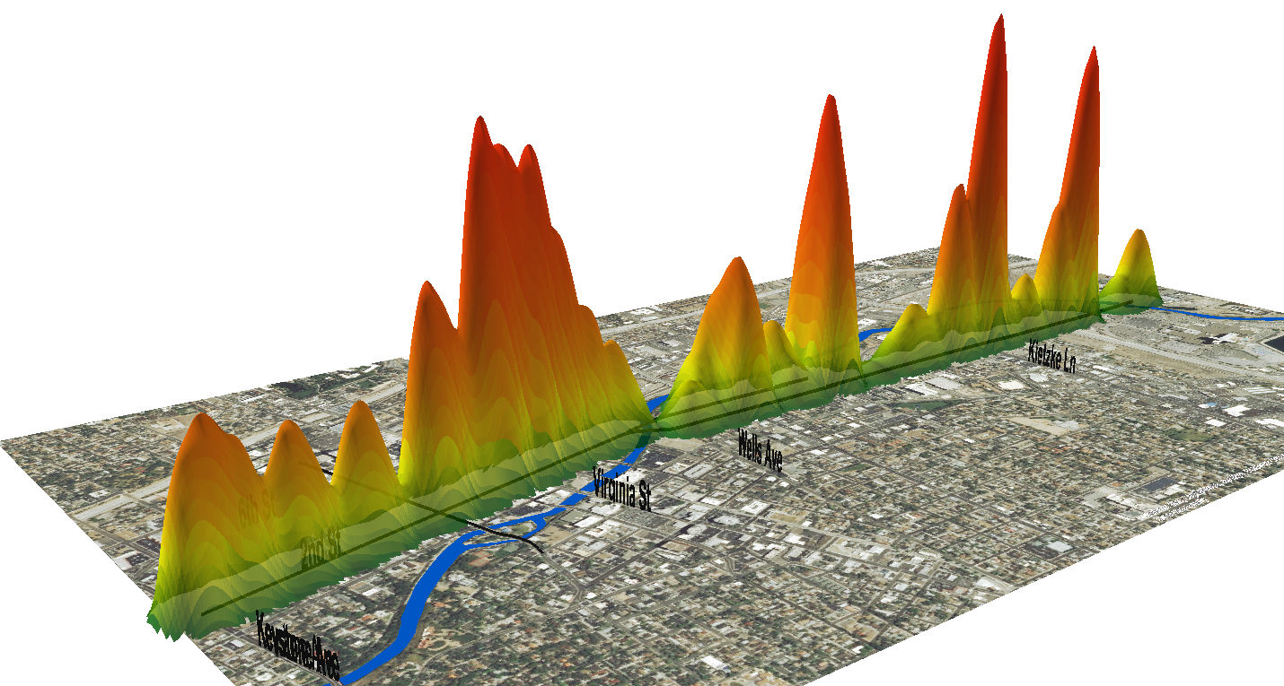
Crash Data Analysis

Slide 16
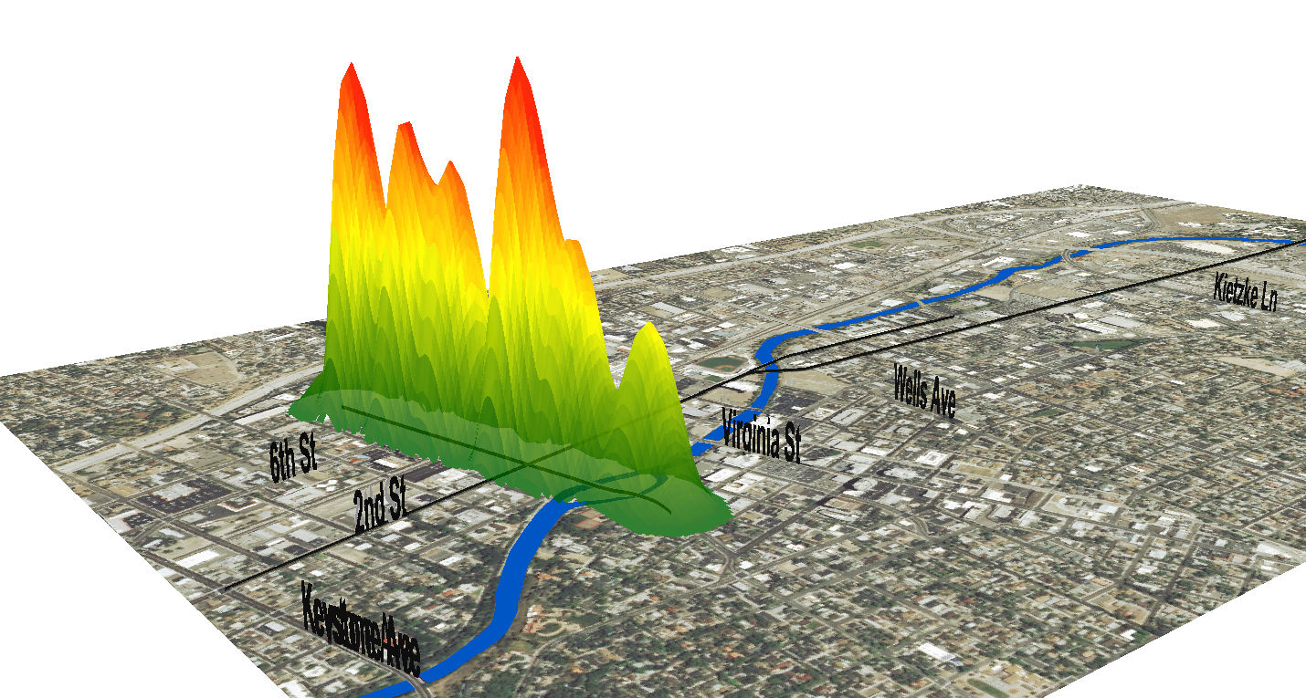
Crash Data Analysis

Slide 17
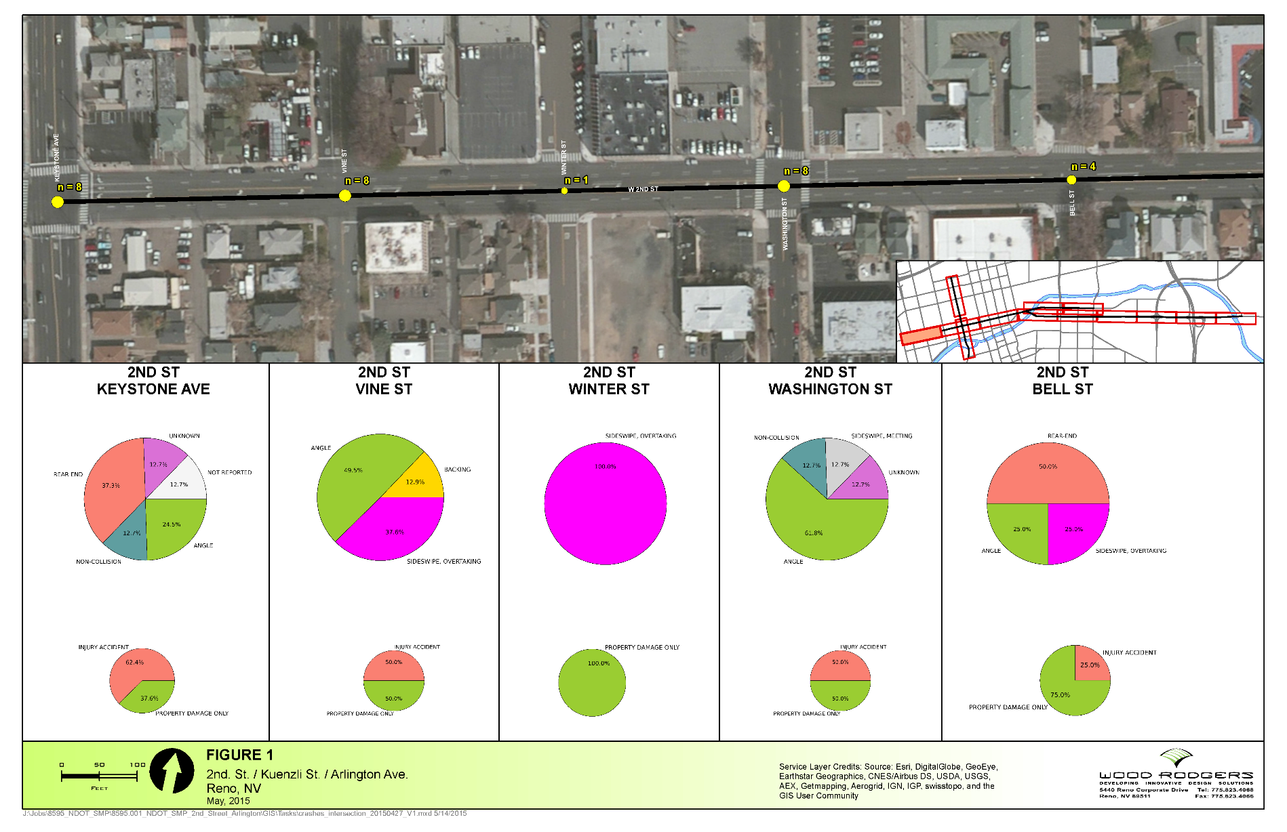
Crash Data Analysis

Slide 18
Sample Recommendations
Improved pedestrian crossings
Roadway lane reductions
Dedicated turn lanes
Intersection improvements / roundabouts
Parking & access management
Operational improvements
Speed reduction techniques
Complete streets / multi-modal integration
Transit stop and amenity improvements

Slide 19
Summary of RSA Recommendations
2nd St. & Kuenzli St.:
Signal timing and ped clearance interval
Conduct lighting study for unlit locations
Consider road diets and bike lanes
Bulb-outs for parking locations
Update to latest PROWAG standards
Power pole relocations / undergrounding
Center signal heads over lanes
Install speed feedback sign on Wells Ave / 2nd St

Slide 20
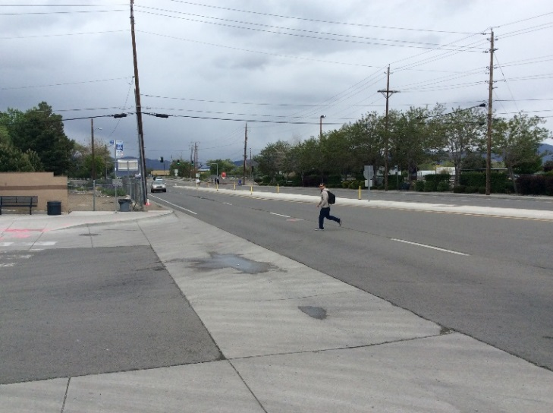
Summary of RSA Recommendations
2nd St. & Kuenzli St. cont.:
Consider roundabout at 2nd St and Kietzke Ln
Raised median between Kietzke Ln and US 395 SB
RRFB at existing pedestrian overpass location
ADA improvements to pedestrian overpass
Install sidewalks at existing gap locations
Move the EB bus stop near Wal-Mart
Install median island ped fencing

Slide 21
Summary of RSA Recommendations
Arlington Ave:
Signal timing and ped clearance interval
Conduct lighting study for unlit locations
Consider road diets and bike lanes
Bulb-outs for parking locations
Update to latest PROWAG standards
Power pole relocations / undergrounding
Center signal heads over lanes
Improve degraded sidewalks
Change static ped signals to push button

Slide 22
Study Process & Outreach
Apr May Jun Jul Aug Sep Oct Nov Dec
Existing Conditions
Develop Recommendations
TAC Meetings
SWG Meetings
Public Meetings &
Agency Updates
Report Preparation
Intro & Crash Summary
Alternative Analysis
SMP Review

Slide 23
Stakeholder Working Group
Potential Stakeholder Group Participants
NDOT | Renown Hospital
Downtown Improvement Assoc. | Reno Sparks Indian Colony
Wards 1,3,5 NABs | Reno Gazette Journal
Downtown Makeover | Grand Sierra Resort
Harrah’s Reno | Reno Bike Project
Cal Neva Reno | Law Enforcement / Emergency
Reno Aces | Sands Casino

Slide 24
Questions?
Lori Campbell, NDOT
lcampbell@dot.state.nv.us
775-888-7462
Bryan Gant, Wood Rodgers
bgant@woodrodgers.com
775-225-3184

