Slide 1







PROJECT DELIVERY DESIGN-BUILD & CONSTRUCTION MANAGER / GENERAL CONTRACTOR (CMGC)

Slide 2


Agenda
Historical Background
Overview of Design-Build
Overview of CMGC
Comparisons, Potential Barriers & Implementation
Q & A
State DOT Perspective
Industry Perspective

Slide 3






Construction Project Delivery Historical Perspective
Code of Hammurabi (Design-Build)
Classical Greece (Design-Build)
Middle Ages Cathedrals (Design-Build)
Renaissance Emergence of Design- Bid-Build
Private Sector Re-emergence
of Design-Build & CMAR
Public Sector Re-emergence of Design-Build
Establishment of the Design- Build Institute of America
Passage of Federal Acquisition Reform Act
1800 B.C.
450 B.C.
1200 A.D.
1450
1960s
1980s
1993
1996

Slide 4




Historical Background:
FHWA Procurement Requirements and SEP-14
Mid-1800’s, many states adopt “low bid” requirements to protect taxpayers from extravagance, corruption and other improper practices by public officials
1938 Federal Highway Act required competitive bidding
1968 Federal Highway Act revised Title 23 USC to award construction contracts, “...only on the basis of the lowest responsive bid.”
February 2, 1990, FHWA establishes “Special Experimental Project No. 14 – Innovative Contacting”
1998 TEA-21 authorizes design-build
No current statutory authority for CMGC

Slide 5

FHWA’s Long Term Project Delivery Goals
All contracting agencies should have a project delivery “toolbox” including:
Design-bid-build
Design-build
Construction Manager General Contractor (Construction Manager at-Risk)
Alliance Contracting
Performance Contracting
ID/IQ contracting
Other

Slide 6



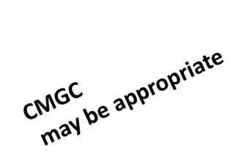
New Zealand Selection Model
Alliance
D B
DBB LS
DBB Cost+
Dollars
DBB M&V
CM/GC
Complexity, Risk, Potential for Innovation, Flexibility Required, Client Involvement, Supply vs Demand, Program Constraint
*P10-0274: Design Build Contracting using a Competitively Negotiated Design by Eric Scheepbouer

Slide 7
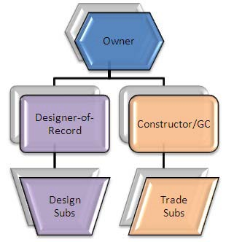

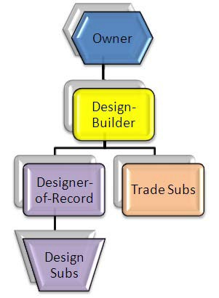
FHWA’s EDC Project Delivery Initiatives
Design-Bid-Build CMGC Design-Build

Slide 8

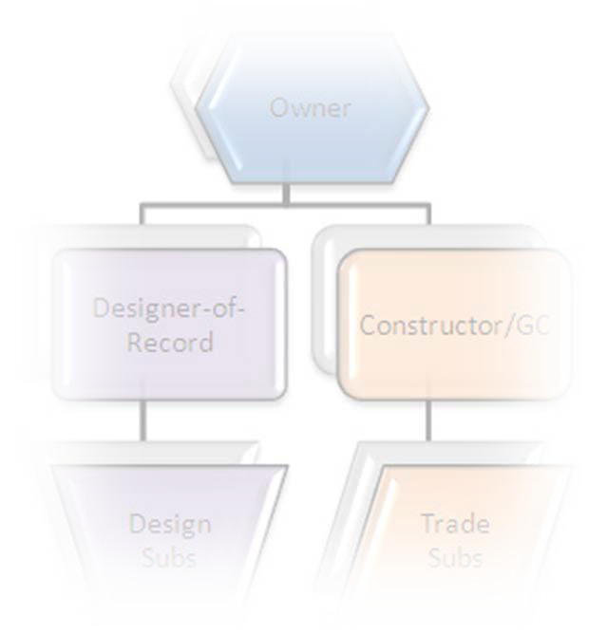
Why Consider DB or CM/GC?
Known issues with Design-Bid-Build:
Low bid may not result in the lowest ultimate cost (base level quality, claims, change orders, etc)
Constructability challenges
Risk allocation
Adversarial relationships
Higher level of inspection/testing by the agency

Slide 9

Why Consider DB or CM/GC?
EDC goal of reducing delivery time
EDC goal of introducing innovation
Better alignment of project goals (quality, schedule, congestion mitigation, etc.) with contract requirements
Appropriate risk allocation
Improved constructability
Improved cost reliability
Potential for reduced owner resources

Slide 10
Agenda
Historical Background
Overview of Design-Build
Overview of CMGC
Comparisons, Potential Barriers & Implementation
Q & A
State DOT Perspective
Industry Perspective
Available Resources

Slide 11





Design-Build
Overview

Slide 12



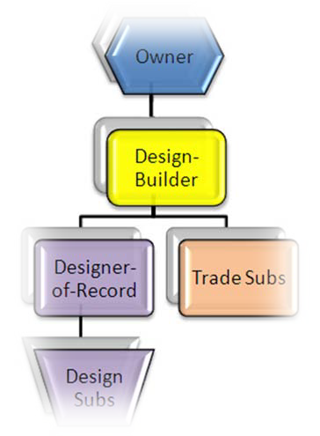
What is Design-Build
“One Step” or “Two Step” competitive negotiation
Proposals based on definitive performance criteria
Uses Request for Proposals instead of Invitation for Bids procedures
Awards on Best Value basis

Slide 13
What is Design-Build
Selects engineer AND constructor on qualifications
Recognizes Design-builder as “Professional”
Applies “Singular Responsibility” principle to entity
It is a CONSTRUCTION contract… DOT ends up with physical property

Slide 14







Contract Components
Project Delivery Method
DBB; CMGC; DB
Procurement Procedure
Low Bid; Best Value; Qualifications-based; Sole Source
Contract Payment Provision
Lump Sum; Guaranteed Maximum Price; Cost Plus Fee; Cost Reimbursable
Trend in Transit and Airports is
DB-QBS-GMP

Slide 15

What’s Different?
Owner
Design compliance review
Need dedicated design assets available to the field
Performance-based
Higher level of trust required
Design-Builder
Owns details of design
Designer-of-Record (DoR) Must design to budget & schedule
Responsive to owner needs- preferences
Internal contracts different
DoR’s client is the design- builder NOT the Owner

Slide 16


Design-Build Time Savings
Design • Bid • Build
Select Engineer
Prelim
Design Development
Working Drawings
Contractor Construction Bids
Design
Minimal Contractor Input
Select Design/ Builder
Design • Build
Working Drawings
Prelim Design
Design Development
Construction
Extensive Contractor Input

Slide 17

Design-Build Project Candidates
Schedule Issues
Can significant time savings be realized through concurrent activities?
Will staff resource constraints impact project
schedule?
Must the work begin or end by a specific time?
Are traffic detours and/or closure periods limited?
Can potential time savings be realized?

Slide 18

Design-Build Project Candidates
Project Complexity
Does the project include a number of primary features (road, bridge, traffic control system)?
Are the features tightly interrelated and/or closely located?
Will construction staging be a major issue?
Does the site present unique or unusual conditions?
Are specialty skills needed for design or construction?

Slide 19

Design-Build Project Candidates
Other Considerations
Will higher quality products be realized from designs tailored to contractor capability?
Will there be less impact on the public with the use of expedited construction processes?
Are there traffic management issues that could benefit from contractor input during design?
Is project size an issue for design and construction funding?

Slide 20


Not a Design-Build Candidate
Final design must be completed before:
  Accurate Estimate of Costs
  Obtain NEPA Clearance
  Approval to Proceed
Owner wants “Heavy” input to design
Project too small to attract competent competitors

Slide 21

Design-Build Semantics
Must be careful about misusing the term:
“Performance Specification”
Specification indicates that a design decision has been made
The DB RFP contains “Performance Criteria”
The DB’s Designer-of-Record prepares “specifications”

Slide 22
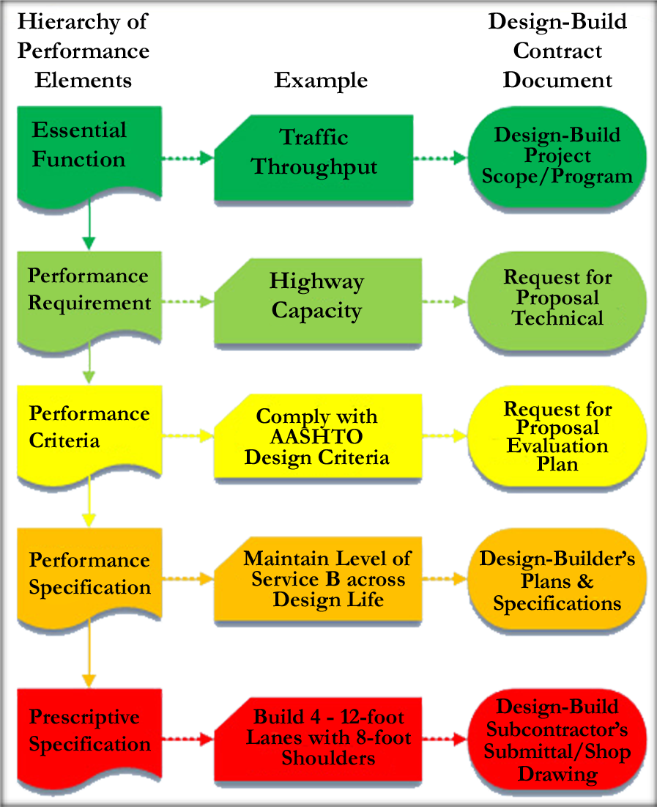





Design-Build Hierarchy of Specificity

Slide 23



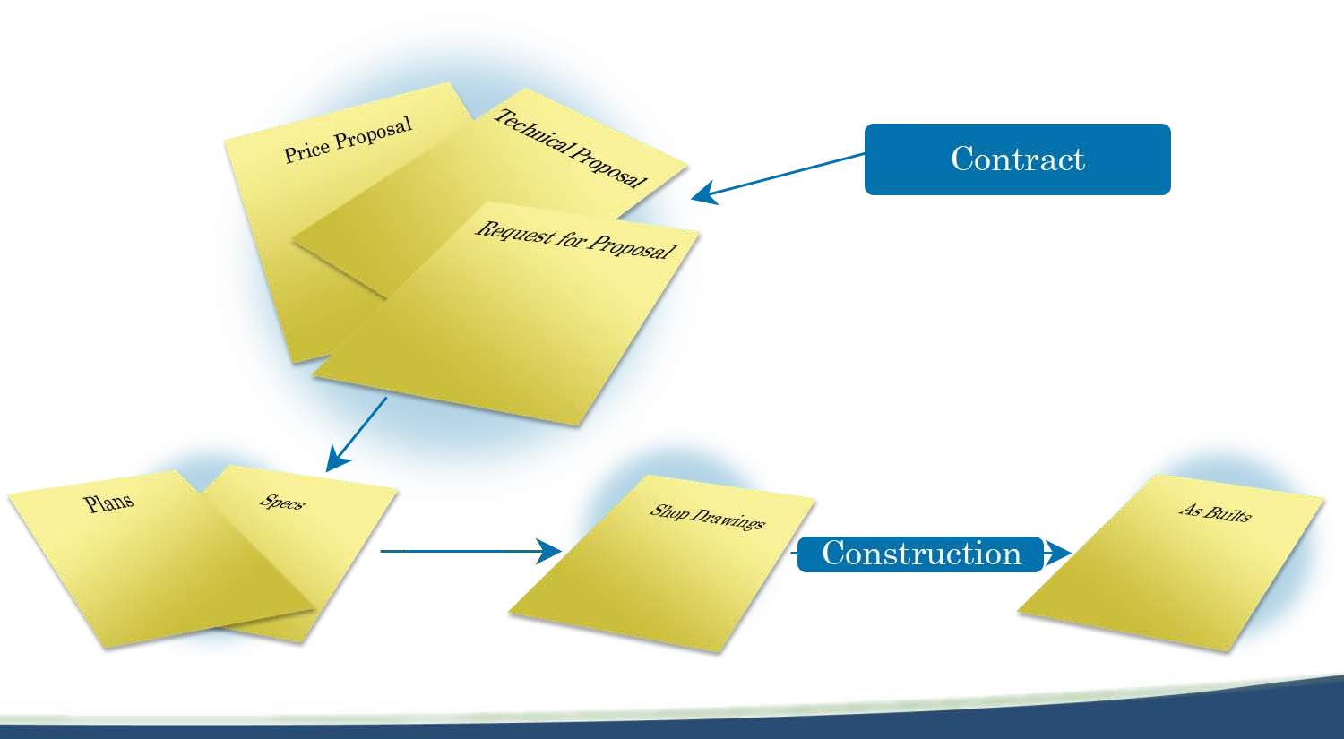
Design-Build Contract Model

Slide 24

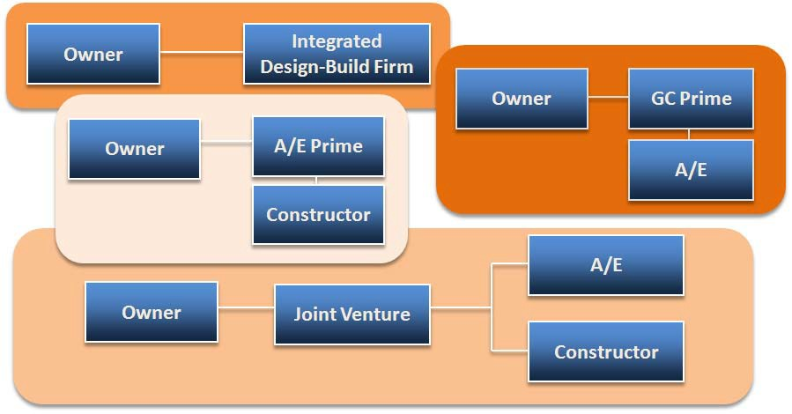
Organizational Variations

Slide 25




Design Submittal Reviews
DBB - A/E reviews
Technical review
Conducted by experts
Comments are DIRECTIVE in nature
A/E must incorporate comments
DB reviews
Compliance review
Comments are ADVISORY in nature
DoR must respond to comments stating logic for not incorporating

Slide 26

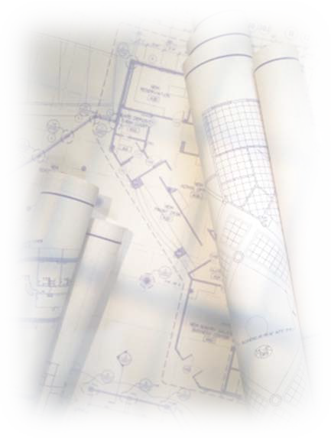
Design Ownership
DBB-A/E: State agency will own the details of design during construction:
Errors/omissions paid for by owner
Seek recovery using A/E responsibility
DB: Design-builder owns the details of design after Award:
Must keep design liability on DoR
Design-builder is paid to retain design liability

Slide 27

Design Completion
DBB-A/E: design complete before construction starts
Construction contractor can do a quantity survey and price
All subs are known and have submitted hard quotes during bid process
DB: Price is fixed before design is complete
May not know who subs are
Must design to both budget and schedule
Details of design represent the variable element in the process

Slide 28


Design Management
DBB-A/E: design management process developed for DBB
Based on design milestones 30%, etc.
DB: Use of traditional process at odds with delivery process
Best based on disciplinary design packages that relate to construction subcontracting plan
Easier to monitor and pay

Slide 29




Cost Engineering vs. Value Engineering
FHWA VE per 23 CFR 627.5(e) must be done prior to RFP release
Cost Engineering ensures that final design meets BOTH cost and schedule constraints
Cost Engineering must be continuously applied during the design phase to stay on budget
Cost Engineering constrained by:
  RFP contract requirements
  RFP prescriptive design content
  Betterments offered in proposal
  Speed at which design is being completed

Slide 30

Owner’s Responsibility
Develop Concept/Preliminary Design
Establish Design criteria & Construction standards (in RFP and Contract)
Provide Project Oversight:
  Design Acceptance/Approval System
  Construction Acceptance (Verification) System
  May augment Agency staff with “Designated Agent” staff (under contract to Agency)

Slide 31
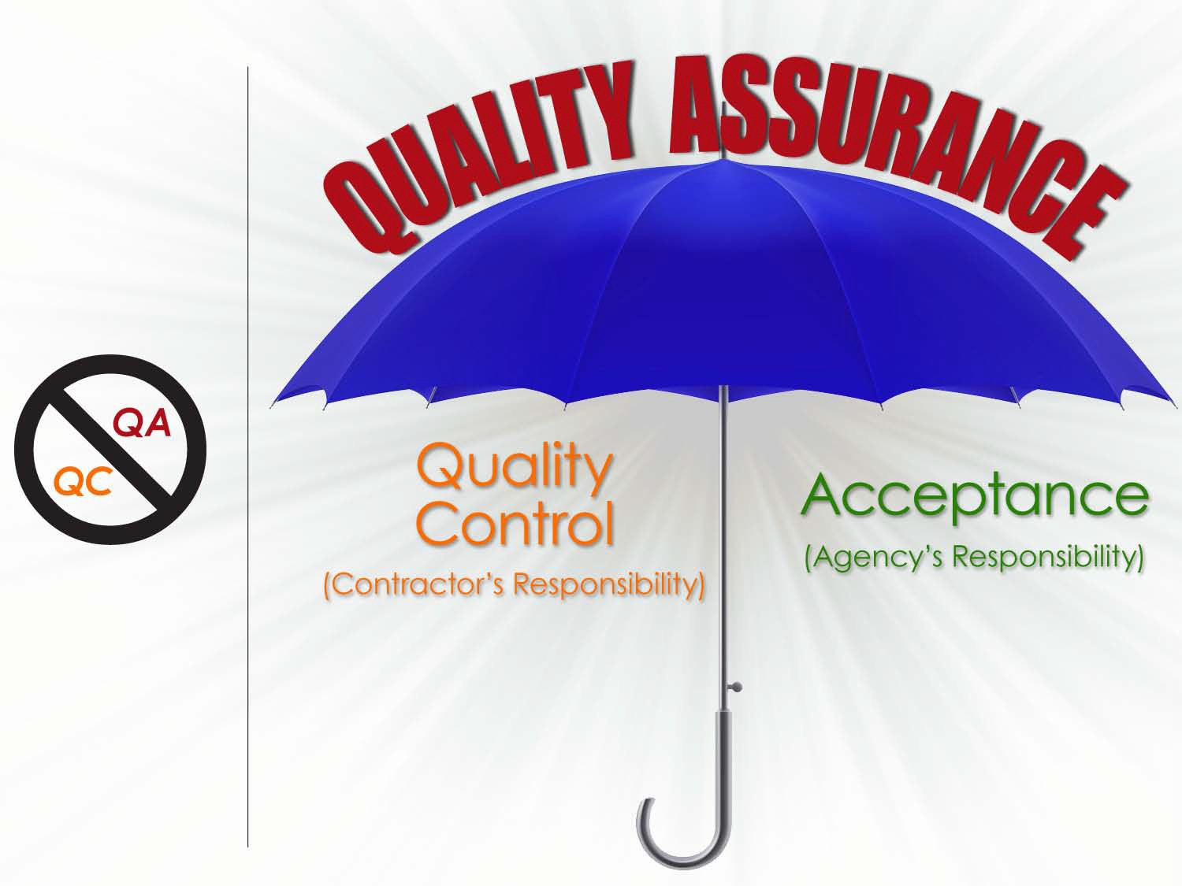
Understanding the Term “Quality Assurance”
“All provisions of 637.207(a) are applicable to Design-Build projects.”
*Note: The Design Builder cannot be Assigned responsibility to perform any Acceptance (Verification) functions.

Slide 32

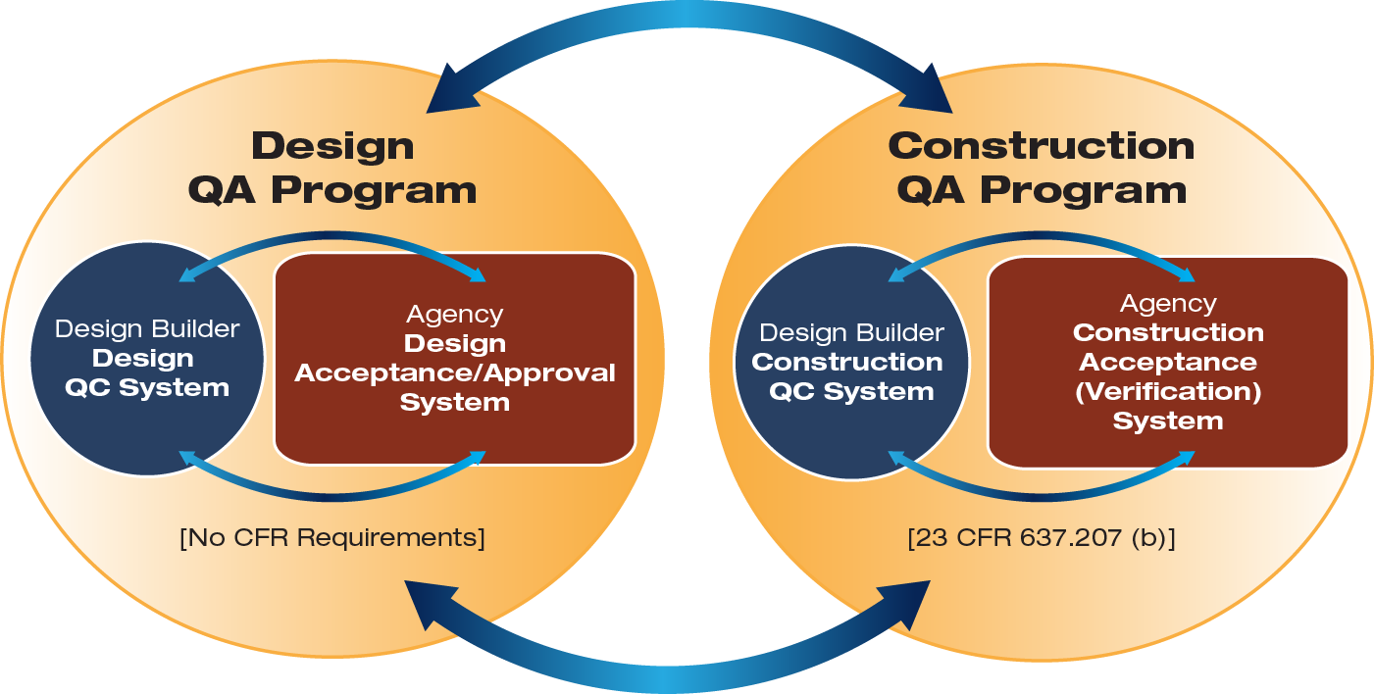
QA Programs for Design-Build

Slide 33

























































Example DB Project QA Organization
Agency Project Manager
Owner’s Responsibility
Design Project Engineer (Accept/Approve for Construction)
Construction Resident Engineer
(Verify for Acceptance & Payment)
Agency Independent Assurance
Design-Builder Project Manager
Design-Builder Quality Control Administrator
Design- builder’s
Design QC Manager
Construction QC Manager
(Control Quality)
(Control Quality)
Responsibility

Slide 34




Design-Build Summary
DB is a CONSTRUCTION project
DOT gives up control of the details of design
DOT must be able to identify TANGIBLE benefits to compensate for shifting control of design details to the design-builder
Don’t build a selection system that puts HEAVY weight on price – that makes it a low bid competition & waters down possible advantages

Slide 35

Agenda
Historical Background
Overview of Design-Build
Overview of CMGC
Comparisons, Potential Barriers & Implementation
Q & A
State DOT Perspective
Industry Perspective

Slide 36



Construction Manager General Contractor
CMGC

Slide 37

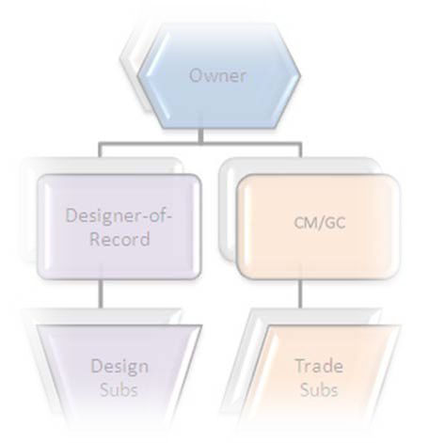
What is CMGC?
A Project Team consisting of three components:
An Owner
A Contract with a Designer
A Two Phase Contract with a General contractor
  Phase one – A “Construction Management” consulting contract to help with design
  Phase two – A “General Contracting “ contract to build the project

Slide 38

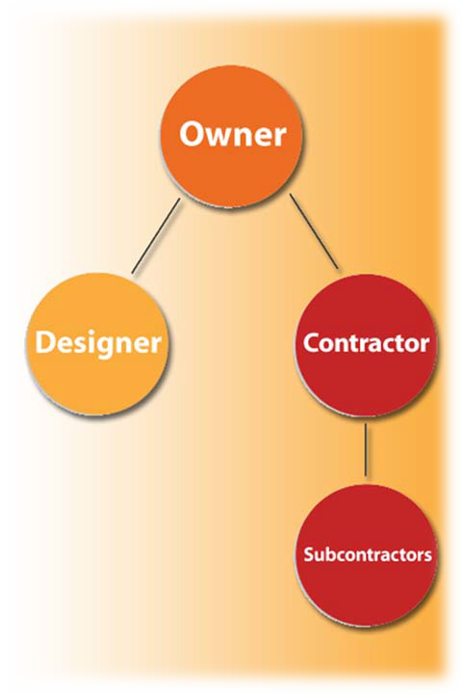
CMGC is not CM@Risk
The process is not the vertical world of CM@Risk – similar but different
Transportation industry projects are different and require a process of their own
  Self-performance requirements are typical
  Subcontractor procurement process is different
  CMGC relies on best-value selection

Slide 39

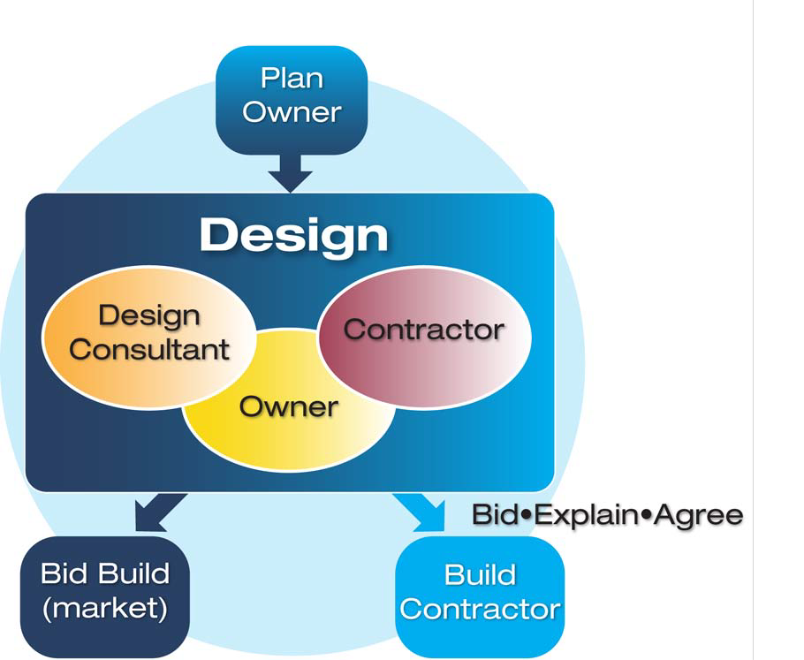
CMGC Process

Slide 40


CMGC Project Delivery
A State’s Perspective

Slide 41


What led Utah to CMGC?
Understanding the good and bad about Design Bid Build – 50 years of history
Understanding Design Build – 30 projects near $5B in work
Looking for a model that takes advantage of the good in both methods
Not looking for a replacement – looking for an additional tool

Slide 42

Turned to CMGC
Constructability of designs
Timely cost information
Cost certainty
Better/ Faster schedules
Owner input into design decisions
Team atmosphere

Slide 43


What does an owner expect?
IN THEORY
Better Designs
Better, Faster schedules
Lower costs
  Savings in design
  Savings in constructability
  Savings in innovation

Slide 44



CMGC Project Delivery
The BIG Picture

Slide 45


BIG Picture Theories with CMGC
Collaboration
Risk Theory
Schedule
Model to Implement Innovation

Slide 46


CMGC Contracting
CMGC is an integrated team approach to the planning, design and construction of highway projects.

Slide 47

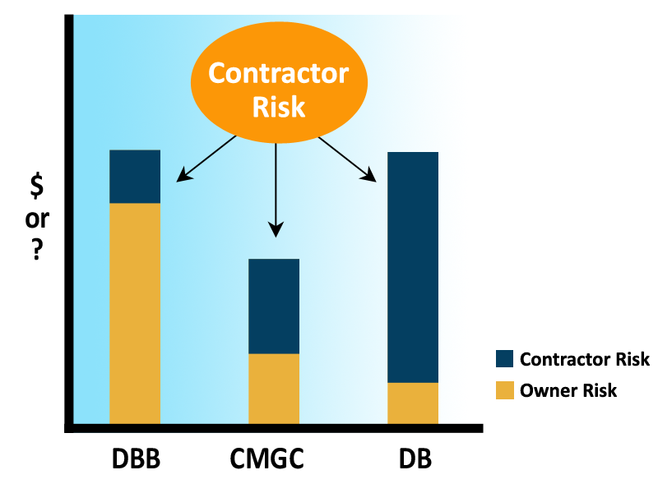
Risk Theory

Slide 48

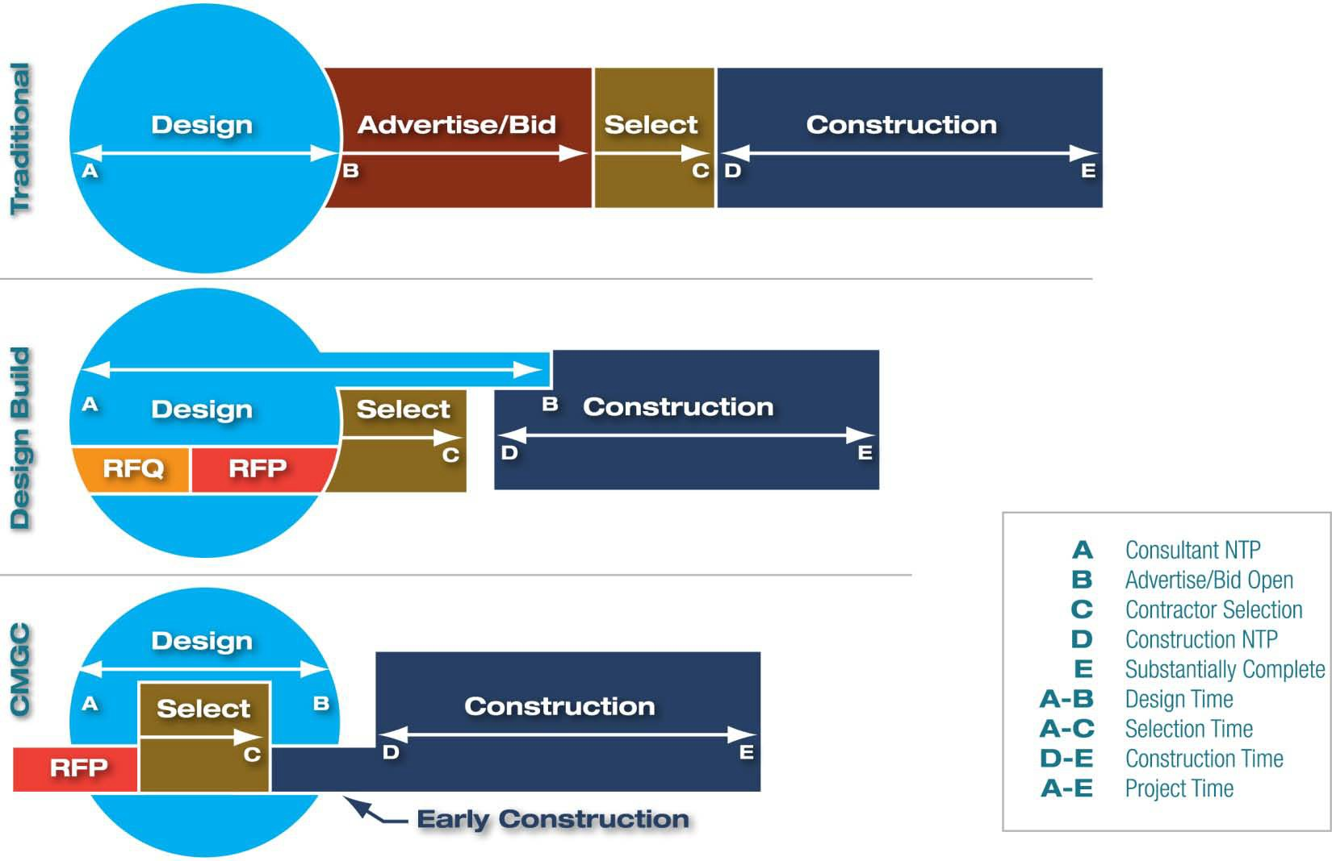
Schedule/Timeline Comparison

Slide 49

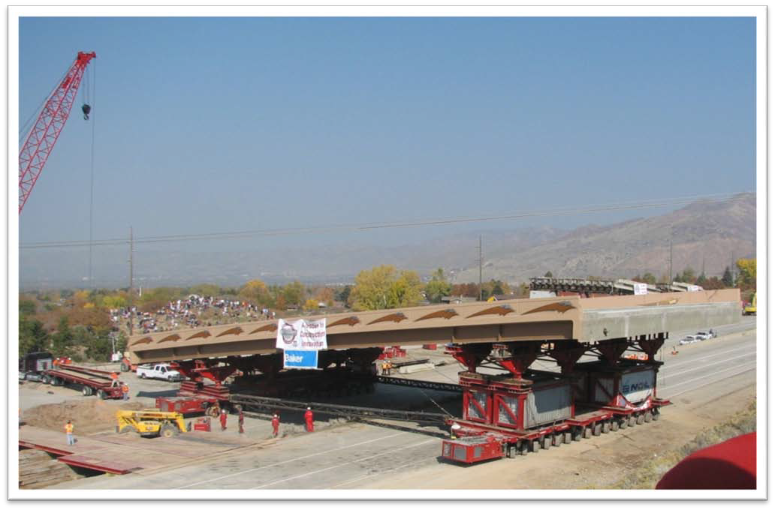
Model to Implement Innovation

Slide 50

CMGC Project Delivery
The Process

Slide 51
CMGC Process

Slide 52

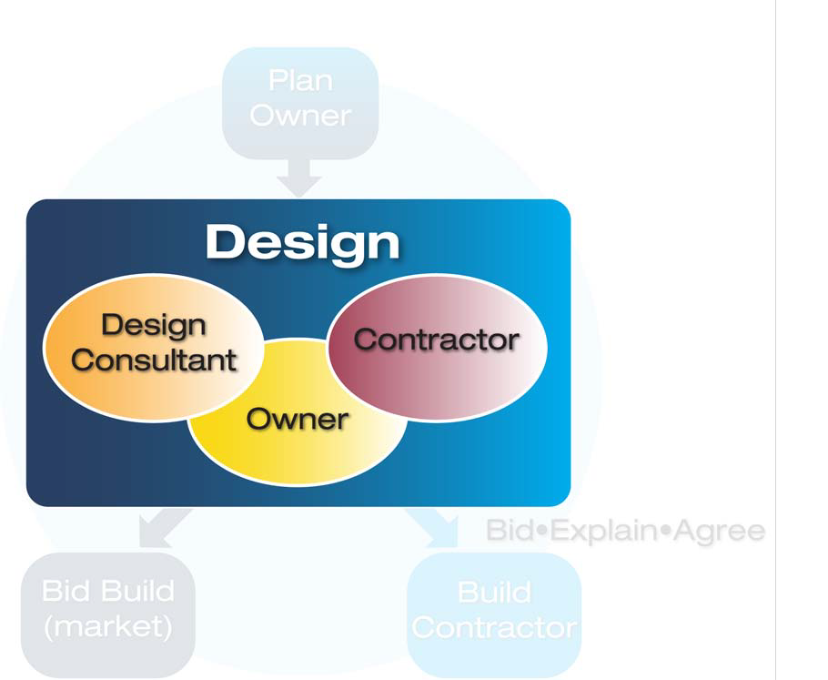
Team Selection Phase

Slide 53


How is the team selected?*
Designer – regular consultant selection process
General Contractor – “Best Value Selection”
  Includes Technical score
  Includes “Price”*
*UDOT model – other models exist including qualifications
based selection and competing profit. FHWA will allow any fair and transparent selection method to be evaluated under SEP-14.

Slide 54

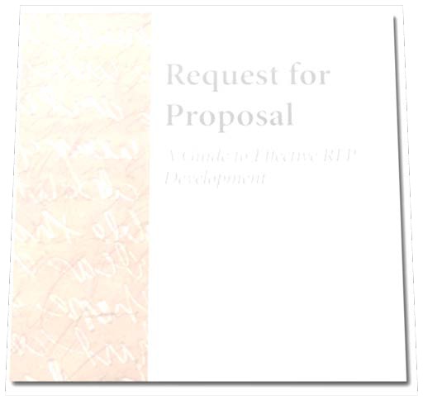
General Contractor RFP
RFP evaluation criteria includes the following:
Team
Approach
Approach to price
Unit prices on a few select items
Innovations
CMGC Design Process

Slide 55

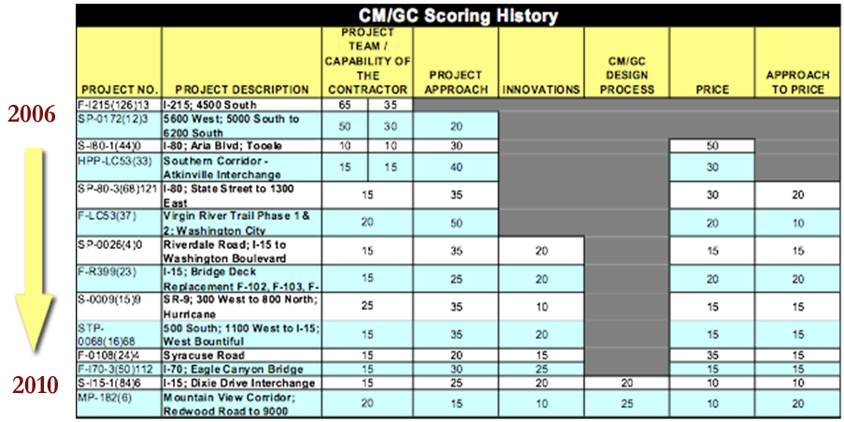
Technical Proposal Scoring Criteria

Slide 56

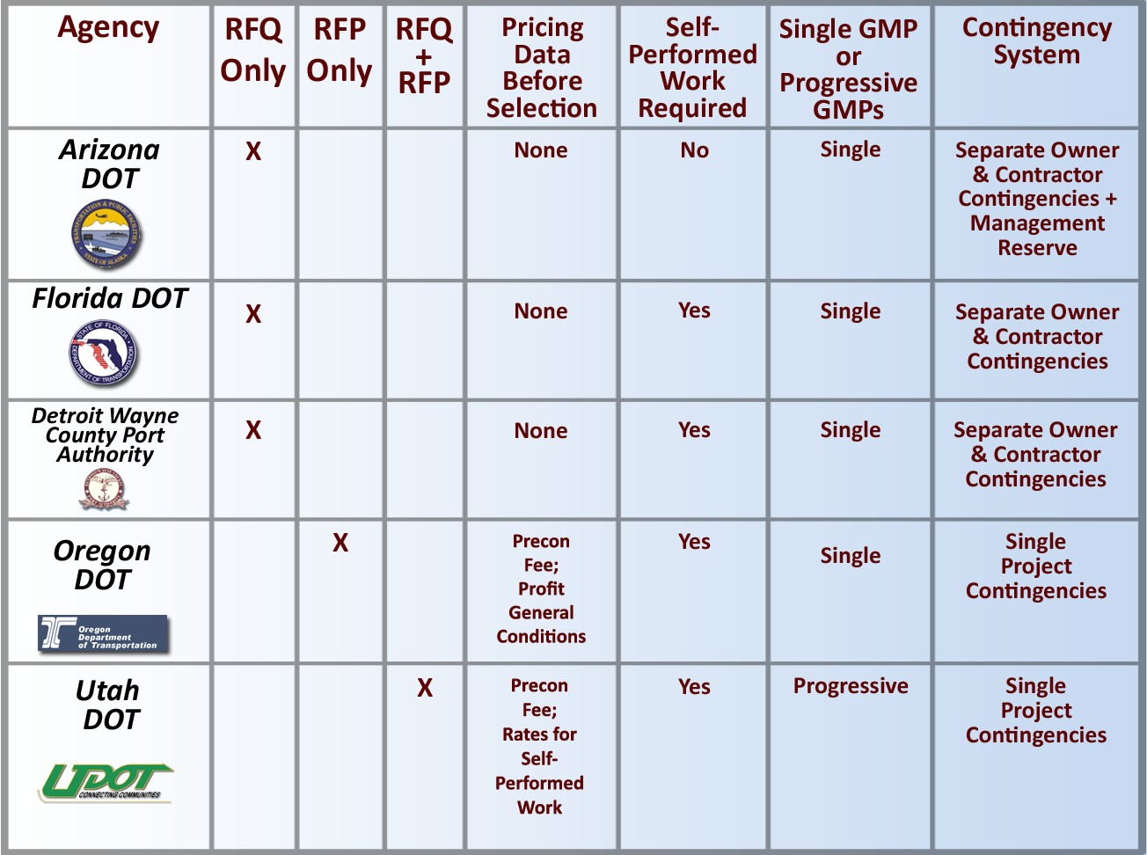
CMGC Variations to Implementation

Slide 57


Unit Prices on a Few Selected Items
Items that define project
Items that demonstrate business reason for awarding project
Items where a contractor can demonstrate expertise or innovation
If dirt job, choose dirt items, if structure job, choose structure items

Slide 58

Approach to Price
Example: Bid item: Full Depth Deck Panels
Contractor to bid on certain size, assume casting site – level playing field
What causes price to go up or down? Energy costs, cement costs, casting site, innovations: light weight concrete, size of panel, crane or gantry, fiber, rebar, etc.

Slide 59


Design Phase
Once we have selected contractor and designer:
Two part contracting method:
  Part one – Construction Management
  Part two – General Contractor
Part one:
  Work with Owner, and Designer to design Project
  Provide advice on Constructability, Schedule, Materials, Budget
  When ready “Bid” on project
Part two:
  Build project

Slide 60

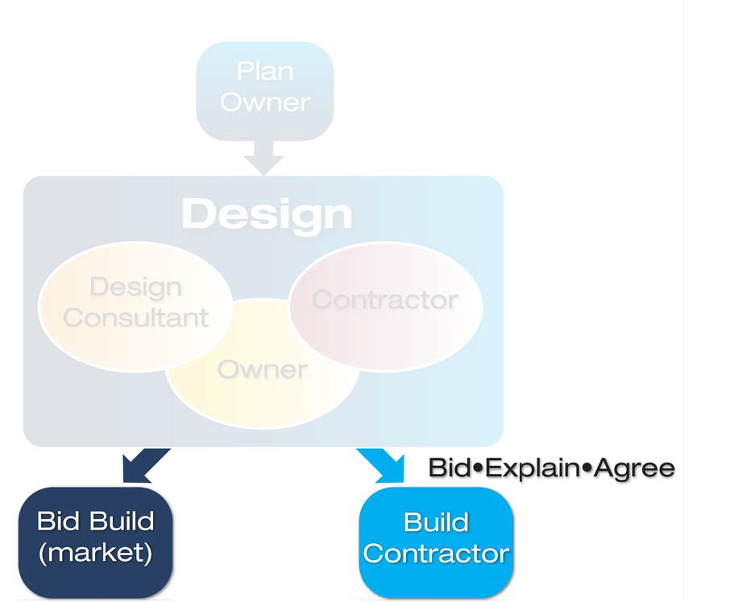
CMGC “Bid” Process

Slide 61

CMGC “Bid” Process
Team works on design:
Periodically owner asks CMGC to price job
Owner evaluates “bid”
UDOTs model has two estimates – Designer furnished Engineers Estimate, and an Independent Cost Estimate (ICE)
If bid is within 10% owner can award
If bid > 10% estimating team meets to discuss differences in bid assumptions
Iterations address risk

Slide 62



CMGC “Bid Process” (Cont.)
Two possible outcomes of “bid”
Owner gets acceptable price
  Proceed with build
Owner doesn’t get acceptable price
  Proceed with more design – ultimately convert to Design- Bid-Build
Build contract can be Guaranteed Max price or Unit price (Should be both)
Allows comparison of pricing
Provides transparency

Slide 63


CMGC Project Delivery
Project Facts

Slide 64

CMGC Project Facts
18 UDOT Projects have been completed using the CMGC method
These Projects have cost $300M+
3CMGC Projects are currently under contract in preconstruction phase
These Projects will total upwards of $600M+
Several projects currently in planning phase

Slide 65


Largest CMGC Project Completed
0, State to 1300 East
  CMGC
  Total Project Cost of $140M
  User savings $25M and 1 construction season
  ABC and SPMT methods employed
  Couldn’t have done it any other way to meet budget and schedule requirements
  Reliable if designer works with you
  Can be done in large urban setting

Slide 66


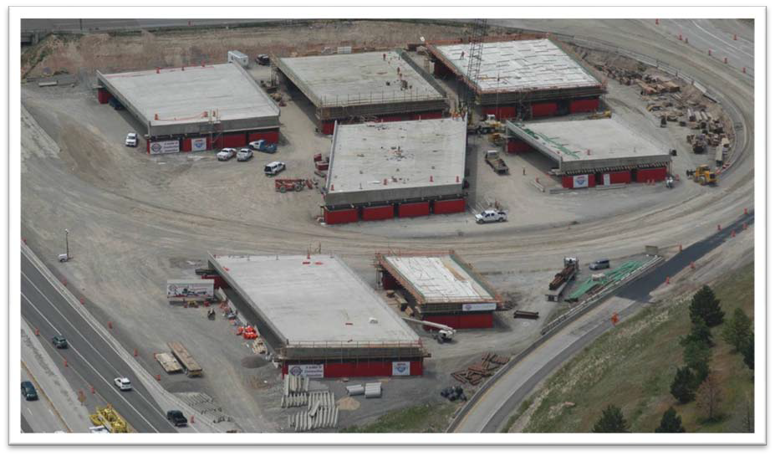
I-80 State Street to 1300 East
Replacement of seven structures along I-80
Moved to location using SPMTs
Contractor innovation
$2M savings in construction

Slide 67

Smallest CMGC Project Completed
Virgin River Trail
CMGC
Total Project Cost of $1.177M
Perfect example of CMGC
Contractor help saved 200,000 dollars by giving advice on trail alignment
Contractor provided oversight and delivered for less than proposed

Slide 68


What does UDOT get from CMGC?
Better Designs – Hard to Quantify – Contractor satisfaction with plans, CO’s
Better schedules – Exceeded expectations
Lower costs
  Savings in design – preliminary early projects savings indicated 40% of design costs
  Savings in constructability and innovation – preliminary savings indicated 8%

Slide 69

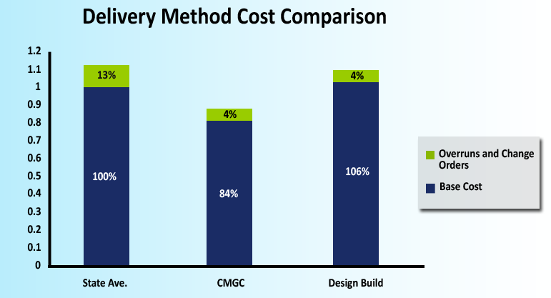
Theory vs. Reality

Slide 70

CMGC Project Delivery
The Strategy

Slide 71


Strategy for CMGC
Projects that UDOT needs contractor involvement, but desires to control design
Projects with high need for innovation
Projects that can benefit from early procurement
Projects with third-party risk
Projects to introduce technology
Projects with a limited or fixed budget

Slide 72


First Time Use
Bridge replacement using ABC
Urban Rehab with Utilities, Third-party coordination
Traffic Signals
Trail projects
Rural Main Streets
Caution DOT capital projects – rest areas, buildings, etc. – process issues – use CM@R

Slide 73


Which Tool from the Toolbox?
You want speed and have no staff – go DB
You have design and not complex – paving or rehab jobs – go DBB
You have complex or urban job with third- party inputs, staffing issues, DB designer issues – CMGC

Slide 74

CMGC Project Delivery
Lessons Learned
74

Slide 75


BIG Picture Collaboration!
Spend lots of time on:
partnering
regular meetings
cultivating relationships

Slide 76


Theory of Risk
This is where the money is!

Slide 77

What does an owner expect?
IN THEORY (FIGURE OUT HOW TO SHOW PROGRESS)
Better Designs
Better, Faster schedules
Lower costs
  Savings in design
  Savings in constructability
  Savings in innovation

Slide 78



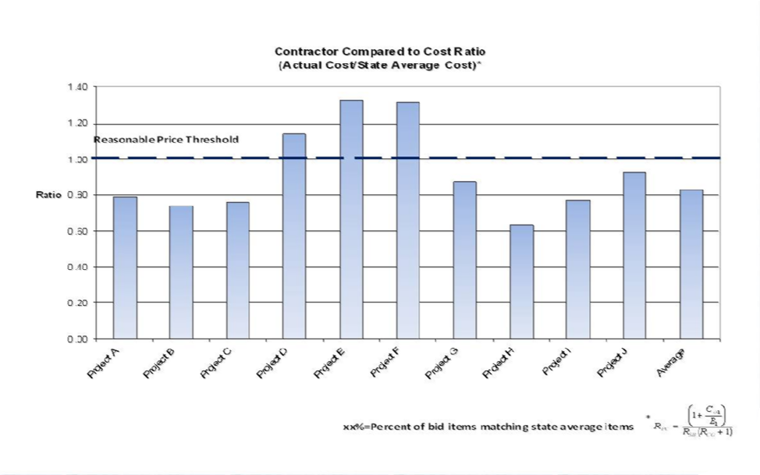
Project Prices vs. Statewide Average Prices

Slide 79


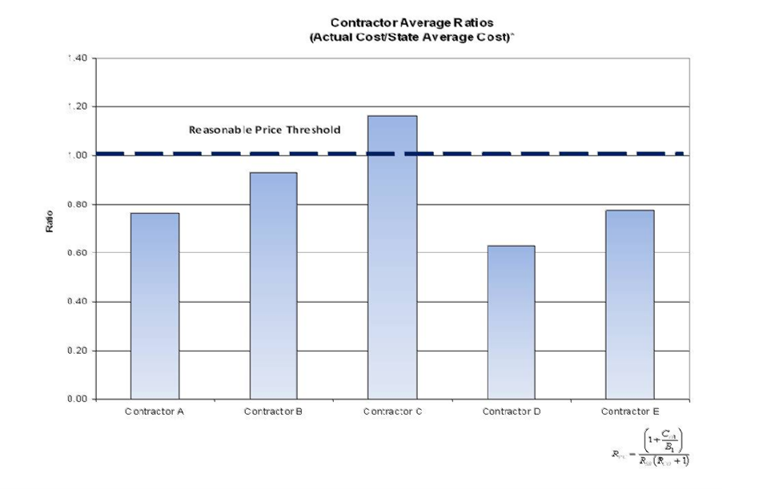
Contractor Price Trends

Slide 80


Contracting Industry Concerns?
“Mom and Pops” concern with competition
  Limit pages of submission – 20 pages or less
Beauty contest
  Demonstrated business reason for selection
Decrease competition higher prices
  Collect Data that demonstrates not true
  Develop process to assure good prices
Concerns with vertical CMAR process
  Adapted process to fit us

Slide 81


How do we choose the team?
Designer – regular consultant selection process
General Contractor – “Best Value Selection”
  Includes Technical score
  Includes “Price”
    How much price?
    Transparency – process known and followed
      Contractors involved in process assurance
      High ranking official involved in process

Slide 82


CMGC Process
Owner hires Designer and CMGC contractor:
CMGC contractor hired with Best Value selection – the earlier the better
Team works on design:
Part of process is M&P dictionary , and discussions – “What is in this item”
Regular Estimator calibration meetings
Periodically owner asks CMGC to price job
Owner evaluates “bid”
UDOTs model has two estimates- Designer furnished Engineers Estimate, and an Independent Cost Estimate (ICE)
ICE is contractor style estimate
Prices usually converge after 2-3 bids

Slide 83


CMGC Project Delivery
Wrapping Up

Slide 84


USE OF SEP-14 for CMGC
SEP-14 is necessary as 23 USC does not allow CMGC
SEP-14 approval does not provide statutory authority or override state law
Project or program approvals are possible
Evaluations are required
Utah has programmatic SEP-14 authorization-3 annual reports available

Slide 85
CMGC Contracting
This method offers significant advantages and benefits including:
•Better designs – value engineering savings
•Increased opportunities for time cost and savings
•Increased innovation and creativity
•Owner control of the design
•Competitive process leads to “Best Value”
85

Slide 86

CMGC Contracting
Bottom Line:
CMGC is a good option for many transportation projects where the qualifications and cooperation of
the contractor are critical to the success of the project.

Slide 87

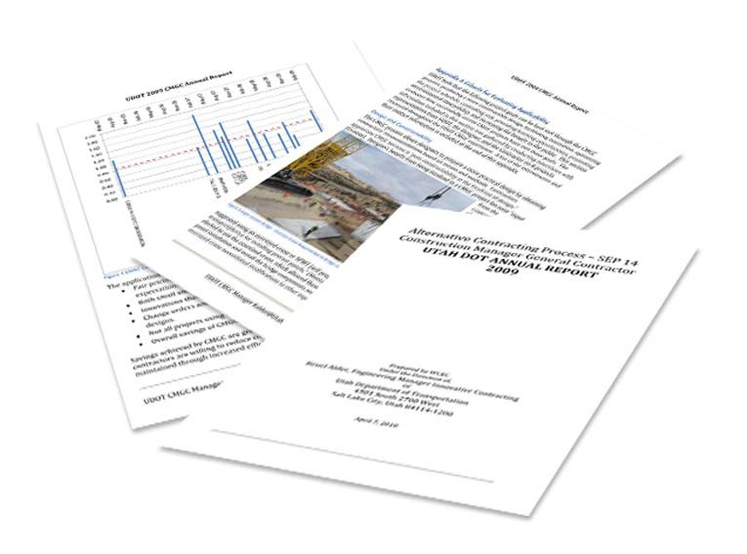
UDOT Report
3 annual SEP 14 reports available
http://www.udot.utah.gov/main/uconowner.gf?n=15227226925482829

Slide 88

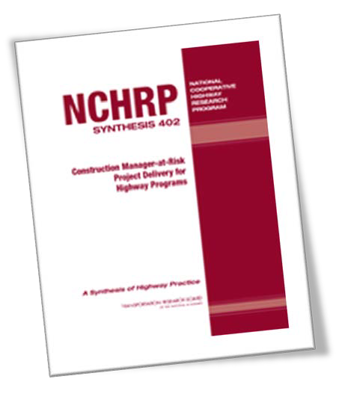
NCHRP Synthesis 402
Construction Manager-at-Risk Project Delivery for Highway Programs
http://www.google.com/search?sourceid=chrome&ie=UTF-&q=nchrp+sythesis+402

Slide 89
Agenda
Historical Background
Overview of Design-Build
Overview of CMGC
Comparisons, Potential Barriers & Implementation
Q & A
State DOT Perspective
Industry Perspective
89

Slide 90



Design-Build/CMGC
Comparisons, Potential Barriers & Implementation

Slide 91

Summary:
FHWA’s EDC Project Delivery Initiatives
Design-Bid-Build CMGC Design-Build

Slide 92



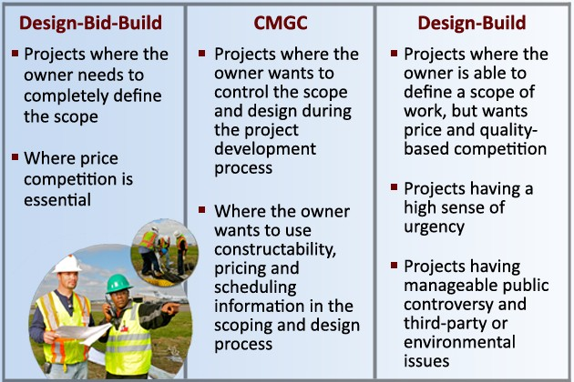
Comparison of Applicability
and Project Selection Criteria

Slide 93

Comparison of Potential Barriers
CMGC Design-Build
State Law
State Personnel Resources/ Training
Minimal guidance
New procedures
Concern with transparency of the selection process
State Law
State personnel resources
Less owner control over final design
Higher procurement costs
Concern with transparency of the selection process

Slide 94


Perception vs. Reality
Loss of opportunity for local contractors
Truths
Larger contracts attract interest from national firms
Larger contracts provide many subcontracting opportunities for smaller or local firms
CMGC contracts do not always go to out-of-state firms

Slide 95

Perception vs. Reality
Loss of opportunity for local contractors
From FHWA’s 12/2/2002 preamble to the final rule Making:
PennDOT data showed similar subcontracting opportunities for similar size DB and DBB contracts
Subcontracting percentages on 7 DB contracts ($80 – 1,318 M) ranged from 33% to 90%
UDOT’s data suggests more related to size of project (18 projects/ 6 different contractors)

Slide 96



Perception vs. Reality – Beauty Contest?
Subjectivity is possible in any best value procurement
Contracting agencies must use transparent procurement procedures to build industry confidence
Third-party observers of procurement
Involve industry and local public agencies as appropriate (state law)
Post-award debriefings promote transparency

Slide 97











Perception vs. Reality – Lower Quality?
Equal product quality 2006 FHWA Report to Congress on Design-Build
“On average, the managers of design-build projects
surveyed in the study estimated that design-build project delivery:
reduced the overall duration of their projects by 14 %,
reduced the total cost of the projects by 3%, and
maintained the same level of quality as compared to design-bid-build project delivery.”

Slide 98
Perception vs. Reality – Lower Quality?
Utah I-15 DB Reconstruction: Interviewed Maintenance, found little difference in quality
CMGC quality of design – Change order percentages (CMGC=5%, DBB 13%)
CMGC – Uses regular construction process with owner acceptance – UDOT believes same quality

Slide 99



The Way Forward – Implementation
Working with industry
Ensure that constructability is included in the design processes
Efficient RFQ/RFP requirements
Well-defined quality assurance procedures
State DOT / FHWA coordination to:
Select the appropriate projects
Develop a transparent process/program

Slide 100

EDC Performance Metrics
Design-Build
By December 2011, increase the number of DB contracts executed for Federal-aid or Federal Lands projects by 50%. (Target based on past 3-year average).
Construction Manager / General Contractor (CM/GC)
By December of 2012, 100 CM/GC contracts executed on Federal-aid or Federal Lands projects. (Goal is approximately 1% of Federal aid annual program)
By December of 2012, 25 state, local, or Federal Land agencies have used CM/GC.
100

Slide 101
Agenda
Historical Background
Overview of Design-Build
Overview of CMGC
Comparisons, Potential Barriers & Implementation
Q & A
State DOT Perspective
Industry Perspective
101

Slide 102

Questions?
Gerald Yakowenko, P.E.
Contract Administration Engineer Federal Highway Administration Office of Program Administration HIPA-30, Room 3134
400 Seventh Street, SW. Washington, DC 20590
Phone: (202) 366–1562
Fax: (202) 366–3988
E-mail: gerald.yakowenko@fhwa.dot.gov
James McMinimee, PSE
Former Director of Project Development, Chief Engineer, Utah Department of Transportation Principal Engineer, Applied Research Associates, Inc.
Phone: (801) 633-6220
E-mail: jmcminimee@ara.com
102

Slide 103
Agenda
Historical Background
Overview of Design-Build
Overview of CMGC
Comparisons, Potential Barriers & Implementation
Q & A
State DOT Perspective
Industry Perspective
103

